Slide 1


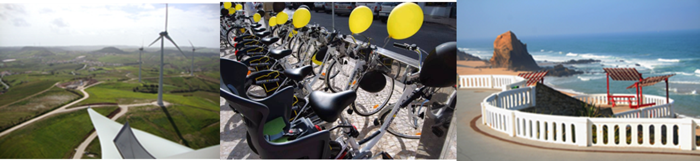

Torres Vedras Sustainable Mobility City

Slide 2
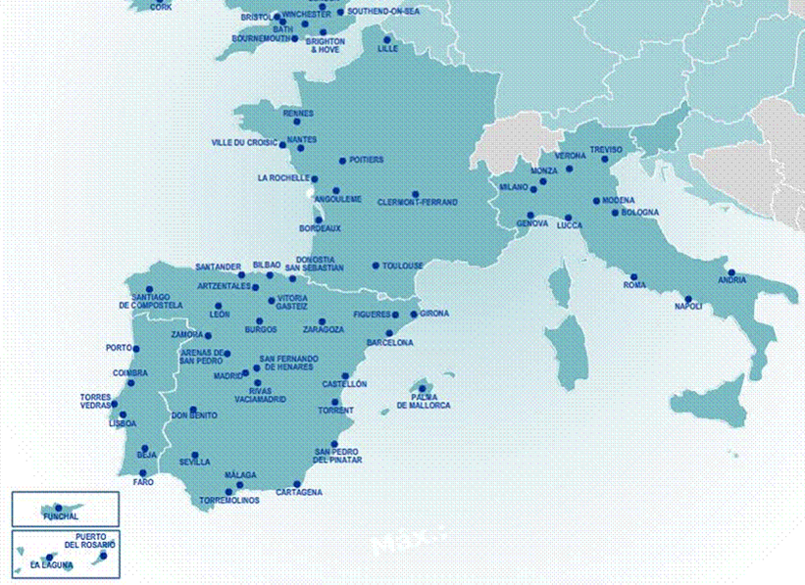
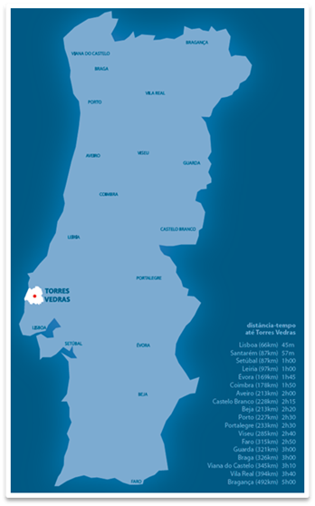
Torres Vedras 400 km2 | 79 503 inhabitants | 46 km away from Lisbon

Slide 3
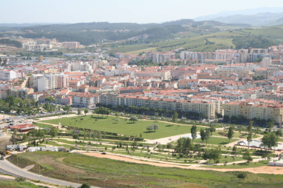
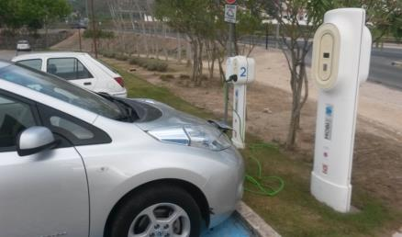
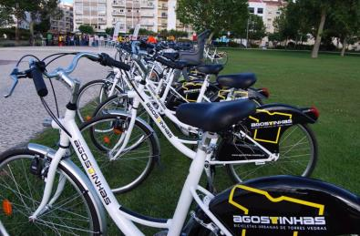
Territory Highlights
City Center with 20.000 inhabitants.
Public bike sharing system, with conventional bikes and e bikes.
Electric Mobility, car charging points network.

Slide 4
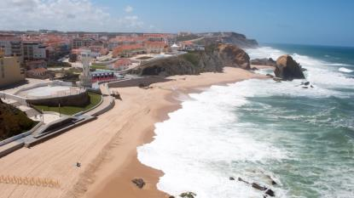
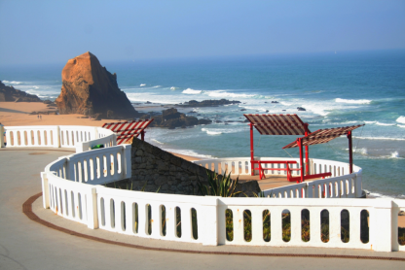
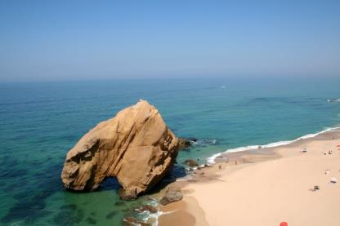

Territory Highlights
20 km of coastal area
More than 20 beaches
Quality Coast destination

Slide 5
Torres Vedras
Managing City Centre Acess
Public Space and Parking Space organization
Intermodality
City Bus Station Relocation
Public Bike Sharing System
Bike Paths
Walking
Accessibility

Slide 6
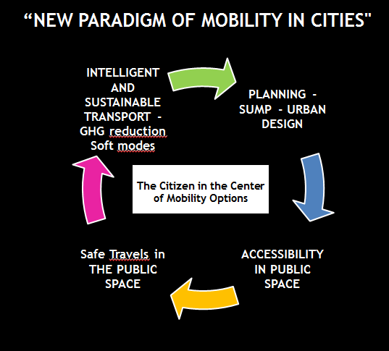
“NEW PARADIGM OF MOBILITY IN CITIES"

Slide 7
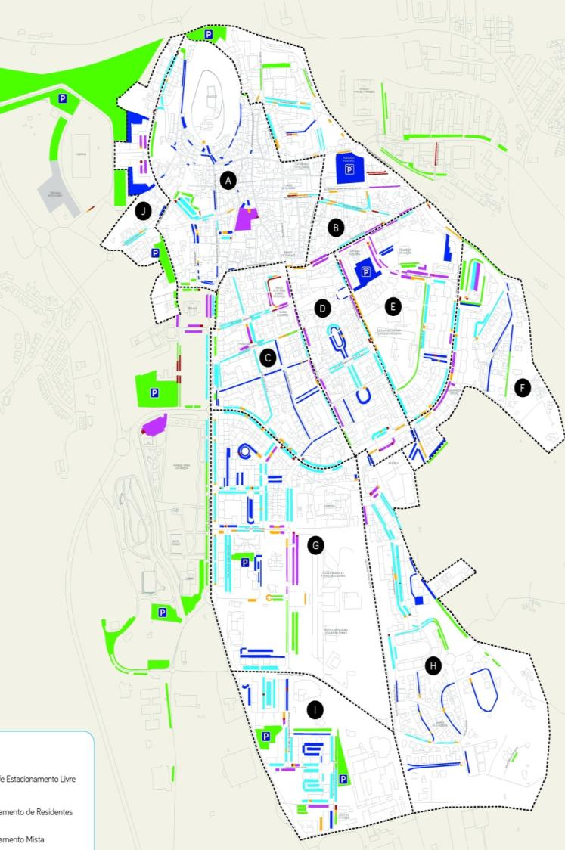
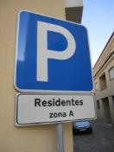
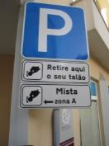
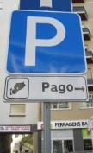
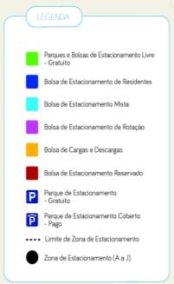
PUBLIC PARKING SPACE ORGANIZATION
10 parking areas A a J
      Residents areas
      Rotation areas
      Mixed areas
      Loading and Unloading areas
      Reserved areas for people with disabilities
      Free areas
Signaling
ZONA B
00-CA-75
Validade: 2016/10
002703
RATIONAL USE OF PRIVATE TRANSPORTS

Slide 8
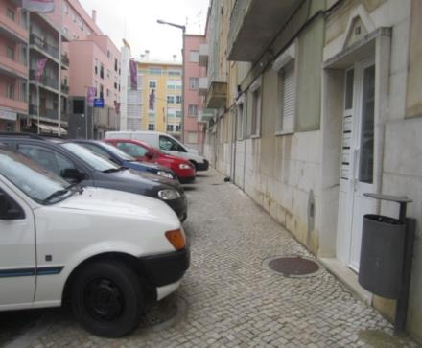
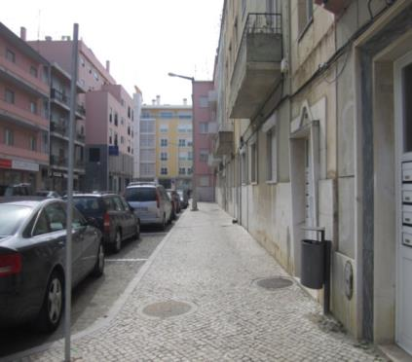
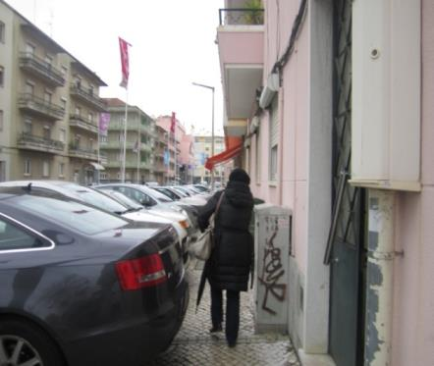
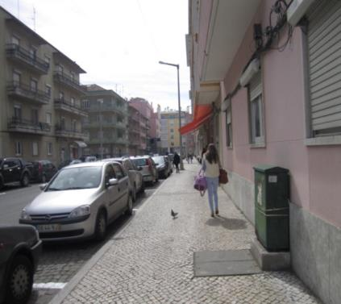
Parking and Traffic Planning
Recovery Urban Living Space
RELEASE THE PEDESTRIAN FUNCTION IN THE SIDEWALK
After
Before

Slide 9
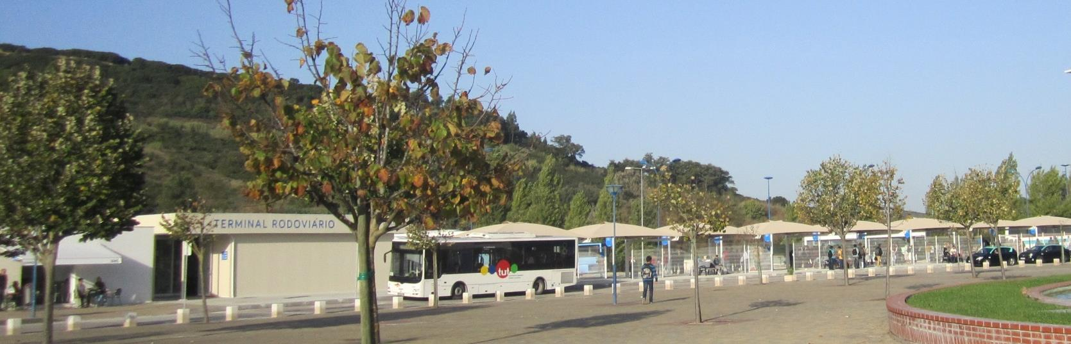
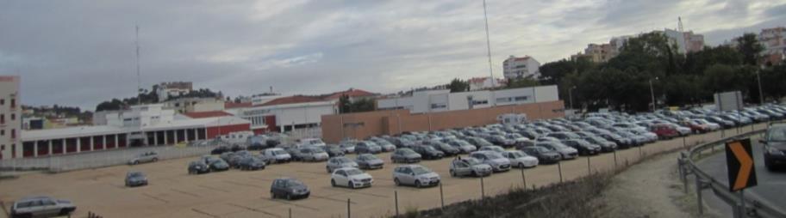
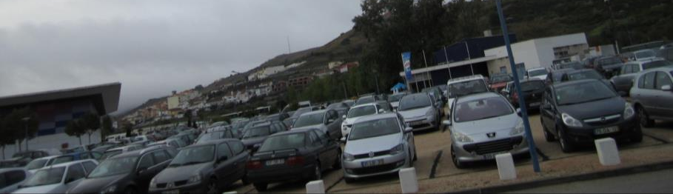
INTERMODALITY
Public and individual transport
City Bus Station Relocation
park and ride with 1000 vehicles parking capacity.
Removing vehicles from the city center, with benefits related to the reduction of CO2 and noise emissions.

Slide 10
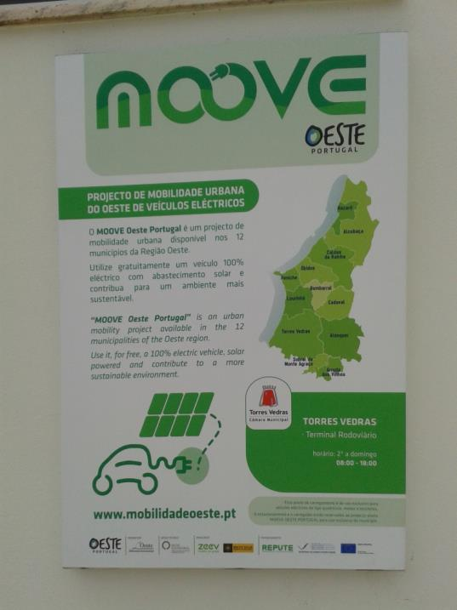
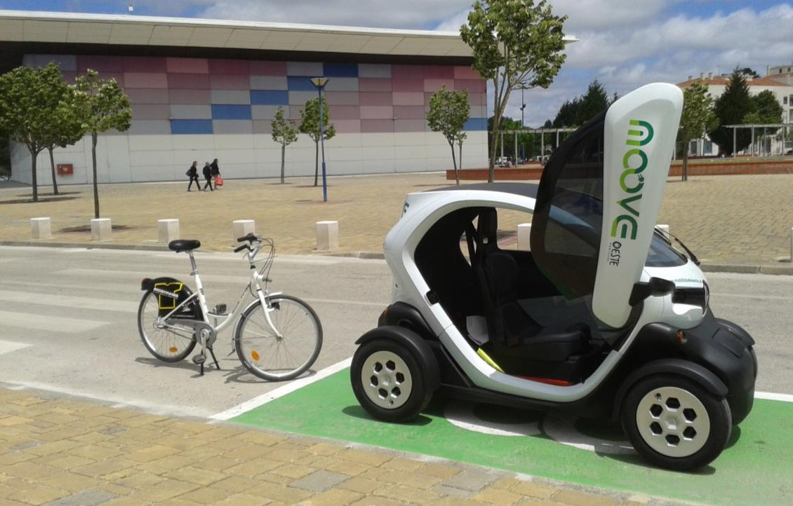
INTERMODALITY
Shared public transport
Car Sharing – MOOVEoeste
Bike Sharing - Agostinhas
Notes:
REPUTE
Renewable Public Transport Enterprise é um projecto financiado pelo Programa Transnacional Espaço Atlântico que visa desenvolver o uso de energias renováveis ​​nos transportes públicos. Promove a inovação e envolvimento no uso eficiente da energia nos transportes públicos.

Slide 11
Soft Modes
Public Bike Sharing System
With provision of electric and conventional bicycles.
The solution is available in the City in a circulation area of 8 km2. The system is in operation since June 2013, the bicycles “Agostinhas" are available every day of the week between 8h00 and 20h00, to citizens over 14 years, the maximum period of uninterrupted use is 4 hours, after which the bicycle must be returned to any Bike station.

Slide 12
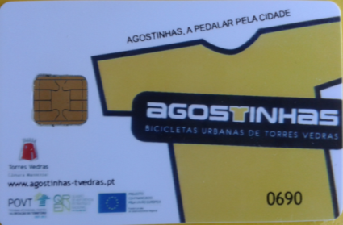
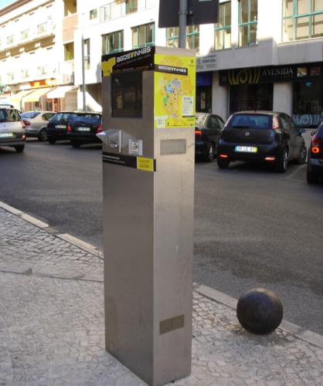
System operation it is quiet easy to the user and that does not need a high involvement.
This system ensures ease and autonomy use, without the need of waiting for a vehicle or complicated bureaucratic processes.
The user has a card that is valid one year, associated with an insurance.
The available technology allows the user to get a bike in a bike station and return it to the system elsewhere in the city.
Soft Modes
Public Bike Sharing System

Slide 13
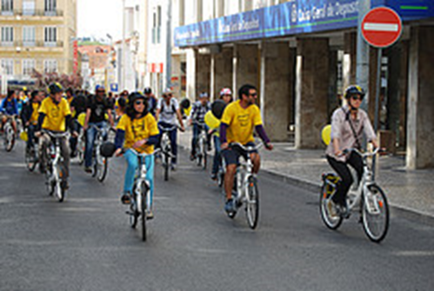
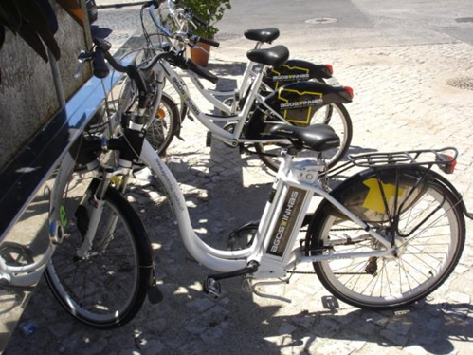
Soft Modes
Public Bike Sharing System
Results and Challenges
Encourage people to see cycling as a fast and cheap transport option, was the most difficult challenge to overcame.
Cycling has a big potential if you think that car trips in cities are of less than 5 km.
The project recorded a high number of memberships with more than 1.400 users and about 35.000 uses, after 3 years of operation. This huge success and the high demand was the reason to undertake the extension of the system in September 2014, creating 3 new Bike Stations and increasing to double the capacity of the 4 existing ones.
The users already have traveled 123. 690 km with this system, which avoided an estimate of 19 ton CO2 emissions.

Slide 14
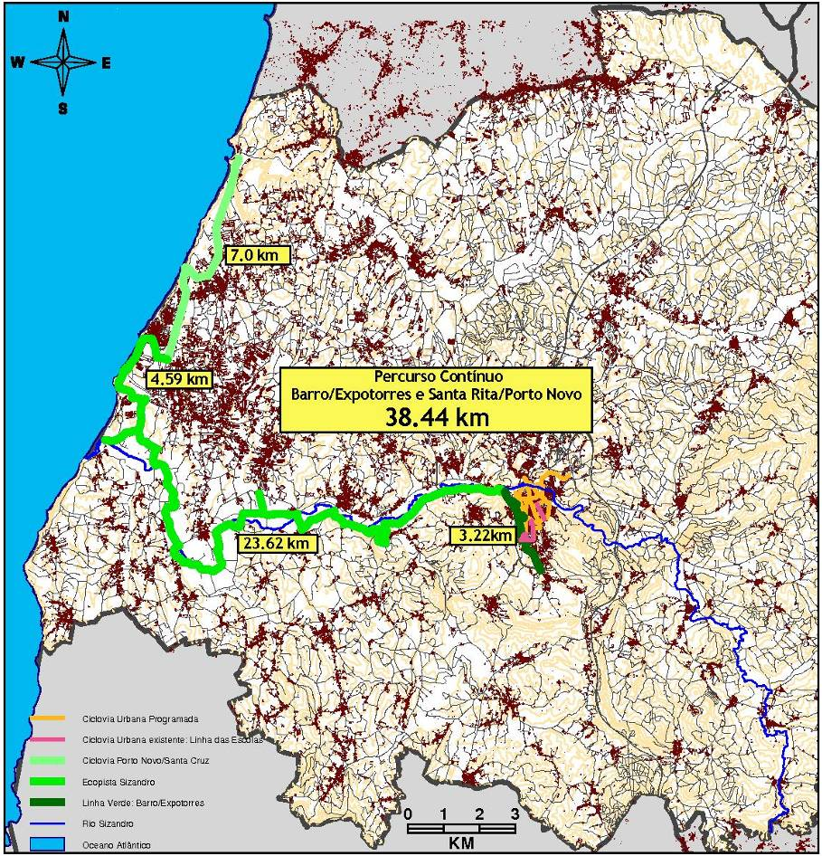
Urban and Leisure bike paths
Continuous cycling route from Torres Vedras City to the Coast - total length 38.44 Km.
Urban bike path, in progressive construction - total length of 14.6 km.

Slide 15
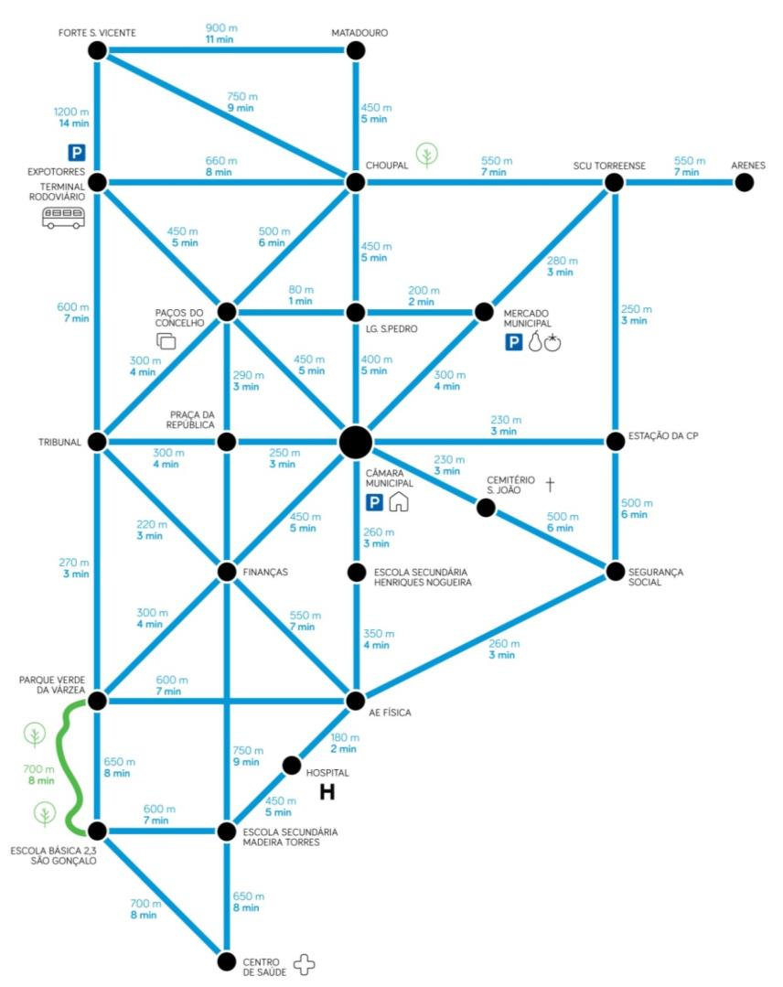

WALKING
Modal Alternative for short journeys between:
Transport stations;
Public;
Public services;
School areas;
Commercial areas;
Green areas.

Slide 16

I WILL WALK TO SCHOOL
City Council Initiative
Safe walking routes for escort children from the 1st cycle of basic education in the City on home course - school - home.
All routes have accompanying for 1 or more adults. On each route there are stopping points that mark the journey times between the start and finish.
http://www.educacaotorresvedras.com/apoio-a-familia/247-faq-perguntas-frequentes

Slide 17
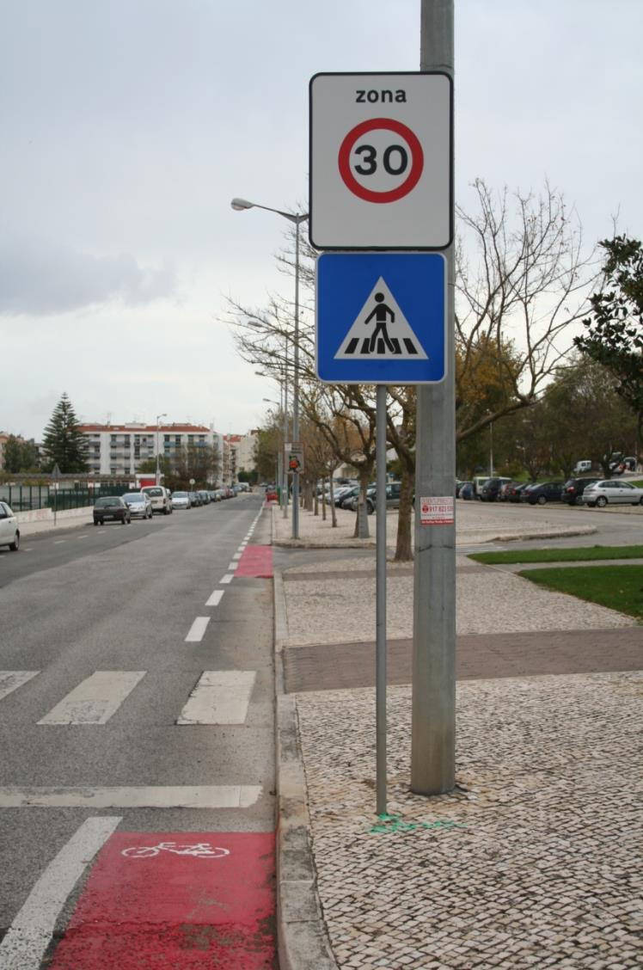
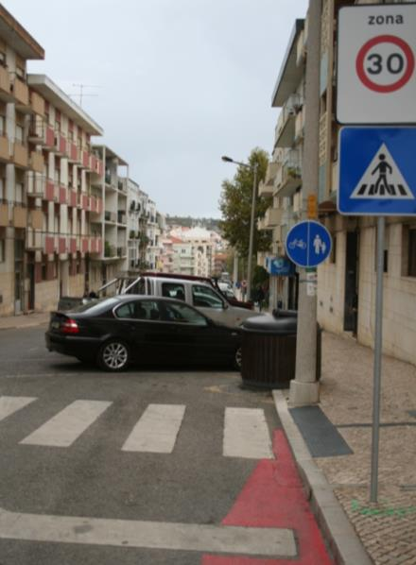
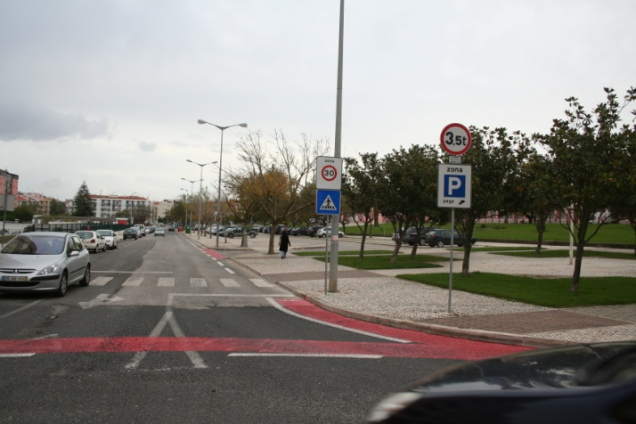
Zona 30
Schools Area
Velocity reduction

Slide 18
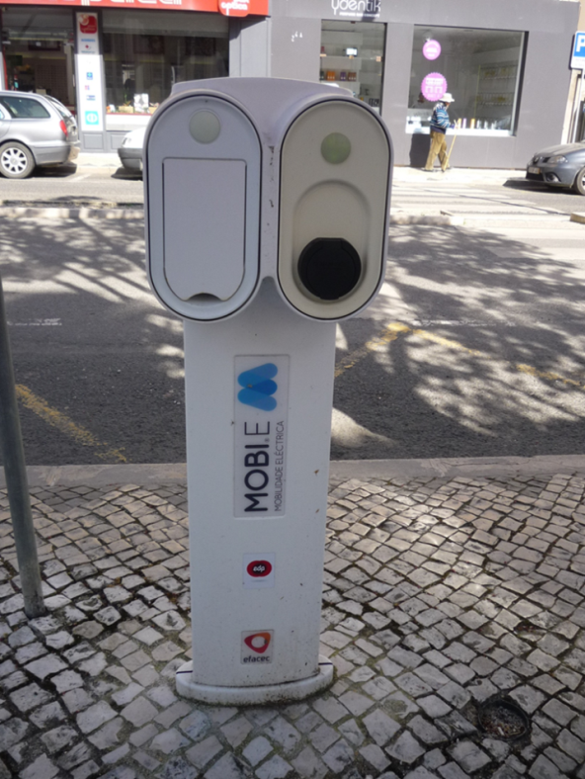

Electric Mobility | Car charging points network.
National integrated network - MOBI.E
Allowing the supply of electric vehicles - 6 points of double charging available.

Slide 19





CARPOOLING
CHUMS- Changing Habits for Urban Mobility Solutions Carpooling in workplaces is an Intelligent Energy Europe Project.
Torres Vedras participates as "observant city." Aimed at encouraging sustainable modal choices for trips home-work-home. It is the first public entity to offer its employees a carpooling system.
Carpooling is the act of combining a commuting trip = continuous or occasional ride making it more affordable and sustainable for the actors.
The contact web platform and the sharing of travel that is being used, since April 2016, can be find at: http://empresas.boleia.net

Slide 20
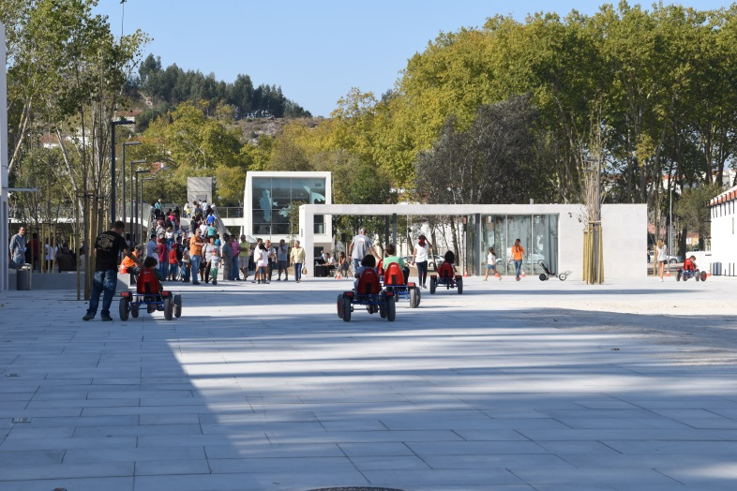
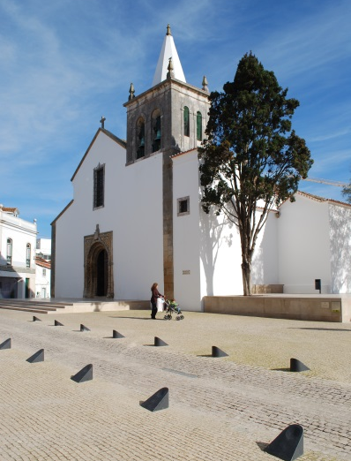
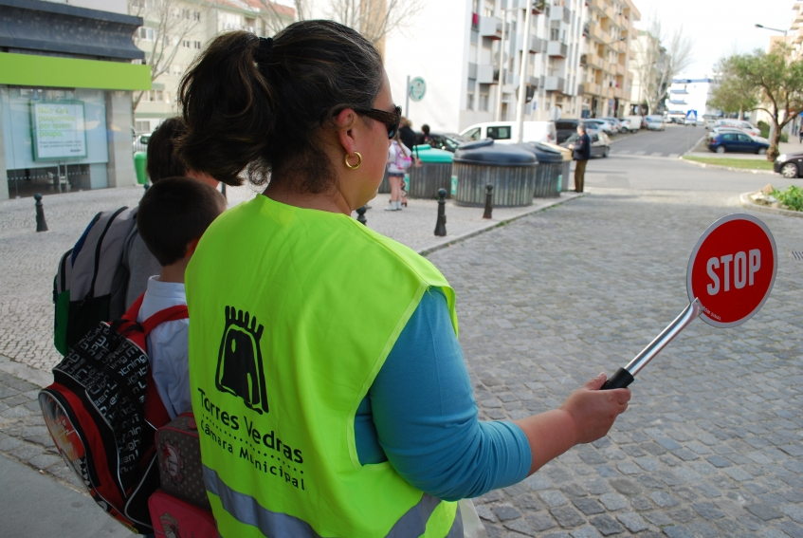
Results
Change citizens' mobility behavior, was the most difficult challenge to overcame.
The projects were crucial to reduce the number of vehicles circulating in the city, with an effective contribution in reducing CO2 emissions and noise.
The public space quality improvement was also one of the major successes.

Slide 21
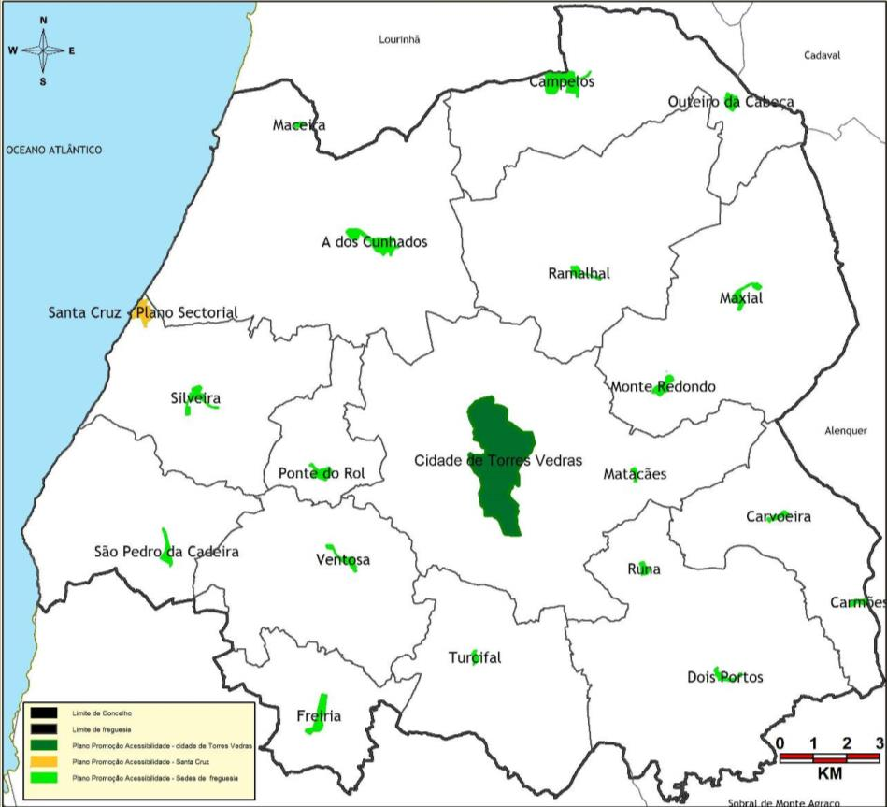
Promoting Accessibility- RAMPA
Torres Vedras City
Parish Headquarter;
Santa Cruz – Coastal Area.
SECTORIAL AREAS
Public space
Buildings
Transports
Communications;
Info accessibility.

Slide 22
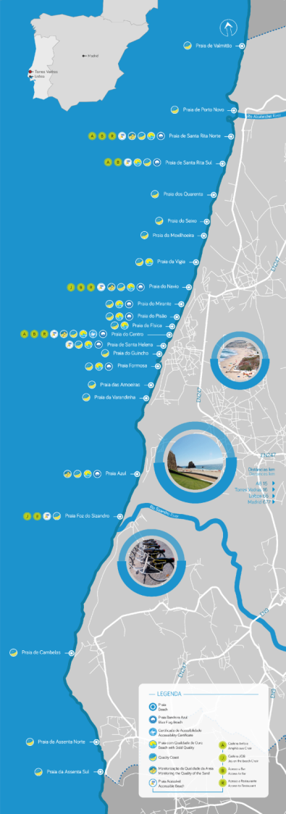

Beaches Accessibility
Equipment and conditions that aloud them to be accessible to all citizens:
Easy pedestrian access;
Organized parking places for people with disabilities;
Access level bathing area by ramp or using mechanical means;
Walkways on the sand;
Accessible toilets;
Accessible First Aid service.
Accessible Beach Flag- Beach for All
9 bathing areas accessible to users with disabilities,

Slide 23
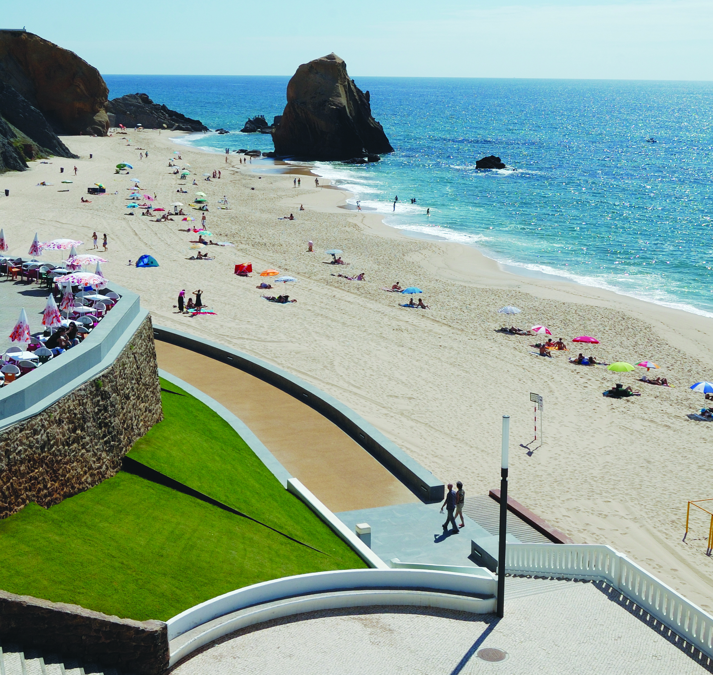
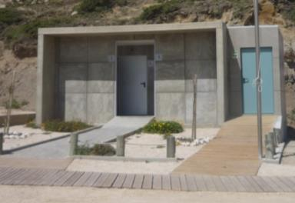
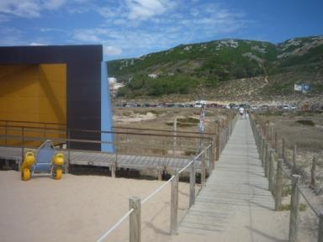
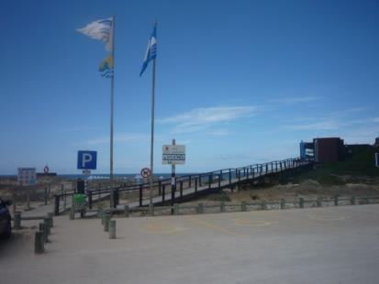
Beaches Accessibility

Slide 24
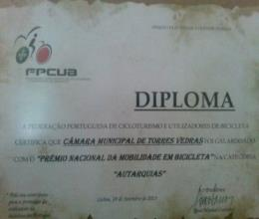
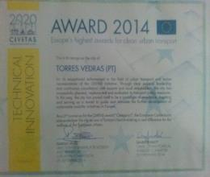


Awards
The Portuguese Federation of Cycling and Bicycle users, awarded in September 2013, Torres Vedras City Council whit the "National Prize of the Bicycle Mobility" in Local Government category.
The European Commission distinguished the municipality of Torres Vedras in the area of mobility. Received at the Forum CIVITAS 2014 held in Morocco, a prize of best practices in the field of sustainable mobility on the City Parking Management System, the strand of Technology and Innovation.
The Municipality of Torres Vedras was awarded in March 2015, with the label "Smart Project for Smart Cities", that distinguishes good practice in urban intelligence and recognize the merit of projects that contribute to the development of innovative, sustainable, inclusive and connected cities, as well as to promote the sharing of good practices and the promotion of partnerships.
The "Agostinhas - public bicycle rental system," won the prize Energy Globe Award 2015. Portugal competed with more than 170 participating countries and over 1,500 project applications. It is more prestigious environmental premium worldwide. Distinguishes projects that preserve resources such as energy or using renewable sources or free sources of emissions

Slide 25




Mobility | NetWorks
Learning from the best
Share experiences and best practices
Develop joint projects

Slide 26

European Mobility Week
Torres Vedras City
joined the initiative since 2002.
This year highligts
Free distribution of Agostinhas bicycles card to students from the city's schools between 14 years and 18 years, valid for 1 year.
Improve intra and interregional mobility;
Promote a public transport system that meets the mobility needs of the population;
Improve intermodality conditions;
Strengthen the share of active modes and implement mobility management measures.

Slide 27


Network of urban bike paths in Torres Vedras,
Extension of the Bike Stations Network of the City, the “Agostinhas” closer to your home,
Implementation of intelligent systems for control and management of road traffic,
Improvement of network operating conditions and urban public transport interfaces,
Implementation of real-time user PT information systems,
Plan of Information and Awareness in Sustainable Mobility.
The Biklio project consists of the dissemination of a mobile application - app , which when installed on the mobile phones of bicycle users can offer discounts in affiliated merchants. It was developed by TIS and INESC-ID in the European project TRACE (Walking and Cycling Tracking Services)

Slide 28



Torres Vedras | New SUMP |
New Challenges
New Challenges
Behavioral change.
Smart cities technology.
Sharing schemes and multimodal integration.
New Torres Vedras SUMP
More and safer urban bike paths in the City.
Extension bike city stations system.
Implementing intelligent traffic control systems
Improving conditions for arrival, stopping and confluence in the public transports.
Real time information systems.
Raising awareness plan for sustainable mobility.

Slide 29


Thank you!
www.cm-tvedras.pt

