Slide 1
How effective are pedestrian crossings?
Tim De Ceunynck, PhD
Vias institute, Belgium
tim.deceunynck@vias.be
CIVITAS Forum

Slide 2
Introduction
Crossing a road by foot is a risky manoeuvre
Roads form barriers that can affect mode choice and lead to social exclusion
Pedestrian crossings aim to mitigate these issues by providing designated locations to cross a road
Conditions/considerations for at-grade crossing:
One lane per direction
Speed: max. 50 km/h limit and V85 of 45 km/h
Volumes of motorized vehicles and pedestrians

Slide 3
Mode change effects
Mode effects as an isolated measure difficult to evaluate, but crucial element of pedestrian infrastructure
Affects ‘walkability’ of an area, which strongly impacts likelihood of walking
Increased likelihood that a trip is walked when pedestrian crossings are present on the route

Slide 4
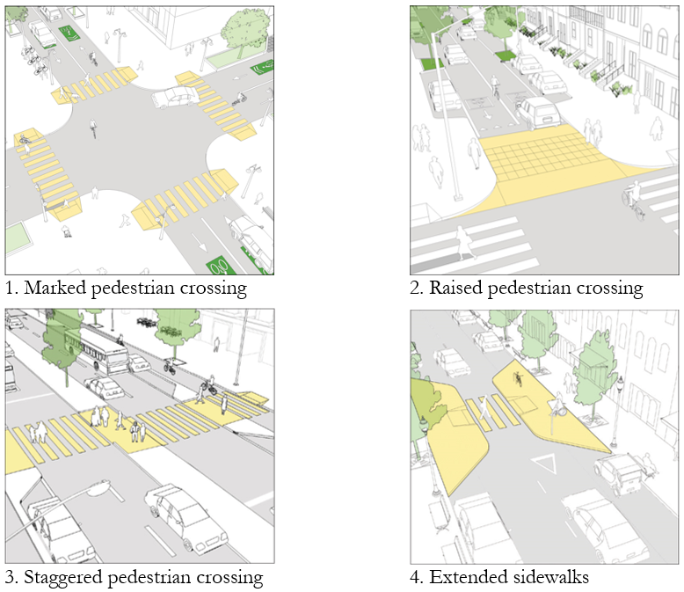
Examples of use
High variety of layouts
For more design guidelines https://globaldesigningcities.org/publication/global-street-design-guide/designing-streets-people/designing-for-pedestrians/pedestrian-crossings/

Slide 5
Effects on safety & security
Results from SafetyCube Road Safety Decision Support System
Available research shows mixed results regarding safety effects
Unclear if pedestrian crossings lead to a reduction in the number of crashes (some studies even find an increase in the number of crashes)
However, the severity of the crashes does consistently reduce
(Perceived) security is mostly an important consideration for non at-grade crossings
Strongest for underpasses, followed by footbridges

Slide 6
Challenges and opportunities
Risk of false sense of protection
Type and design may pose challenges to physically, cognitively or visually impaired people
Finding the optimal crossing locations and design can be challenging
Crossings can contribute to enhancing the livability and walkability of an area, which may reduce barrier formation and social exclusion, and enhance community formation

