Slide 1
Welcome to session #12a MONITORING MOBILITY PERFORMANCE IN EUROPEAN URBAN AREAS THROUGH SUSTAINABLE URBAN MOBILITY INDICATORS
CIVITAS Forum conference 2018, Umeå, 20 September 2018

Slide 2
Agenda
SiMPLify, a global project for easy, safe and clean urban mobility systems for all
Irene Martinetti, World Business Council for Sustainable Development
The Sustainable Urban Mobility Indicators (SUMI) project – helping European cities using WBCSD’s SiMPlify tool
Marcel Braun, Rupprecht Consult
Why SUMI? – The rationale for funding the project and the EC’s plans regarding SUMI results and outcomes
Piotr Rapacz, DG MOVE, European Commission
Time for questions
Short statements from cities cooperating with SUMI: interests, expectations and questions
Time for questions/ discussion

Slide 3
The Sustainable Urban Mobility Indicators (SUMI) project – helping European cities using WBCSD’s SiMPlify tool
Marcel Braun, Rupprecht Consult

Slide 4
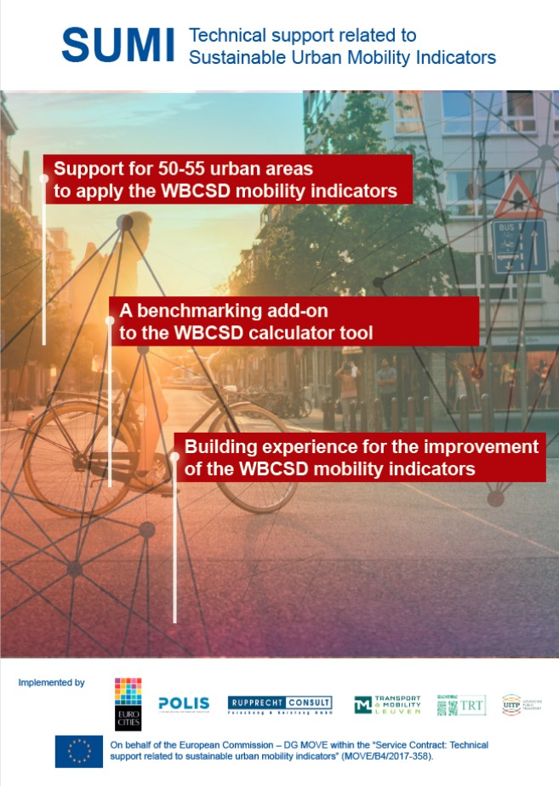
The SUMI project
SUMI consortium
Project Coordinator
Main project objectives
to provide technical support to 50-55 urban areas across the EU to use WBCSD’s indicator set and tool
to collect learnings for the improvement of WBCSD’s indicator set and tool based on cities’ concrete experiences
to develop a benchmarking add-on to WBCSD’s online calculator tool
Project duration
December 2017 – December 2019

Slide 5
SUMI’s main activities
Provision of technical support to cities in using the indicator set
Urban Area Coaches
Indicator Mentors
Collection and analysis of the experiences of
cooperating cities
Indicator Mentors
Urban Area Coaches
Organisation of a consultation process with
cities not involved in SUMI
other relevant stakeholders
Development of recommendations for the EC
on how the indicator set could be improved further
on ways to ensure long-term use of the indicator set after the end of SUMI

Slide 6
Project status
SUMI was tasked by EC with preparing suggestions for revisions to WBCSD’s indicators, taking into account
existing EU data sources and methodologies
the preference of DG MOVE for quantifiable data instead of non-representative survey data to be able to compare data in a scientific way
the realities of data availability and data gathering possibilities at urban area level
Agreement between EC, WBCSD and SUMI on list of 12 core indicators to be revised by SUMI according to suggestions
SUMI currently in process of finalising revised excel-based data collection sheets
Data collection at urban area level with cooperating cities starts when first final excel sheet is available

Slide 7
List of indicators
No. | Indicator | Indicator mentor (organisation) | Core indicator
1 | Affordability of public transport for the poorest group | UITP | ✓
2 | Accessibility for mobility-impaired groups | Rupprecht | ✓
3 | Air pollution emissions | TRT | ✓
4 | Noise hindrance | TRT | ✓
5 | Fatalities | TML | ✓
6 | Access to mobility services | TRT | ✓
7 | Quality of public area | Polis
8 | Urban functional diversity | Polis
9 | Commuting travel time | UITP
10 | Economic opportunity | Polis
11 | Net public finance | TML
12 | Mobility space usage | Polis
13 | Emissions of GHG | TRT
14 | Congestion and delays | TML | ✓
15 | Energy efficiency | TML | ✓
16 | Opportunity for active mobility | EUROCITIES | ✓
17 | Intermodal integration | UITP | ✓
18 | Comfort and pleasure | Rupprecht | ✓
19 | Security | EUROCITIES
20 | Traffic safety active modes | ECF | ✓
 | Modal split | TML

Slide 8
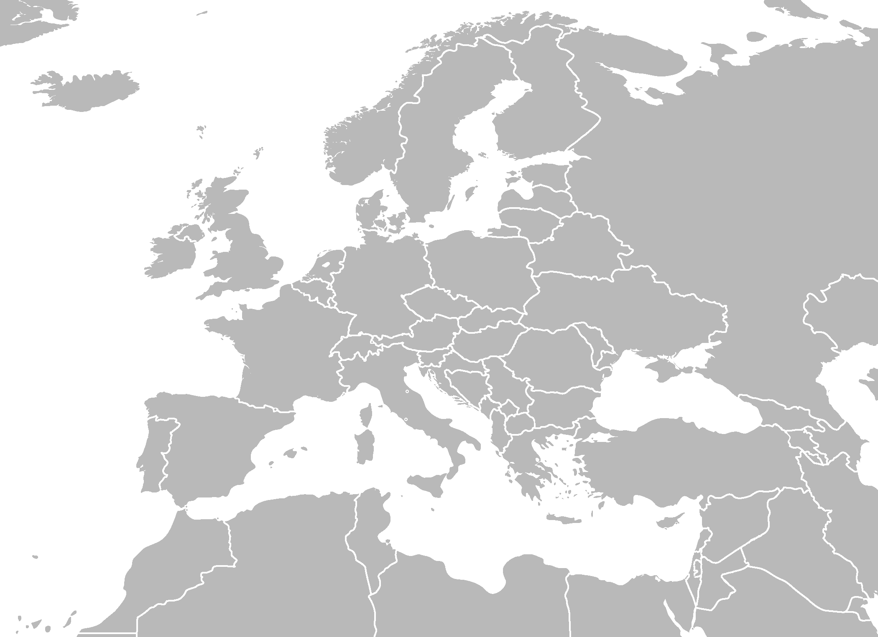
City cooperation
SUMI’s aim: cooperate with 53 cities: 2 cities per EU country (1 large and 1 small), and 1 city in Cyprus, Luxemburg, Malta
Confirmed cities are now in process of signing Memorandum of Understanding
Remaining gaps
Large cities | Small cities
Belgium | Czech Republic
Germany | Estonia
Latvia | Ireland
Lithuania | Luxembourg
 | Malta

Slide 9
Benefits for cities
support in determining the current status of your city with regards to sustainable urban mobility, incl. identification of deficiency areas where additional action may be required
tailored technical assistance to calculate each indicator, incl. identification and gathering of data
personal training and capacity building for data collection
free analysis of available data
possibility to actively contribute to the definition and improvement of a common European urban mobility indicator set
experience sharing and peer-to-peer exchange with cities of similar size and characteristics
visibility and recognition beyond the project at European, national and local levels as frontrunner in the application of sustainable urban mobility indicators

Slide 10
For more information about SUMI please contact
Marcel Braun, Rupprecht Consult
m.braun@Rupprecht-consult.eu
+49-221-60 60 55 20

Slide 11
Thank you very much for your participation!
Please come and visit us at the WBCSD/ SUMI stand in the exhibition area

