Slide 1



Main results from the
CIVITAS ELAN project
Zdenka Šimonovič, CIVITAS ELAN Project Coordinator, City of Ljubljana
23 October 2013
CIVITAS Study tour
Ljubljana

Slide 2
Some aspects to remember
Know well the challenges in your city
Define an integrated set of measures (8 CIVITAS thematic fields)
Measures in line with local, national & EU policies
Ensure political support
Plan your measures in a participatory process (stakeholders, public)
Define well measurable objectives, goals
Ensure good cooperation within your organisation
Work in good partnership (local and international)

Slide 3
Some aspects to remember
Get qualified & dedicated staff working on the project
Ensure adequate funding
Evaluate your implementation
Communicate the results (within your organisation, locally, EU level)
Share your experiences with other cities
In a EU funded project:
solid consortium
good understanding of administrative & financial rules
work with other EU funded projects (CIVITAS), support actions, EU project officer

Slide 4
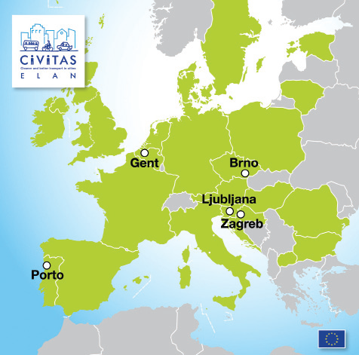
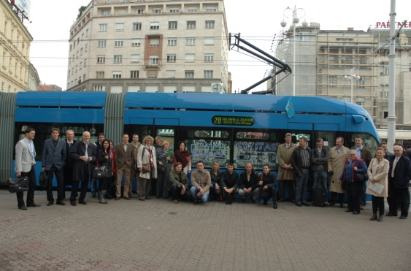
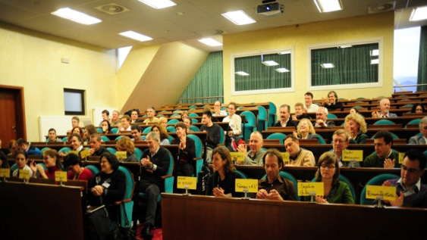
CIVITAS ELAN in brief
5 cities: Ljubljana, Gent, Zagreb, Brno, Porto
39 partners & 2 third parties
69 measures
28.600.000 € of total costs
17.850.000 € of EU co-funding
120.000.000 € of total costs incl. infrastructure
590.750 hours worked in ELAN = 105 people working full time in ELAN every month
744 people worked in ELAN in four years
~60 people (incl. students) were newly emplo-yed by partner organisations to work on ELAN

Slide 5
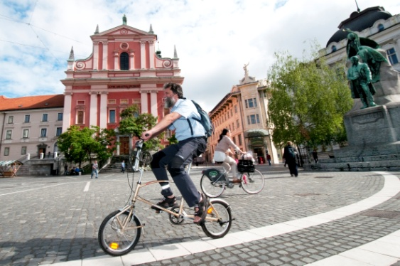
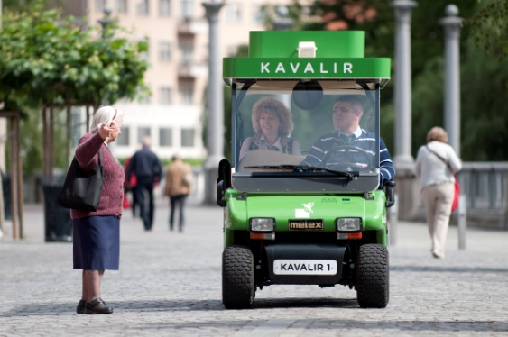
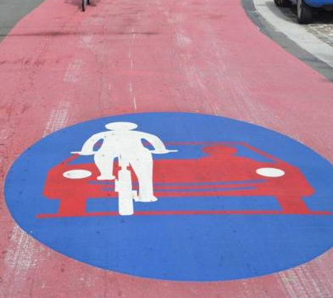
Main results from the CIVITAS ELAN project
Ljubljana
  Modal share of cycling increased by 27%
  Improved public transport services due to ICT
  Great influence of ELAN on Ljubljana’s new “Traffic Policy Until 2020”
Gent
  New parking guidelines for project development – enormous long-term impact
  6 small adjustments on tram leads to 20% energy reduction (= 200.000€/ year)
  Cycling street: 36% more cyclists (1st in Belgium, introduced in national legislation)

Slide 6
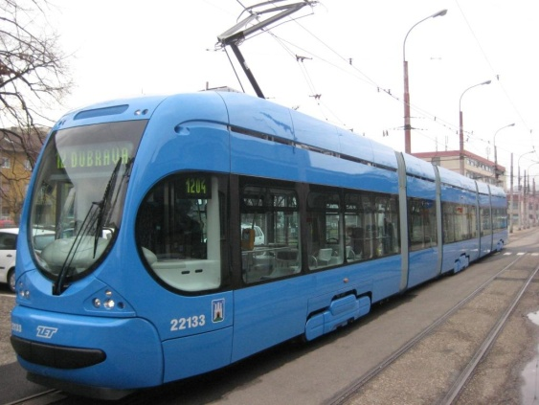
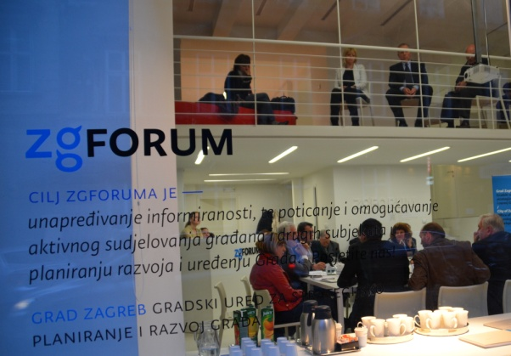
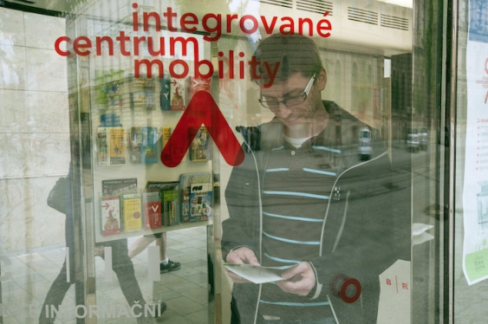
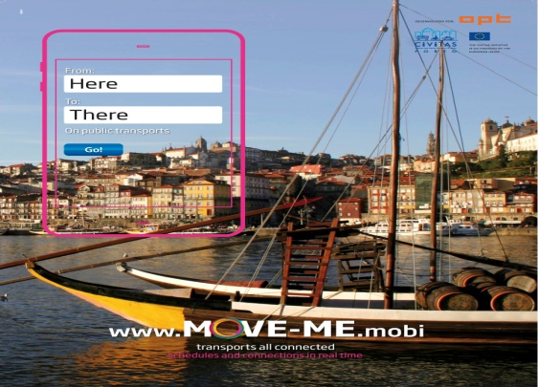
Main results from the CIVITAS ELAN project
Zagreb
  Improved PT services (new trams & buses); introduction of new electronic ticketing system for PT
  Implementation of innovative citizen engagement activities
  Great influence of ELAN on “ZagrebPlan”, the City’s main development strategy document
Brno
  Improved quality of providing transport information and of PT services
  70,000€ savings due to introduction of optimised energy consumption in trams
Porto
  Mobility Shop and MOVE-ME smartphone app improved public transport information
  Better cycling conditions (4 km of new cycle lanes)

Slide 7
CIVITAS Study tour, Ljubljana 23 October 2013
Thank you!
Zdenka Šimonovič, Head of Section
City of Ljubljana
City Administration
Development Projects and Investments Office
Development Projects Section
Adamič-Lundrovo nabrežje 2, 1000 Ljubljana
Ph.: +386 1 306 46 66, Fax: +386 1 306 13 47
e-mail: zdenka.simonovic@ljubljana.si;
www.ljubljana.si

