Slide 1
Webinar
Mobility Management – Interactive mobility information
3th of April 2014

Slide 2
Introduction

Slide 3
Introduction
Purpose of this webinar
Inspire !
Provoke discussion
Launch Thematic Group on Mobility Management
Define themes for further work and activities

Slide 4
The CIVITAS Community
Projects:
Dyn@mo and 2Move2
WIKI and CAPITAL
10 Thematic Groups
http://www.civitas.eu/content/mobility-management-0
Gathering knowledge & expertise
Feeding into the Community

Slide 5
Introduction
How does GoToWebinar work?

Slide 6
Introduction
Programme
timing | subject | speaker
14h00 | Welcome and intro | Sarah Martens
14h10 | Personalised travel info in Aalborg, Denmark | Niels Andersen
14h25 | Q&A | All
14h30 | Buzzy Net: virtual itinerary planner for young digital natives in Belgium | Jonathan Detavernier
15h45 | Q&A | All
15h50 | Introduction to the Thematic Group on Mobility Management | Sarah Martens

Slide 7
Personalised travel info in Aalborg, Denmark
Who is Niels Andersen?
Niels is a civil engineer from the University of Aalborg in traffic engineering. He finished his education in 2007 and has since been employed at Aalborg Kommune.
He mainly works with traffic signals, ITS, traffic information, capacity in junctions and general traffic planning.

Slide 8
Personalised travel info in Aalborg, Denmark
The floor is for Niels!

Slide 9
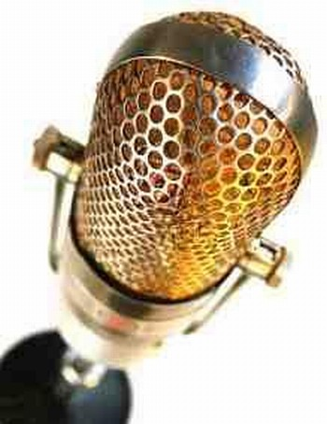
Personalised travel info in Aalborg, Denmark
Questions ?
Raise questions by:
Raising your hand via the GoToWebinar Control Panel
Starting a chat in your control panel

Slide 10
Buzzy Net: virtual itinerary planner for young digital natives in Belgium
Who is Jonathan Detavernier?
Jonathan is the Interactive Partner of Famous, an integrated independent agency in Brussels.
Being responsible for the digital department, he works on clients such as Electrabel (GDFSuez), ABInbev, Hyundai, De Lijn, DeltaLloyd, Thomas Cook,…
Famous makes websites, digital campaigns, CRM-solutions, mobile apps and digital games.

Slide 11
Buzzy Net: virtual itinerary planner for young digital natives in Belgium
The floor is for Jonathan!

Slide 12
Buzzy Net: virtual itinerary planner for young digital natives in Belgium
Questions ?
Raise questions by:
Raising your hand via the GoToWebinar Control Panel
Starting a chat in your control panel
Ask your questions directly (unmute yourself if muted)

Slide 13
Information on the Thematic Group Mobility Management
Purpose:
Discuss and cooperate on joint products / publications / briefs
How?
Interactive Discussion Platform on civitas.eu
Physical & online meetings
Limited budget to cover travels and specific activities
Collaborative exercises

Slide 14
Information on TG Mobility Management
Collaborative exercise (4-5 months)
 | format
Starting point | Physical meeting, Virtual discussion
Setting the scene | Keynote on annual meeting , webinar, training
Finding facts | Post studies on platform and discuss outcomes Search through knowledge base Invite experts to webinar Invite experts to training
Finding solutions / conclusions | Discuss via platform Collaborate on joint paper
Consolidating the output | Discuss via platform Feeding of materials into Knowledge Base / Centre Collaborate on joint publication or inspirational material Joint training or webinar (given by the group) Giving input in HighLights Webinar

Slide 15
Information on TG Mobility Management
TG Mobility management on civitas.eu
TG-pages under ‘Working Groups’ – ‘Thematic Groups’
Create profile and request membership
Start discussing on CIVITAS Interactive
Other examples of interactive mobility information?
Does your city have similar plans?
What barriers do you encounter?
What kind of support do you need?
…
Send suggestions and questions to sarah.martens@mobiel21.be

Slide 16
Information on TG Mobility Management
Questions?

