Slide 1
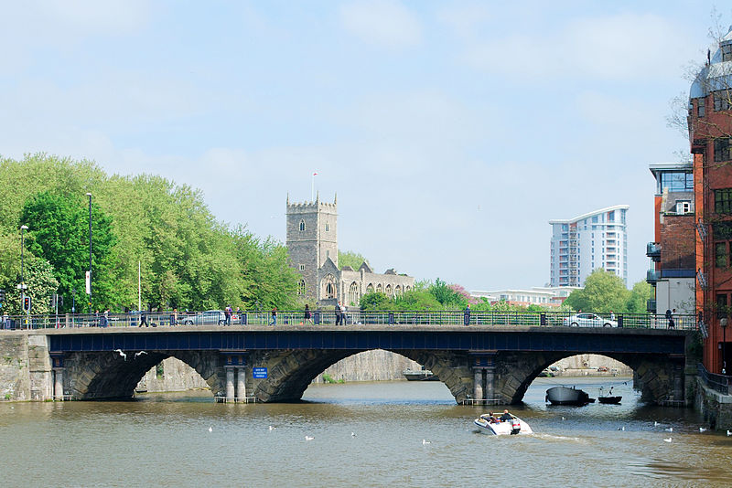
The health benefits of active travel
Dr Adrian Davis, Public Health and Transport Specialist, FFPH

Slide 2
Learning outcomes
Understanding the dominance of mobility over accessibility and how this impacted on active travel
Understand some basic science on health effects of physical activity
Be aware of evidence bases and sources
Confidence to engage with transport planning/public health colleagues colleagues

Slide 3
Background:
What is the purpose of transport planning ?

Slide 4
Access
Access = Transport’s primary function is in connecting people, goods and services. This itself allows the activities for which people travel to happen.
Described as exchange opportunities - people are entitled to the protection of their right to a just and equitable share of exchange opportunities (Engwicht, 1992).
Can be achieved best where distances are short ie high density settlements

Slide 5
Mobility
The focus of UK transport policy since the 1940s has been on increasing mobility.
Mobility - measured through distance travelled but of itself does not necessarily lead to accessibility.
Focus on mobility has had effect of increasing the ability of some groups to travel - by car, plane and, to a degree, by other forms of public transport while deprivation tends to be amplified through transport systems

Slide 6
The bad news
Health is not intrinsically a policy driver of transport planning or considered seriously as such among transport planners

Slide 7
But… the policy drivers are…
Economic growth
Carbon reduction
Congestion reduction
Air quality
Safety and health
Health particularly appears with Local Transport as a ‘sustainable transport mode’
Need to identify ways to align health with these! (Co-benefits agenda)

Slide 8
Buchanan Report- Interpreted to say:
Car ownership and use would grow
This was a legitimate desire of most adults
More roads had to be built in towns to accommodate extra cars
‘Accidents’, noise and possibly air pollution were the negative health impacts
Transport Minister Ernest Marples

Slide 9
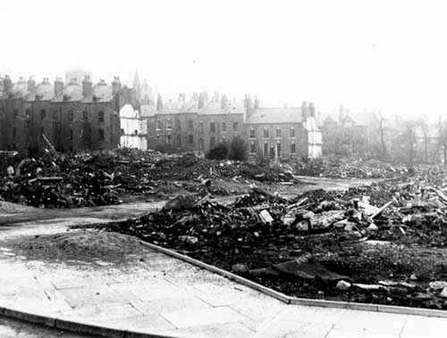

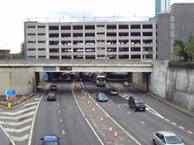
More space for motor vehicles = less for pedestrians/ cyclists
Inner Leeds 1963
In total 365 homes and 174 commercial buildings were razed to the ground. People who were living in the demolished houses were moved to new estates such as Little London.
The myth of progress
1990s

Slide 10
Value of Time Savings
The Department for Transport's values of travel time savings and travel time reliability are central to assessment of the value for money of most transport schemes
One of the main justifications for transport ‘improvements’ is the amount of time that travellers will save. Using a set of values of time, the economic benefits of a transport project can be quantified in order to compare them to the costs
The value of car occupants time has historically been costed more highly than bus users and pedestrians and cycle users

Slide 11
The slow awakening to the health benefits of active travel

Slide 12

Ways in Which Transport Influences Health
Health Promoting
Health Damaging
Enables access to physical activity, employment, shops, goods, education, other services, countryside, social support networks, active travel, well being
Injuries
Sedentary lifestyle.
Pollution: particulates, carbon monoxide, nitrogen oxides, hydrocarbon, ozone, carbon dioxide, lead, benzene,
Climate change
Noise and vibration
Stress and anxiety
Traffic danger
Loss of land and planning blight
Severance of communities by motor traffic

Slide 13
Transport and health knowledge time-line
‘Accidents’, air and noise – dominance of and aspirations for car use
Traffic in Towns, 1963
Livable Streets, 1972
Road traffic volume and speed damage social support networks
Social and environmental context for health
Development of
new public health
from mid 1970s
BMA cycling
& health report, 1992
Health benefits outweigh the risks
Royal Commission on
Environmental Pollution, 1994
Traffic growth not environmentally or socially acceptable
BMA, Road transport
and Health, 1997
1st account of the myriad impacts of road transport on health
DfT, 1998 A New
Deal for Transport
‘The way we travel is making us a less healthy nation’ p.22
Half adult population in developed countries is sedentary or does minimal physical activity. Barriers to physical activity might have the greatest impact of all traffic-related health risks.
WHO, 2000
Development of peer
reviewed evidence base
of health impacts
Including studies linking obesity to sedentary travel
House of Commons
Environment Committee, 2010
DfT - premature deaths from poor air quality likely to be double previous estimate

Slide 14
Impact of car use on body weight
Time spent travelling by car has increased and walking declined by 23% between 1972 & 2005
Adults who bought private motorised transport to travel to work doubled their likelihood of becoming overweight in comparison to those where there was no mode change 1
Countries with highest levels of active travel generally have the lowest obesity rates
Bell, C., e, K., Popkin, B. 2002 The road to obesity or the path to prevention: motorised. transportation and obesity in China, Obesity Research, 10(4): 277-283
Bassett, D., Pucher, J., Buehler, R., Thompson, D., Crouter, S. 2008 Walking, cycling, and obesity rates in Europe, North America and Australia, Journal of Physical Activity and Health, 5: 795-814.

Slide 15
How does physical activity produce health benefits?
The greatest health benefits from physical activity are from its anti-inflammatory properties
In cells - the release of free radicals from the mitochondria when sedentary causes inflammation and speeds up the ageing process
The increased insulin sensitivity as a result of physical activity reduces cardiovascular disease, prevents diabetes and reduces the risk of cancer
Weight loss only accounts for about 10% of the cardiovascular health benefits of physical activity
Notes:
Our cells generate highly reactive, destructive entities known as free radicals. Free radicals are unstable because they have an unpaired electron, a negatively charged particle. Free radicals are atoms or groups of atoms with an odd (unpaired) number of electrons and can be formed when oxygen interacts with certain molecules. Once formed these highly reactive radicals can start a chain reaction, like dominoes. Their chief danger comes from the damage they can do when they react with important cellular components such as DNA, or the cell membrane. Cells may function poorly or die if this occurs. To prevent free radical damage the body has a defence system of antioxidants.
Free radicals are commonly thought of as perpetrators of cell damage, ageing and even cancer, while antioxidants are seen as the defence against these threats. As awareness about the harmful effects of free radicals has increased, so has consciousness regarding the importance physical activity antioxidants

Slide 16
‘Grand Father’ of Public Health Epidemiology: Jerry Morris
1910-2009. Uses of Epidemiology 1957
Epidemiology is the study of how often diseases occur in different groups of people and why.
Morris studied 31,000 bus drivers and conductors
- conductors climbed 500-700 steps per shift
drivers sat for 90% of their shift
Found less coronary artery disease (CAD) in conductors
Studied 110,000 postal workers
Demonstrated that postmen who cycled or walked to deliver mail had fewer CAD events than colleagues with less active jobs

Slide 17
Health Protector extraordinary…
Disease | Risk reduction | Strength of evidence
Death | 20-25% | Strong
CHD & Stroke | 20-35% | Strong
Type 2 Diabetes | 35-40% | Strong
Colon Cancer | 30-50% | Strong
Breast Cancer | 20% | Strong
Hip Fracture | 36-38% | Moderate
Depression | 20-30% | Strong
Hypertension | 33% | Strong
Alzheimer’s Disease | 20-30% | Moderate
Functional limitations, elderly | 30% | Strong

Slide 18
Physical activity
‘I have two doctors, my left leg and my right…’
Trevelyan, G. Walking. 1913 In Clio, a muse and other essays. London: Longman, Green and Co. 56.
“For most people, the easiest and most acceptable forms of physical activity are those that can be incorporated into everyday life. Examples include walking or cycling instead of travelling by car.”
CMOs, Start Active, Stay Active 2011

Slide 19
Dose response curve: physical activity
26% of adults are here

Slide 20
The risk of premature death through physical inactivity compared to road casualties
So what is more dangerous, being active or being sedentary?
Source: * **DfT Road Traffic Casualties 2009 *** BHF statistics 2010 edition; McPherson et al 2002.

Slide 21
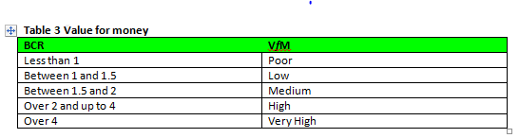
Dept. Transport’s WebTAG: categories of value for money (UK)
Most walking and cycling schemes score over 4:1

Slide 22
How significant are the economic health benefits?
Pie chart of user benefits arising from the Yeadon to Guisely Links to Schools scheme

Slide 23

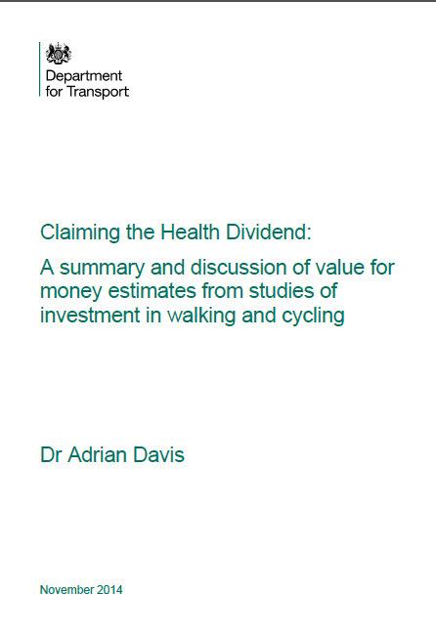
Business case
Unequivocal economic justification for investments to facilitate cycling and walking yet undervalued or not even considered in many transport assessments
Almost all studies report highly significant economic benefits
2/3 of Benefit to Cost Ratios derived from health benefits

Slide 24
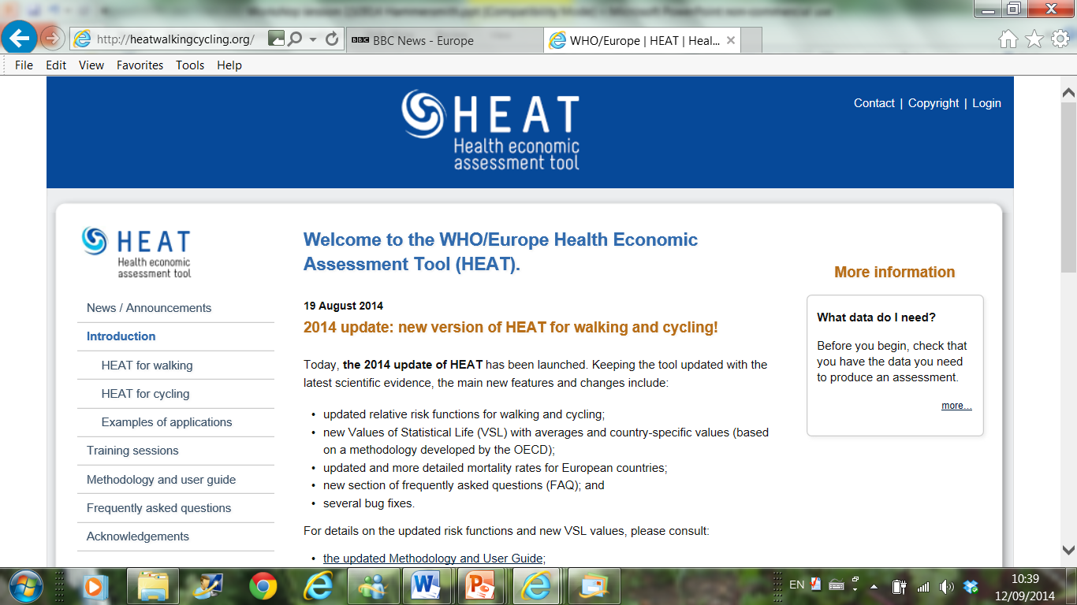

Slide 25
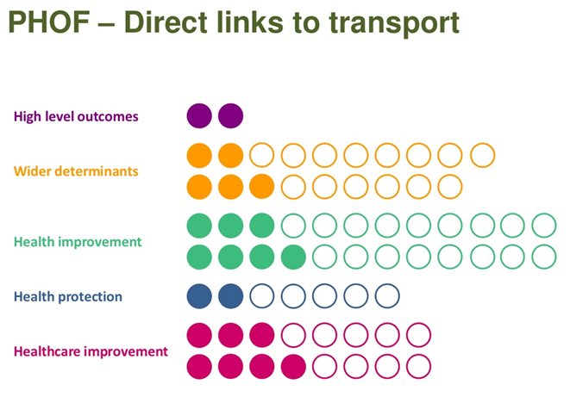
Public Health Outcomes Framework: Direct links to transport (England)
https://www.gov.uk/government/publications/healthy-lives-healthy-people-improving-outcomes-and-supporting-transparency

Slide 26
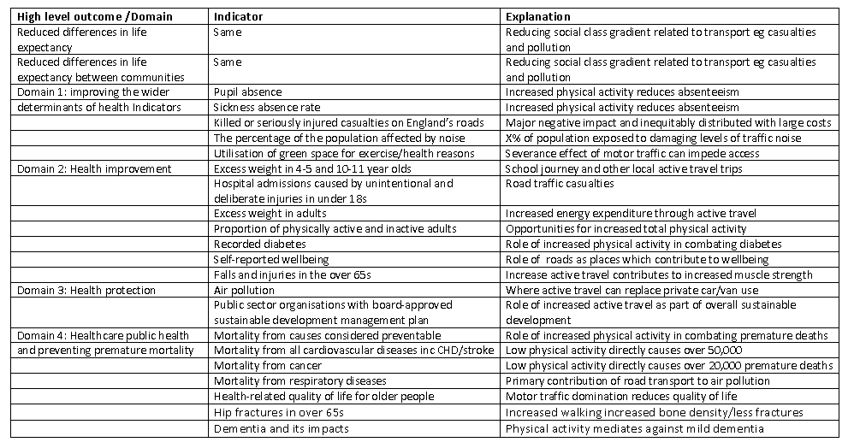

Slide 27

Utilising co-benefits
Co- benefits: “ Substantial evidence indicated that designing and creating parks, communities, transportation systems, schools and buildings that make physical activity attractive and convenient is also likely to produce a wide range of additional benefits”.
Salliis, J. et al, 2015 Co-benefits of designing communities for active living: an exploration of the literature, Int. J. of Behavioural Nutrition & Physical Activity, 12:30.
Children, MVPA and academic attainment

Slide 28
Evidence

Slide 29
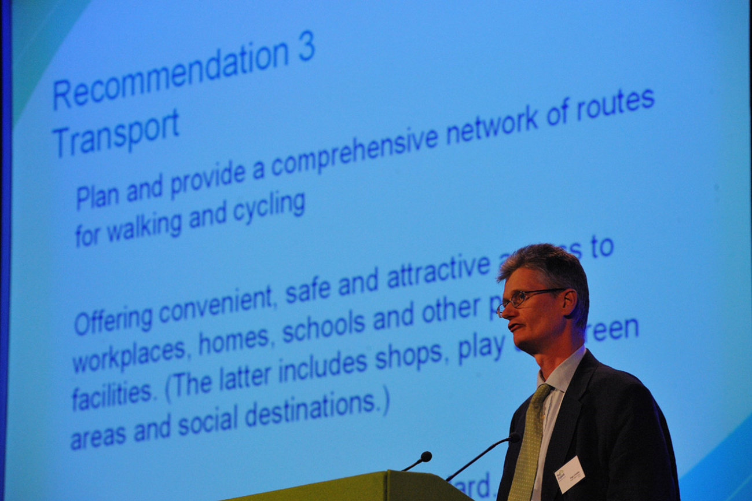
National Institute for Health and Care Excellence recommends

Slide 30
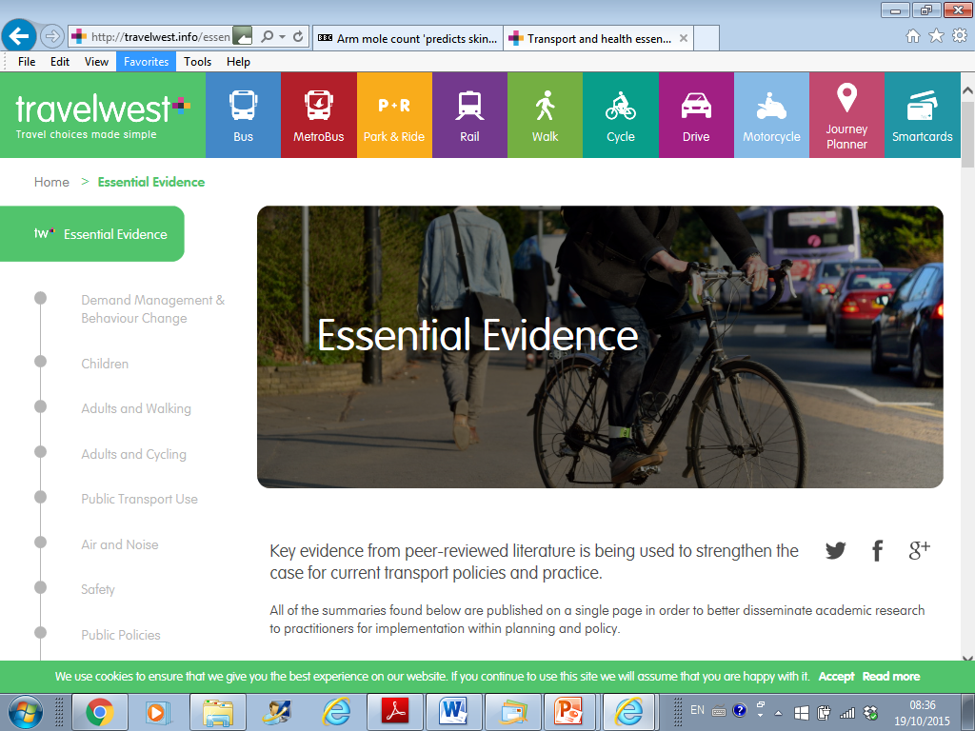

Slide 31
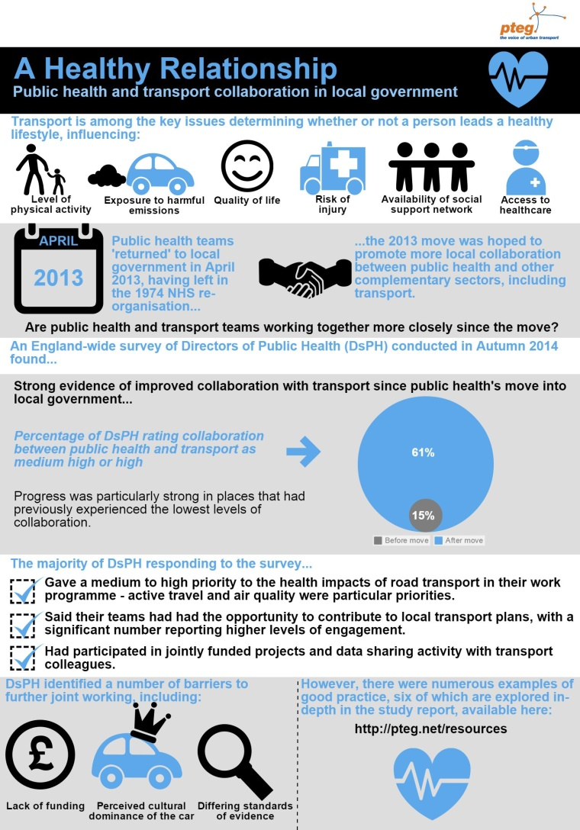
Background
Return of public Health to Local Government (England)
Would this move result in greater collaboration?

Slide 32
Survey of Dirs of Public Health

Slide 33
Key findings
Percentage of Directors of Public Health rating collaboration between public health & transport as medium high or high…
After move
Before move

Slide 34
Key survey findings
The majority of respondents:
Gave a medium to high priority to the health impacts of road transport in their work programme.
Said their teams had had the opportunity to contribute to local transport plans.
Had participated in jointly funded projects and data sharing with transport colleagues.
Reported that Active Travel the single largest area of collaboration.

Slide 35

Barriers to joint working

Slide 36
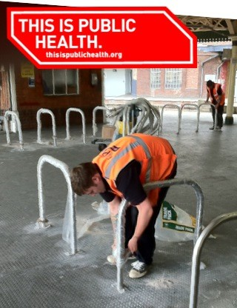

Slide 37
Thank you
adrian.l.davis@phe.gov.uk
www.travelwest.info/evidence
www.pteg.net
http://www.euro.who.int/en/health-topics/environment-and-health/Transport-and-health
www.elsevier.com/locate/jth

