Slide 1




TransformingTransport
Big Data Value in Mobility and Logistics
Vivian Kiousi (INTRASOFT International)
Rodrigo Castiñeira (INDRA)

Slide 2


Transport and Logistics Domain
One of the most-used industries in the world and in EU…
  15% of GDP (source: KLU), employment of 11.2 million persons in EU-28 (source: DG MOVE)
  3,768 billion tonne-kilometres and 6,391 billion person-kilometres in EU-28
  Key contributor to emissions: 4,824 megatonnes CO2 (source: DG MOVE)
…and growing
  Business and tourism travel expected to grow significantly over next decades
  Freight transport slated to increase by 40 % in 2030 and by 80% in 2050 (source: ALICE ETP)
Need for paradigm shift!
  A 10% efficiency improvement = EU cost savings of 100 B€ (source: ALICE ETP)
  Big Data expected to lead to 500 billion USD in value worldwide in the form of time and fuel savings, and savings of 380 megatons CO₂ in transport and logistics (source: OECD)
But: Current Situation
  Only 19% of EU transport and logistics companies employ Big Data solutions as part of value creation and business processes, and 70% do not plan to do so in the future (source: Price Waterhouse Coopers)

Slide 3
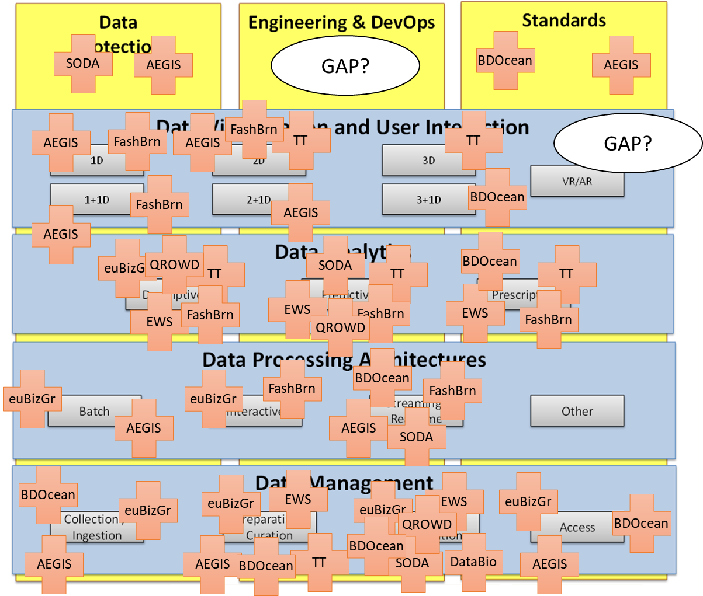
Active Collaborations
Highlights
Big Data Value Association
Co-leading (with ALICE) “transport and logistics” sub-group of Applications Task Force (TF7)
BDV PPP Technical / Steering Committee
TT adopted BDV reference model in its first round of pilot deliverables (served as reference example for BDV technology mapping)
US Big Data Hubs
Exploring transatlantic research & innovation opportunities in big data for transport (TT keynotes, joint workshops, whitepaper drafted)
Notes:
13 active collaborations (incl. BDVA)

Slide 4







Overall Objective
TT aims to demonstrate, in a realistic, measurable, and replicable way the transformations that big data will bring to the mobility and logistics sector
TT aims to bring about a demonstrated increase of productivity and demonstrable impact in seven pilot areas, covering areas of major importance for the transport and logistics sector in Europe
HIGHWAYS
AIRPORTS
PORTS
RAIL
VEHICLES
URBAN MOBILITY
SUPPLY NETWORKS

Slide 5

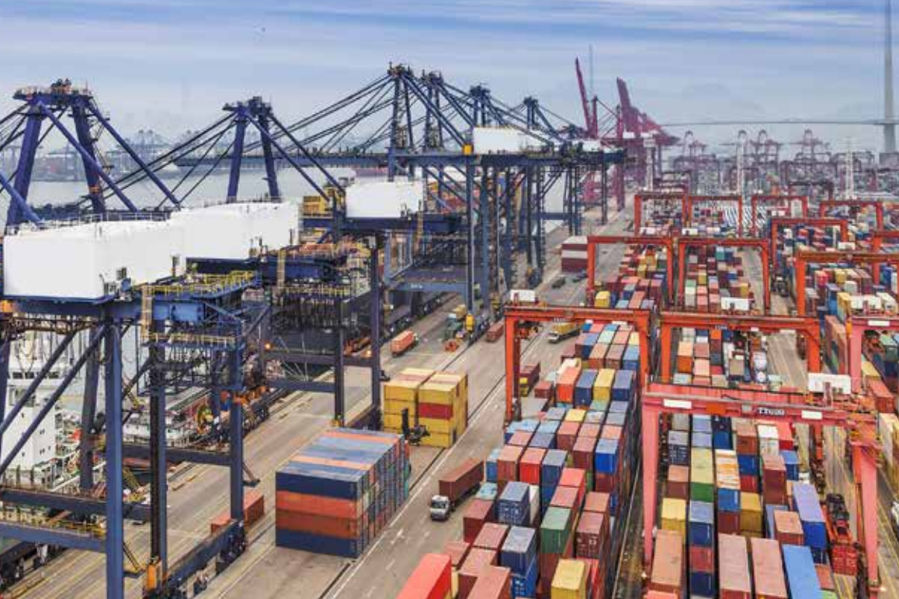
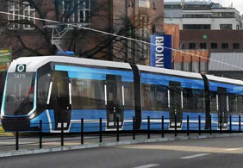

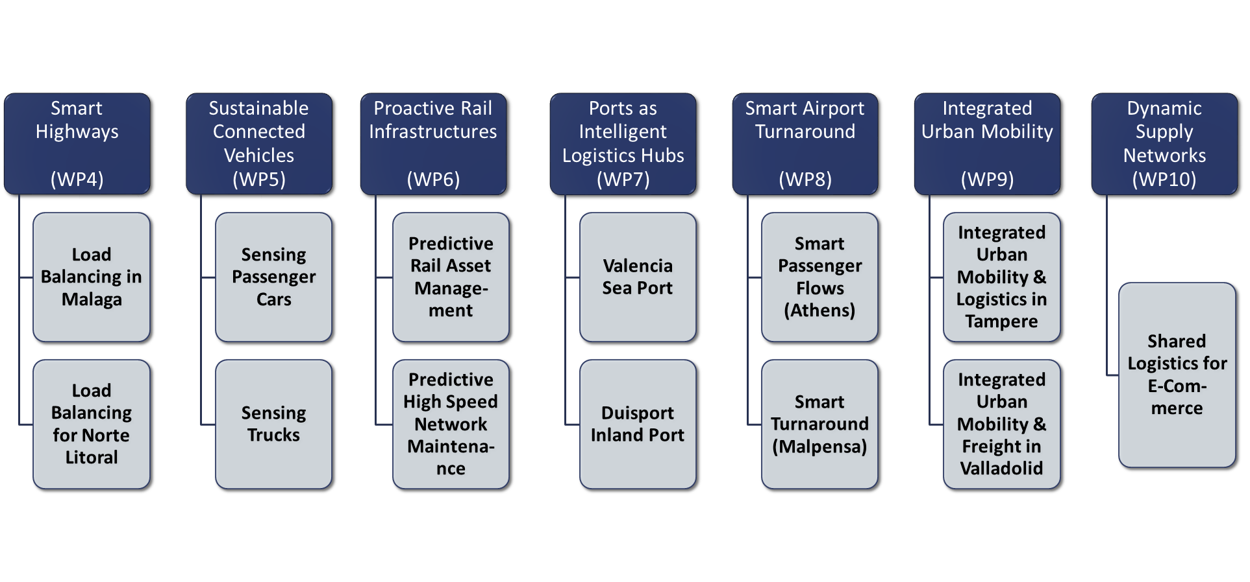
Piloting
Large-scale piloting and demonstrations of the Big Data technologies in the transport sector

Slide 6

Valencia Port Pilot – Predictive maintenance use case
This project has received funding from the European Union’s Horizon 2020 research and innovation programme under grant agreement No 731932

Slide 7
Valencia Pilot
Big Data technologies have a key role to play in port logistics as new IoT information from equipment, such as trucks, containers or cranes, becomes available.
Valenciaport the Spain’s leading Mediterranean port in terms of containerised commercial traffic: 50,000 movements of cranes, trucks and other
equipment per day to handle the 4.7 million of TEU movements per year.
Specifically this pilot has three main goals to address:
Develop an advanced Cockpit for better decision-making, including predictive KPIs that consider as a whole the historical data available at the Valenciaport and Noatum information systems
Design, implement and deploy and optimization algorithm that provides the user with the best sequence of crane movements
Apply Predictive Maintenance models to cranes’ spreaders, starting with the study and deployment of a set of sensor devices to gather relevant information from critical equipment parts.

Slide 8
Pilot Ambitions
One of Ports domain generate vast quantities of historical and real time data from multiple sources
By bringing together this data, we could have an overview of ongoing processes in real-time and react accordingly
We could apply predictive models to present the expected trends.

Slide 9
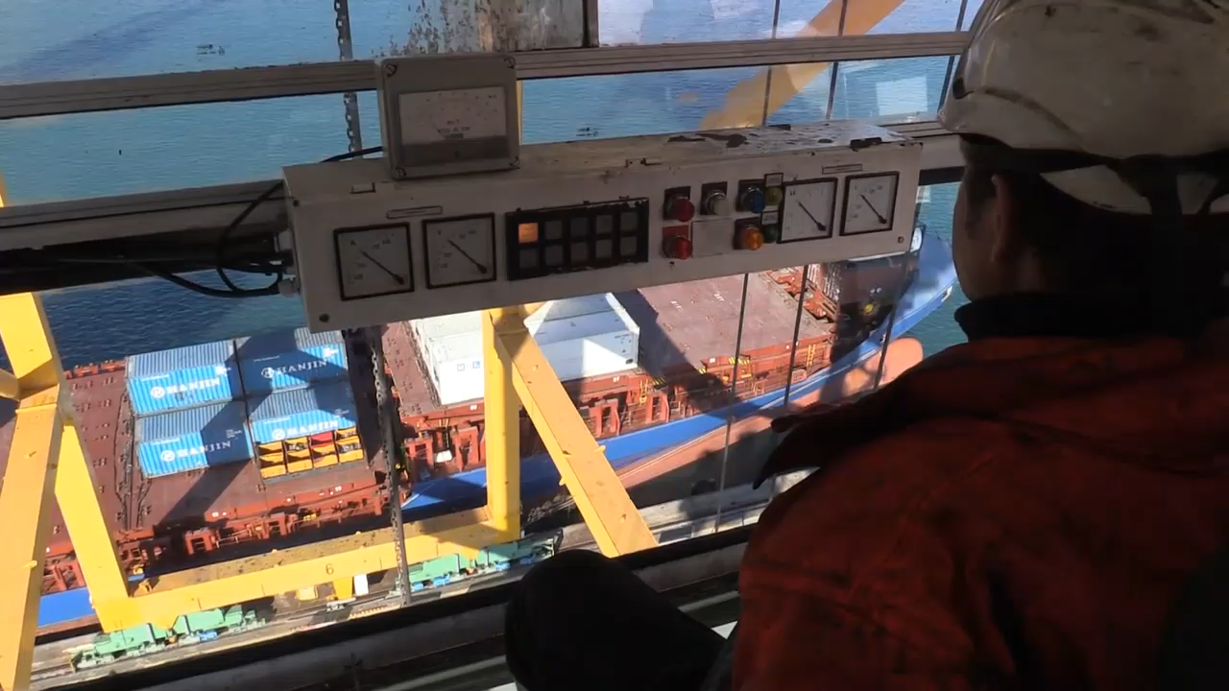
Use Case 2
Predictive Maintenance
One of Ports challenge is to work on optimum solutions to Reduce Downtime and Breakdowns of crane spreaders applying a predictive maintenance approach
By bringing together relevant data we could have an overview of ongoing processes apply preventive maintenance strategies and work towards the envisaged
The current preventive maintenance strategy will be enriched with a prognosis model that will alert of possible failures as they are detected.

Slide 10





Descriptive Data Analysis
1st Challenge: Data Sources Integration
Continuous stream of data on a second basis from cranes and trucks (around 150): GPS position, status variables, internals operative
Cranes PLC & Sensors
Historical database with 10 years of Noatum operations: containers inventory, movements, vessels arrival, traffic.
Noatum TOS
Information of the Valencia Port gates accesses and Vessels arrivals in real-time
Port Information Systems

Slide 11



Sustainable Connected Cars Pilot

Slide 12



Connected Cars
The Sustainable Connected Cars pilot is focused on cars that belong to different companies interested in achieving an efficient management of their fleets.
Thanks to OBD (On Board Diagnostics) dongle devices installed on each car and a Big Data architecture, the partners will apply techniques and algorithms to offer a decision support system for preventive maintenance of fleets, monitoring and promotion of eco-friendly driver behaviors and identification of traffic congestions.
Risks
Financial
More stress, less responsibilities in business trips
Costs due to fuel and maintenance are important and increase the TCO
Environment
Companies have sustainable development goals, one of which is to decrease the carbon print
More than 7M business cars in France, less than 5% is electric or hybrid
Electric fleets are used less than 15% of their capacity

Slide 13
Connected Cars
How this pilot can help
Improve vehicle maintenance:
  Through performance indicators of different brands
  Through interpretation of malfunction codes we can predict maintenance needs
Decrease fuel consumption:
  Good maintenance
  Driving education
  Fuel control
Detection of problematic vehicles:
  Cold analysis of huge fleets

Slide 14
Connected Cars: Business Impact
Car insurance companies
  Analyse driver behaviours and derive risk assessments to adjust premiums.
Car Manufactures
  Checking of cars
Stakeholders
Companies operating a fleet of vehicles: Car rental, businesses to deliver goods or transport of passengers
  Maintenance
  Drivers behaviours

Slide 15






WP10: Shared Logistics for E-Commerce
(WP10 / Task 10.1 – 10.2)

Slide 16
The changing landscape of logistics: e-commerce logistics characteristics
A dynamic and turbulent environment, where the density of the distribution network consists of many delivery points and multiple delivery channels
Complexity is increased by the variety of distribution requests, e.g. orders and returns from various consumers at different points
High number of returns depending on the industry
Significant demand for dedicated delivery services that results in increasing fragmentation of shipments in the “last mile"
Stores are becoming fulfillment centers, serving as pick-up locations for online orders
High distribution costs
Omni-channel growth where inventory optimization and in-transit inventory is an important aspect
E-commerce Europe. (2016). European B2C E-commerce Report - Facts, Figures, Infographic & Trends of 2015 and the 2016 Forecast of the European B2C E-commerce Market of Goods and Services

Slide 17








User requirements collection and elicitation approach
Literature Review
E-Commerce Logistics
Big data and Logistics
Participating 3PL
Industry Working Group
In-depth Interviews
160 e-shops

Slide 18
E-commerce logistics requirements and scenarios
Depict current distribution processes and
forecast future deliveries
Employing collaboration in the distribution processes
Suggest alternative shipping methods
Dynamic routing in an omnichannel environment
Capture consumer insights about e-commerce logistics processes
Scenario 1
Scenario 2
Scenario 3
Scenario 4
Scenario 5
Identification of delivery patterns and problematic issues and forecasting
End-to-end information sharing
Click and collect points
Inventory routing in an omnichannel environment
Online consumer insights regarding logistics and delivery
3PL
3PL and
courier
3PL and courier
Online and brick and mortar retailer
Consumer

Slide 19
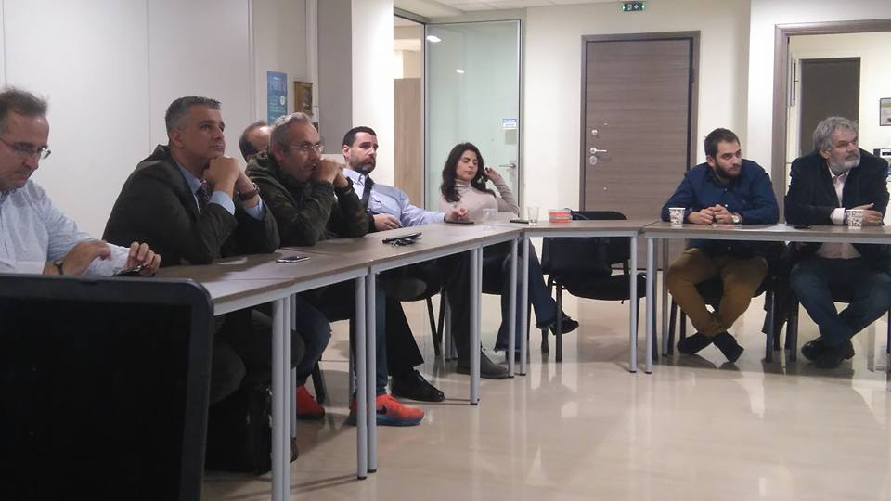
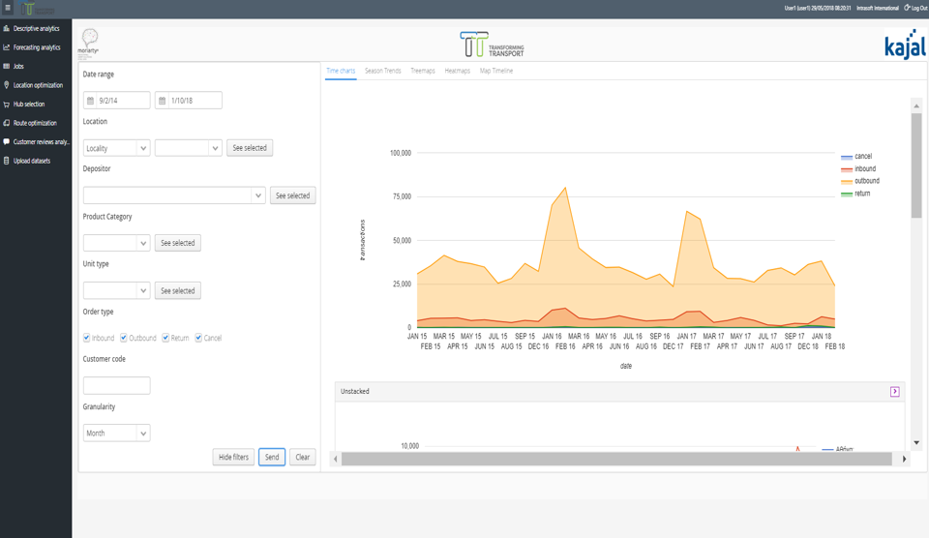
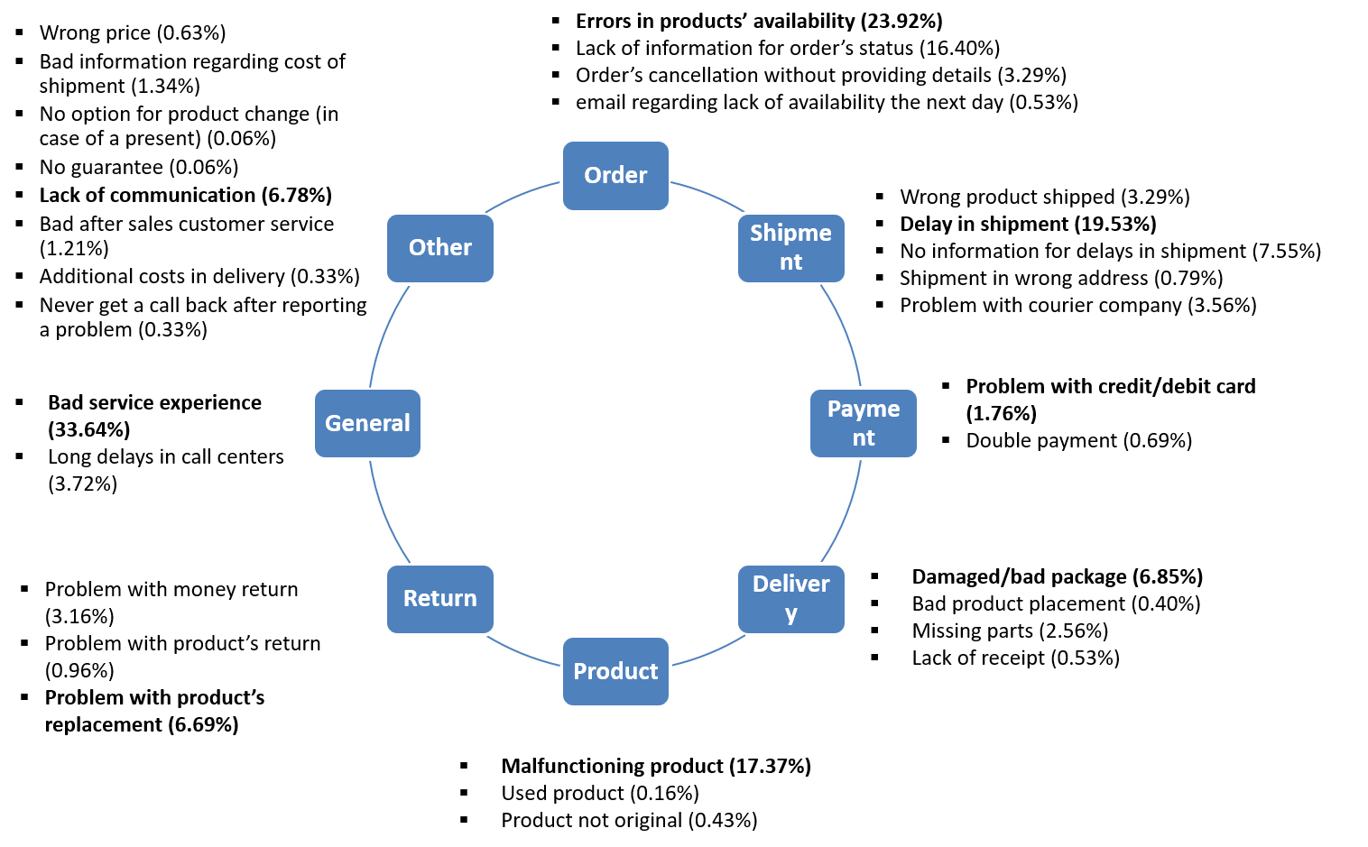
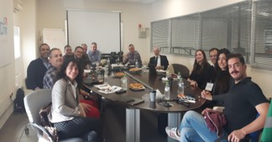
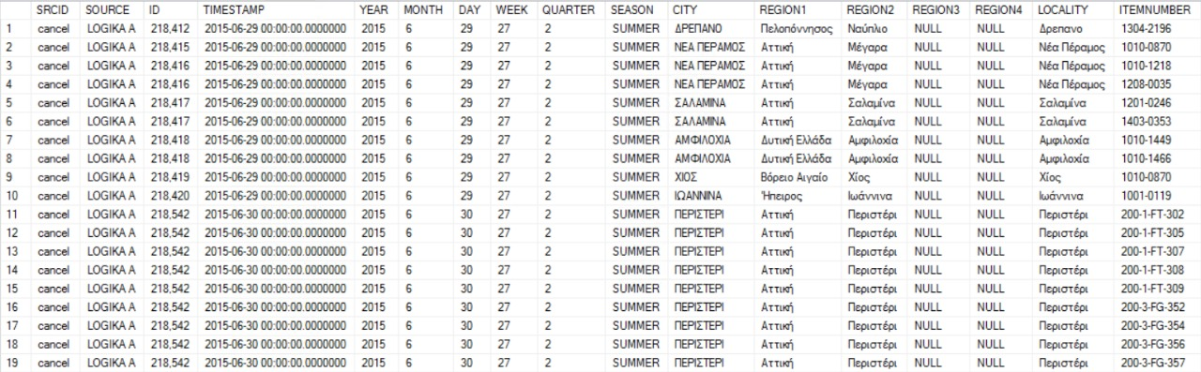
Μain results and achievements
Capturing e-commerce logistics requirements (End user insights, Models, KPIs, Data requirements) and addressing market needs
Tools and algorithms
Empirical evidence related to various e-commerce logistics models was collected for a variety of logistics contexts and different stakeholders
High end-user engagement by actively organizing working groups on e-commerce and online grocery supported by GRECA and ECR, while collecting data from two non-contractual partners
Addressing implementation challenges and providing practical guidelines

Slide 20
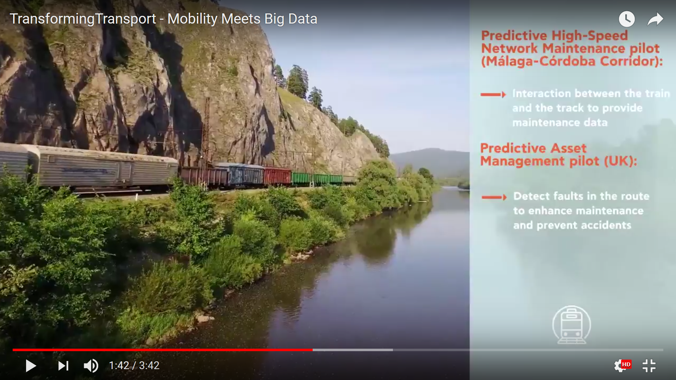
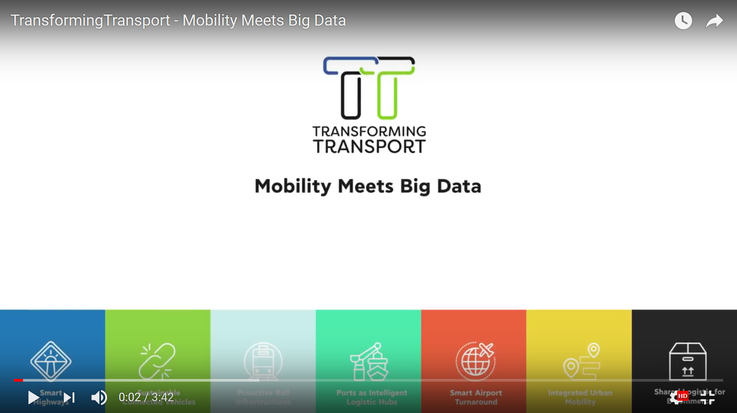
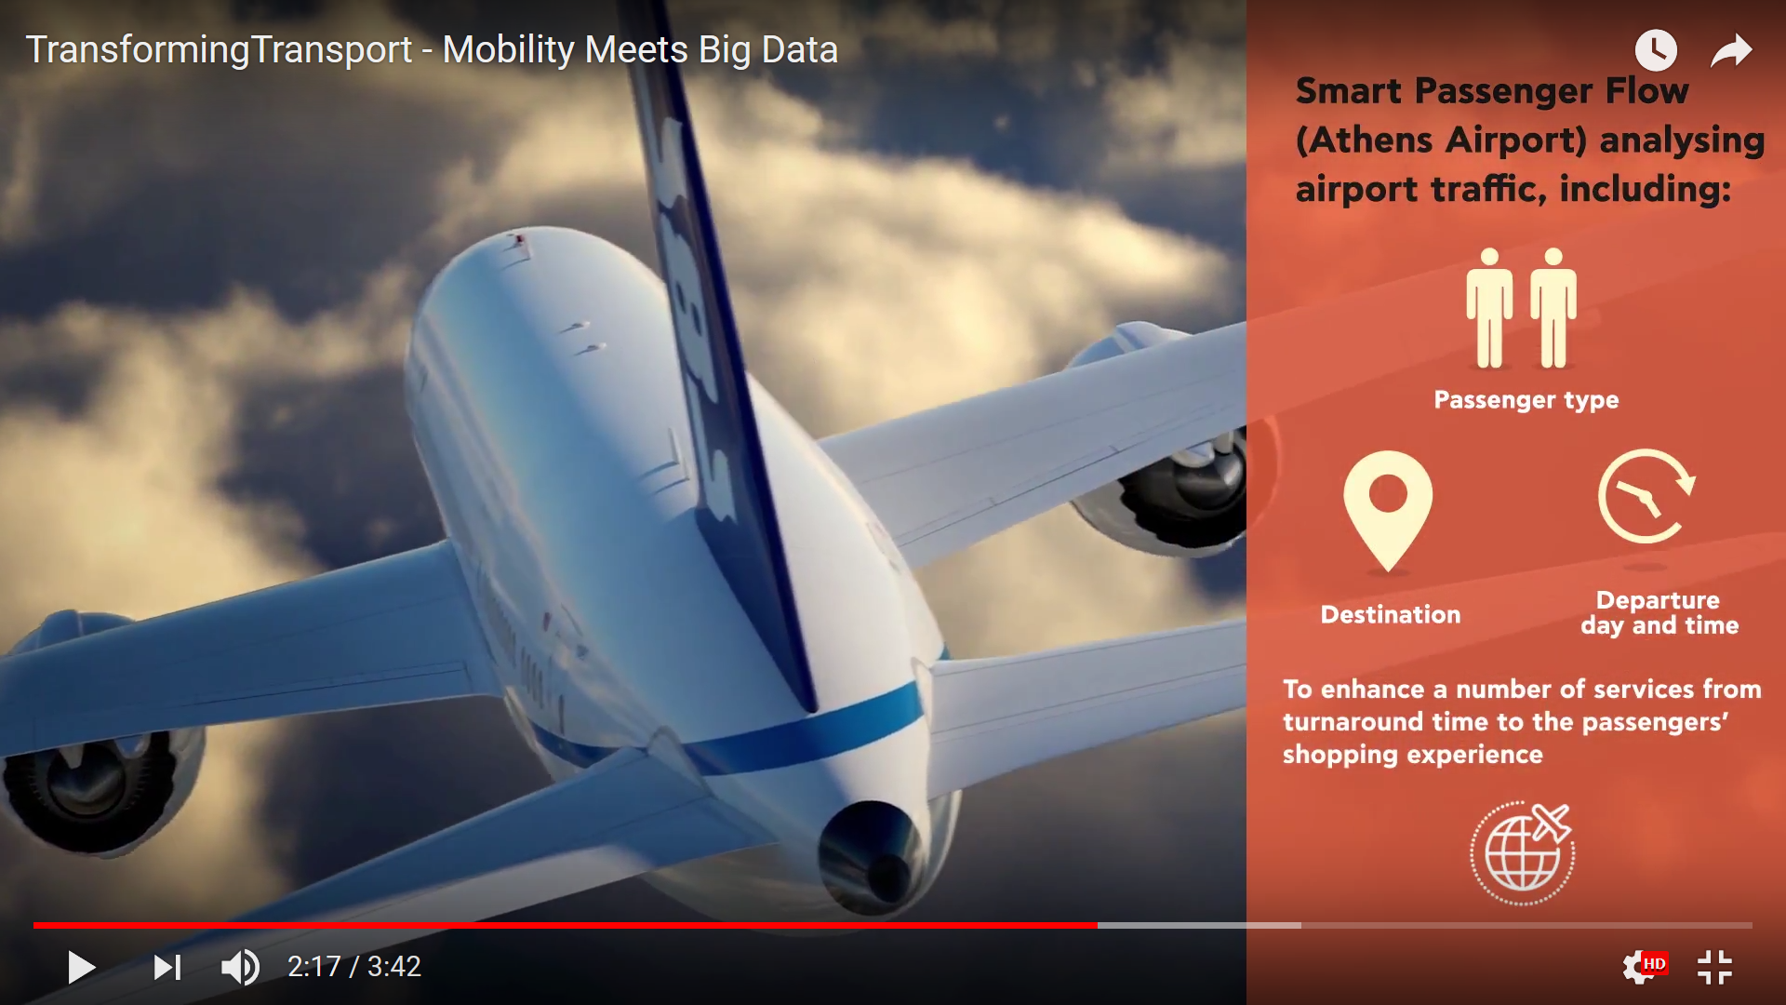
Project video
  TransformingTransport has created a video featuring and explaining to the targeted stakeholders and a wide public the scope and objectives of the project, as well as expected impacts and initial results of the project Pilots.
  The first version of the video was shown during the TRA 2018. The updated version was then presented on the BDV PPP Meetup event and the ITF 2018.
  The first version of the video was shown during the TRA 2018. The updated version was then presented on the BDV PPP Meetup event and the ITF 2018.
  The video is available on the TT website and the YouTube channel:
  https://www.youtube.com/watch?v=GWpmoxJDtAg

Slide 21
Specific outputs to share with the
Policy Collaborators
Deliverables:
Data Management Plan Link
Summary of the TT data assets
Data Management Approach Link
Summary of the data management strategy and governance guidelines
Open Data Portal Link https://data.transformingtransport.eu/
Summary of the Open Data Portal
More Deliverables will be added in the future

Slide 22

















Engagement
+120 stakeholders
RELEVANT TRANSPORT PLATFORMS
BDV PPP Projects
RELEVANT DATA PROVIDERS
Other relevant projects

Slide 23










High-Level Advisory Board
HLAB
Members from key transport/ICT organizations
Dr. Maxime Flament / Dr. Johanna Tzanidaki (ERTICO)
Prof Dr. J. Rod Franklin (ALICE ETP & Kühne Logistics U)
Ramón García (ELA)
Scott Hansen (Open Group)
Thorsten Hülsmann (IDSA)
Dr. Tobias Knobloch (snv - stiftung neue verantwortung)
Kevin Lea (407 ETR)
Georgios Tzavaras / Nikos Losif (ACI)
Javier Ibáñez de Yrigoyen (EIM)

Slide 24
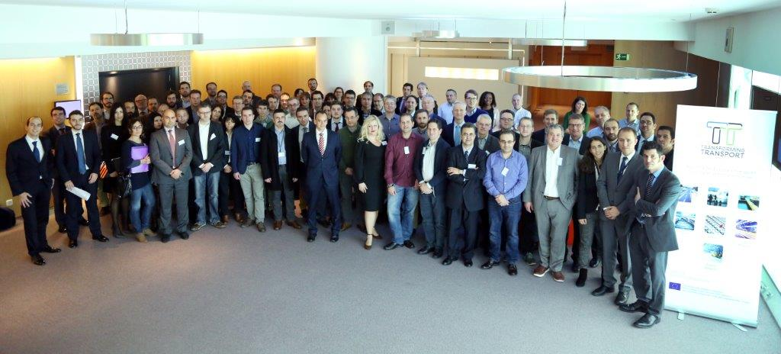

Thank You!

Slide 25

  INTRASOFT TT Impact team – Who is who
Name | Role
Mrs. Vivian Kiousi | Impact Manager
Prof. George Dimitrakopoulos | Asst. Impact Manager & Evaluation Responsible
Mrs. Dariya Rublova | Social Media, Events Logistics & Asst. Evaluation
Mr. Michel Montaldo | Design, layouting
Mr. Nikos Dalivigas | Website issues
Mr. Iyad Kayali | Chief Editor: Content & Press Issues
Contact us:
Communication@transformingtransport.eu or at individual level

