Slide 1
CIVITAS DESTINATIONS’ 2018
CROSS-FERTILIZATION ACTIVITIES WITH CHINA
Julia Pérez-Cerezo – GV21, DESTINATIONS China Coordinator
Claudio Mantero – Horários do Funchal, DESTINATIONS Project Coordinator
CIVITAS FORUM 2018 • September 2018 • Umea, Sweden

Slide 2
INDEX
DESTINATIONS’ CROSS-FERTILIZATION GOALS
DESTINATIONS’ CROSS-FERTILIZATION CITIES
DESTINATIONS’ CROSS-FERTILIZATION 2017 & 2018 ACTIVITIES
22-JUNE-2018 BEIJING WORKSHOP
ON-SITE VISITS IN BEIJING & SHENZHEN
CHINA TRANSPORT facts LEARNED WHILE IN CHINA
WHAT DESTINATIONS SITES LEARNT FROM THE CHINA VISITS
APPLICATION OF WHAT WAS LEARNED IN DESTINATION SITES
THE WAY AHEAD
CIVITAS FORUM 2018• 21-September 2018• Umea, Sweden

Slide 3
DESTINATIONS’ CROSS-FERTILIZATION GOALS
The goals were:
  to interact with China cities and mobility stakeholders - vs. not only academic cooperation
  to learn from China - not just Chinese learning from us
Common issues of interest for DESTINATIONS cities
(July-August 2017 internal survey)
  To learn about Chinese cities’ sustainable transport experiences
  To learn about innovative sustainable transport solutions implemented in Chinese cities by innovative leading Chinese companies
  To see on-site innovative sustainable transport solutions already implemented in Chinese cities by innovative leading Chinese companies
  To visit the headquarters of innovative leading transport related companies
CIVITAS FORUM 2018• 21-September 2018• Umea, Sweden
Notes:
How are all demo WP leaders approaching/ what progress made re x.1 cross site coordination and x.2 task measure design.

Slide 4
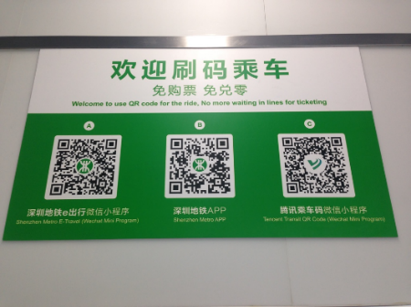
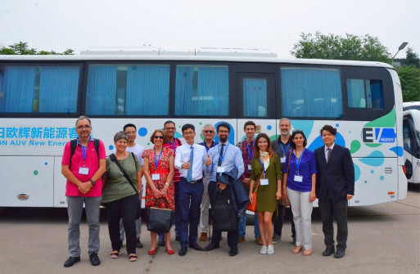
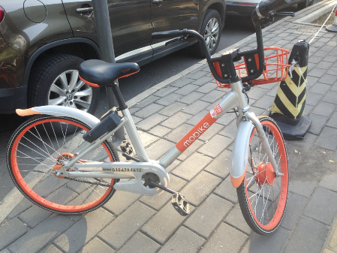
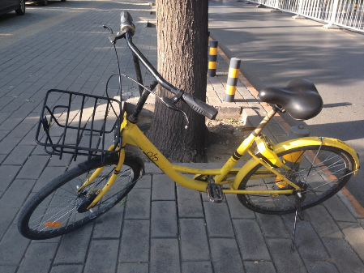
KEY CROSS-FERTILIZATION TOPICS
  Electric Vehicles
  Mobility Sharing
  Integrated Mobile Payment solutions
  Mobile Apps
  SMART solutions
  Innovative Unique Mobility and Transport Planning Solutions
CIVITAS FORUM 2018• 21-September 2018• Umea, Sweden
Notes:
How are all demo WP leaders approaching/ what progress made re x.1 cross site coordination and x.2 task measure design.

Slide 5
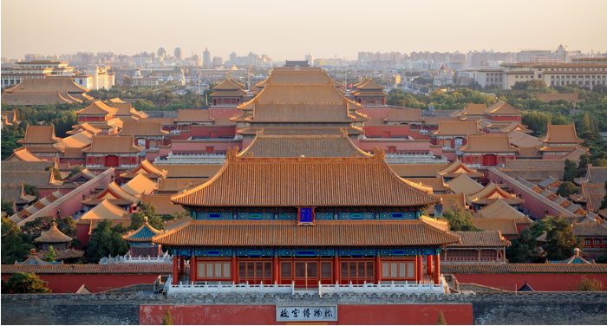
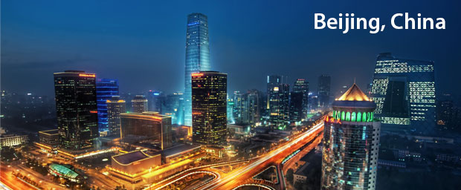
CROSS-FERTILIZATION CITIES
BEIJING
  The Most Popular Tourist Destination in China
  The capital and cultural centre of China
  The Central Government base
  The National Academies and National Technical Institutes Base
  Our Chinese partner’s (Beijing University of Technology -BJUT) city
  The headquarters’ base of: Didi, Foton, Mobike, Ofo
CIVITAS FORUM 2018• 21-September 2018• Umea, Sweden
Notes:
How are all demo WP leaders approaching/ what progress made re x.1 cross site coordination and x.2 task measure design.

Slide 6
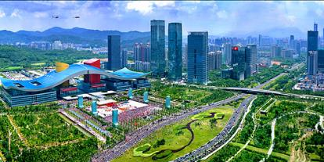
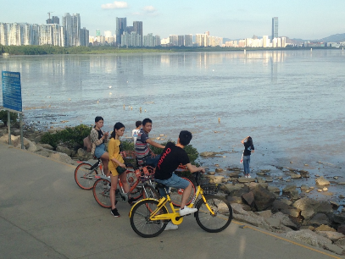
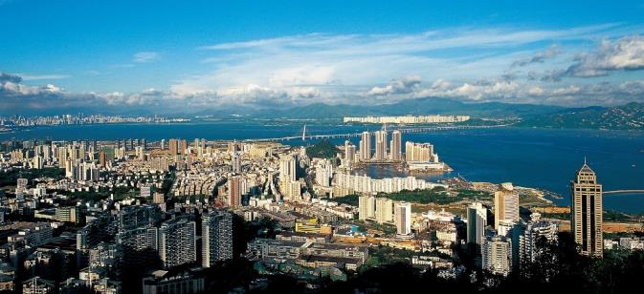
CROSS-FERTILIZATION CITIES
SHENZHEN
  In 1979 <0.5 Million people, a fishing “village”
  Today a city by the sea of around 13 Million people
  The “Sillicon Valley” of China
  In 2017, its GDP overcame Hong Kong’s one
  The 1st city in the world to have electrified 100% of its 16,359 bus fleet (January 2018)
  2020: will electrify all its >17,000 taxis (already 12,518 electrified)
  The headquarters’ base of: BYD, Huawei, SZ Bus, SZ Metro, Tencent, ZTE
CIVITAS FORUM 2018• 21-September 2018• Umea, Sweden
Notes:
How are all demo WP leaders approaching/ what progress made re x.1 cross site coordination and x.2 task measure design.

Slide 7
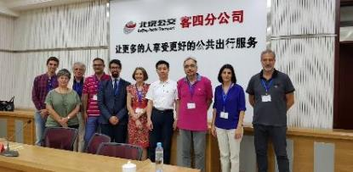
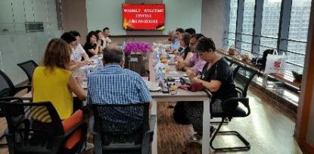
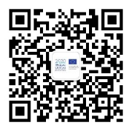
2017/2018 CROSS-FERTILIZATION ACTIVITIES
2017 ACTIVITIES
Booth at ITB China (10-12 May, Shanghai)
Deliverable “Mobility Implications for European Cities of Receiving Chinese Outbound Tourists”
2018 ACTIVITIES
1 day Mid-term Workshop in Beijing 6 people (1 per city), 22-June
right after the celebration of the 2018 World Transport Convention (June 18-21)
Audience: cities, mobility stakeholders, universities
5 Chinese journalists
    Visit Beijing + Shenzhen, 25-29 June
    Development of a WeChat DESTINATIONS’ Dissemination Tool (WCDDT)
    Link with URBAN-EU-CHINA http://www.urban-eu-china.eu/en/ (DG RTD)
CIVITAS FORUM 2018• 21-September 2018• Umea, Sweden
Notes:
How are all demo WP leaders approaching/ what progress made re x.1 cross site coordination and x.2 task measure design.

Slide 8
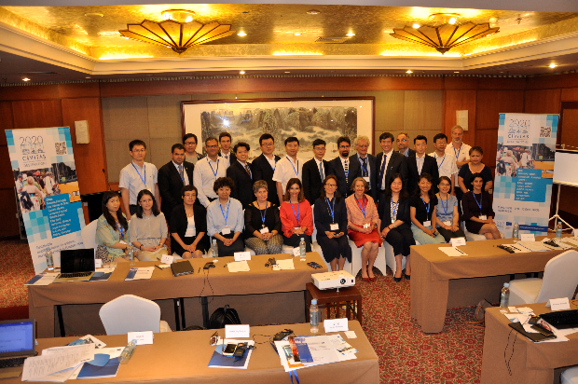
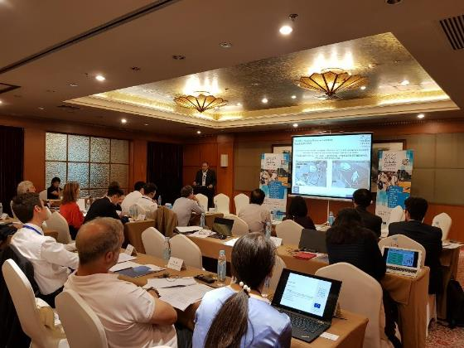
22-JUNE-2018 BEIJING WORKSHOP
SESSIONS
  Mobility Management And Transport Planning Measures In Tourist Destinations
  Alternative Energy Vehicles ENGLISH + MANDARIN
  Mobility Sharing
  Mobile Apps & Integrated Mobile Payment Solutions
  SMART Urban Transportation Management
CIVITAS FORUM 2018• 21-September 2018• Umea, Sweden
Notes:
How are all demo WP leaders approaching/ what progress made re x.1 cross site coordination and x.2 task measure design.

Slide 9
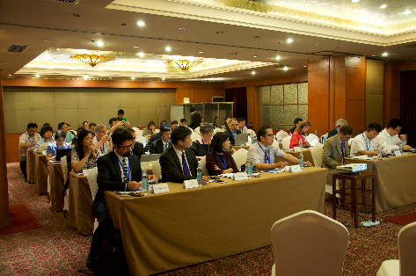
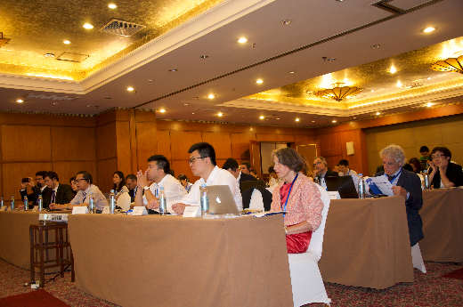
22-JUNE-2018 BEIJING WORKSHOP
PARTICIPANTS
  GOVERNMENTS
    Institute of Comprehensive Transportation of the NDRC
    China Ministry of Transport
    Shenzhen Urban Transport Planning Center
  UNIVERSITIES / RESEARCH INSTITUTIONS
    BJUT - has no financing
    China Academy of Sciences (CAS)
    China Academy of Urban Planning & Design (CAUPD)
    China Center For Urban Development (CCUD)
  INNOVATIVE COMPANIES
    BESTPAY + CTS, CIT
    BYD + SINOLGIS NOT EASY TO ATTRACT THEM !
    DIDI CHUXING
    FOTON
    Founder International (BU)
    HUAWEI
    INSPUR + 5 Media
    Keanda
    Lakala Payment
    MOBIKE
    POTEVIO
    SHENZHEN METRO
    Zhongtong Bus
CIVITAS FORUM 2018• 21-September 2018• Umea, Sweden
Notes:
How are all demo WP leaders approaching/ what progress made re x.1 cross site coordination and x.2 task measure design.

Slide 10
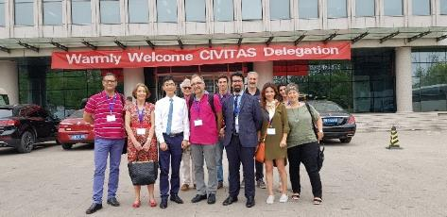
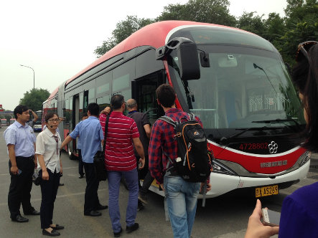
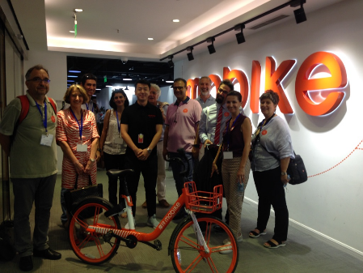
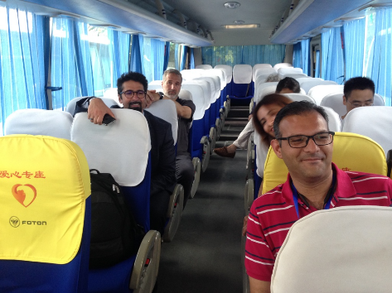
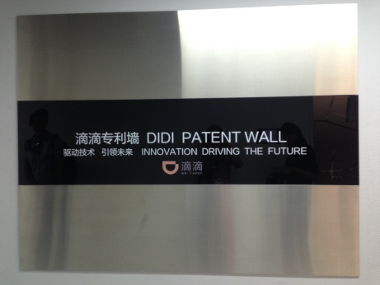
ON-SITE VISITS
BEIJING
  Beijing Bus Group MOBIKE
  FOTON EV Unit DIDI CHUXING
Notes:
How are all demo WP leaders approaching/ what progress made re x.1 cross site coordination and x.2 task measure design.

Slide 11
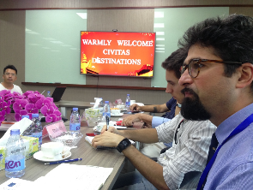
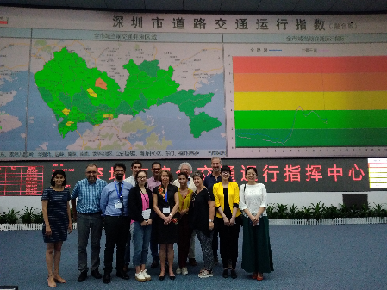
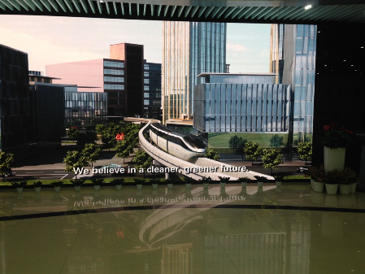
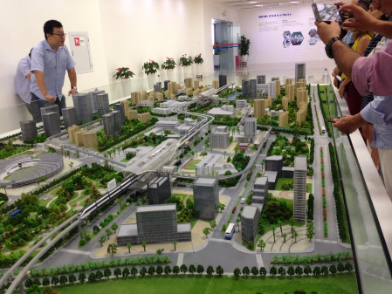
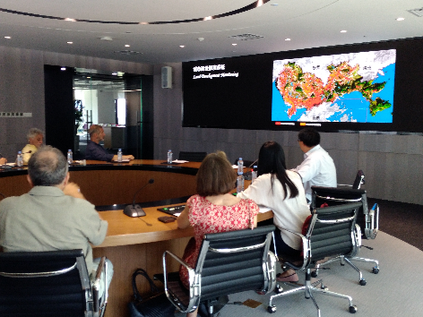
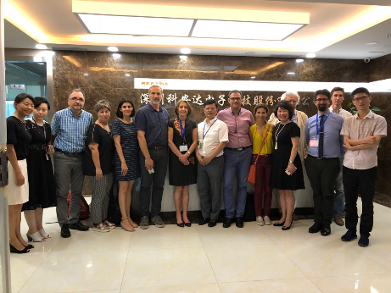
ON-SITE VISITS
SHENZHEN (1)
  Shenzhen Transport Bureau BYD
  SZ Urban Transport Planning Center’s Lab Keanda
Notes:
How are all demo WP leaders approaching/ what progress made re x.1 cross site coordination and x.2 task measure design.

Slide 12
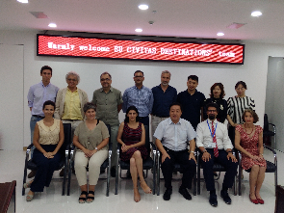
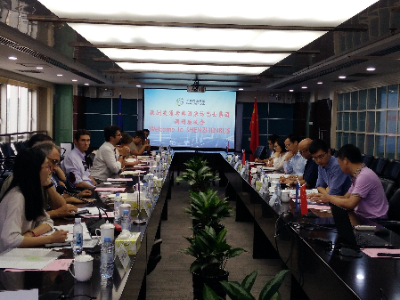
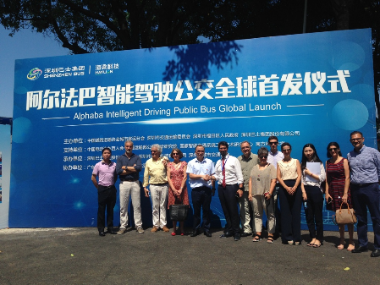
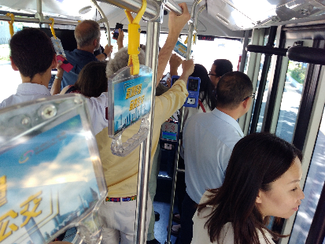
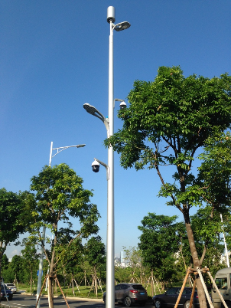
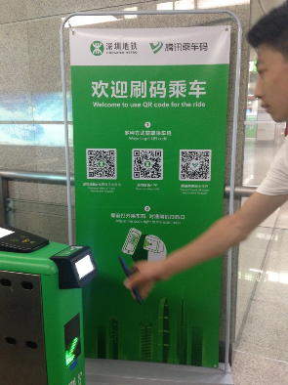
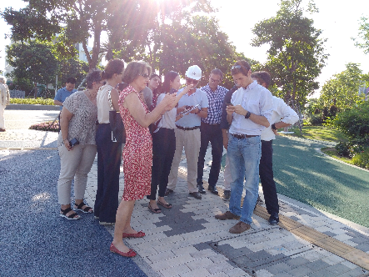
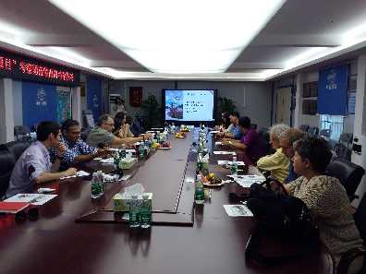
ON-SITE VISITS
SHENZHEN (2)
  Shenzhen Bus Group
  Shenzhen Metro
  Golden Road Traffic Technology
Notes:
How are all demo WP leaders approaching/ what progress made re x.1 cross site coordination and x.2 task measure design.

Slide 13
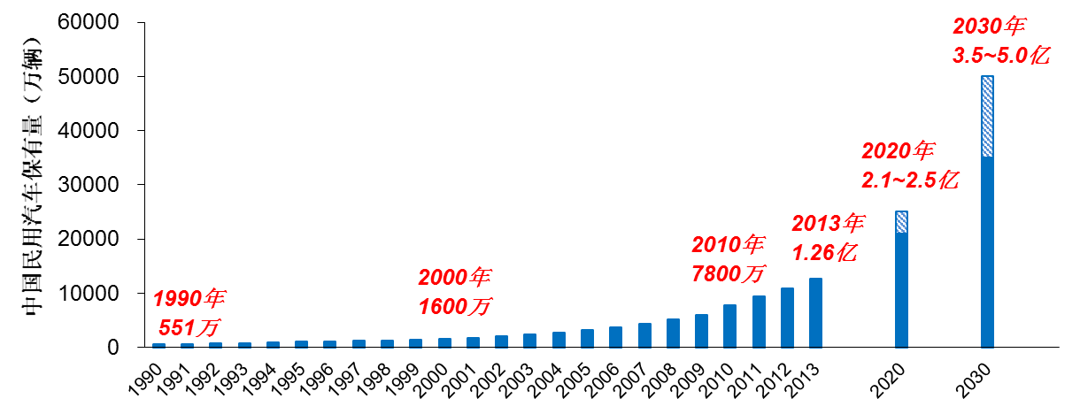
TRANSPORT facts CHINA - Transport
The number of vehicles in China is around 304m,in which automobile is around 205m(253m in US).It will reach 350m to 500m by 2030
CIVITAS FORUM 2018• 21-September 2018• Umea, Sweden

Slide 14
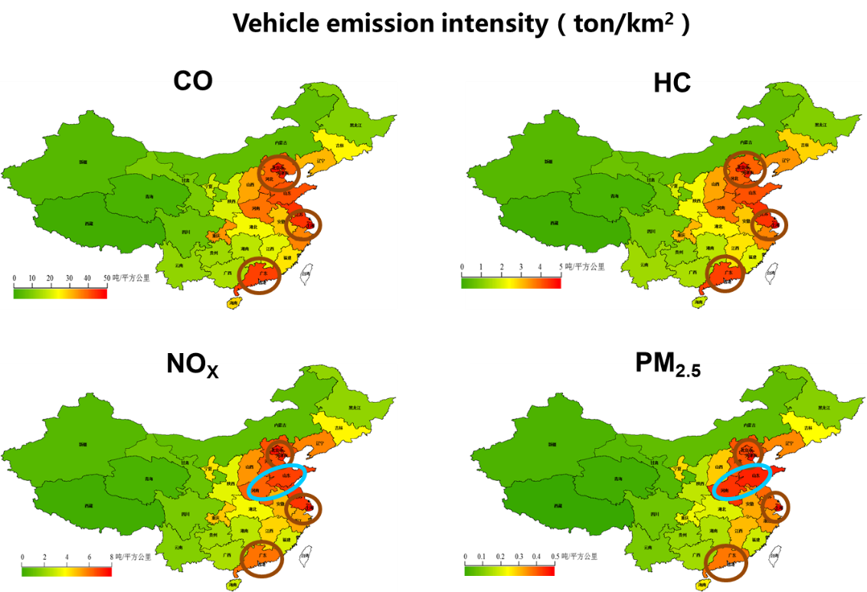
TRANSPORT facts CHINA - Emissions
CIVITAS FORUM 2018• 21-September 2018• Umea, Sweden

Slide 15
COOPERATION in TRANSPORT EU/CHINA
Connectivity Platform between EU and China (September 2015)
  Promote seamless transport connections and transport facilitation,
  Synergize related policies and projects
  Create cooperation opportunities for Chinese and European enterprises
  Transparent environment and a level playing field for investment in transport and other fields
  EU-China Connectivity Platform Short-Term Action Plan (july 2018)
  Cooperation on the main infrastrucutural projects China’s Belt and TEN-T
  Infrastructure standardization
  Specific workplan on specific plans.
CIVITAS FORUM 2018• 21-September 2018• Umea, Sweden

Slide 16
BEST PRACTICE AND LESSONS LEARNT IN CHINA
  Soft transport modes: China country of Bikes (MOBIKE and OFO)
  Mobile Apps & Integrated Mobile Payment Solutions (ORANGE, ALIPAY..)
  New market for smart mobility and smart cities (HUAWEY and DIDI)
  Electric mobility (BYD, FOTON and Shenzhen bus company)
  Mobility and tourism a new way to see connections and acessibilities
  SMART Urban Transportation Control and Management
CIVITAS FORUM 2018• 21-September 2018• Umea, Sweden

Slide 17
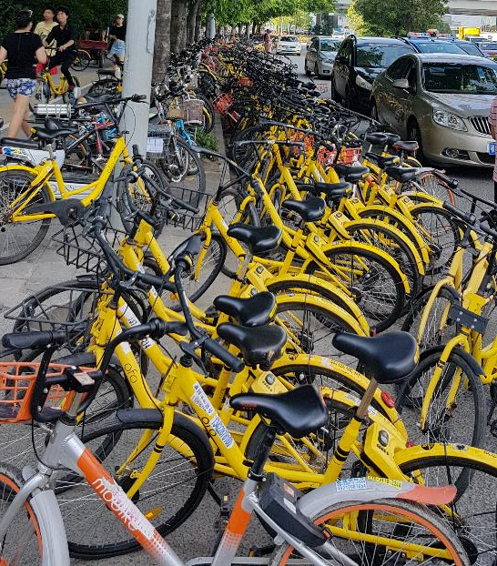
Soft transport modes: China country of Bikes (MOBIKE and OFO)
AFTER THE BOOM
The challenge of GOVERNANCE
CIVITAS FORUM 2018• 21-September 2018• Umea, Sweden

Slide 18
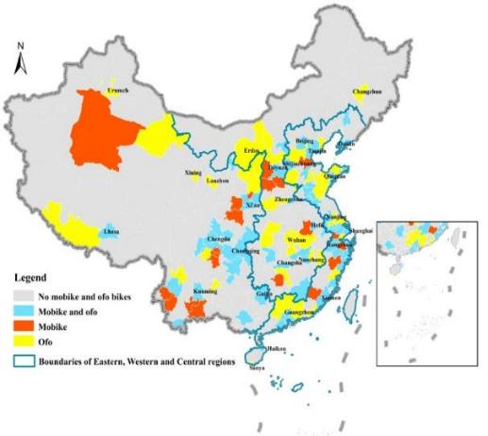
Soft transport modes: China country of Bikes
Bike sharing in China: OFO vs. MOBIKE
Currently, urban population, economic development, the number of buses are with statistical significance.
Market coverage: East > Central region > West
Frequent usage appeared，Short distance
Competition existed among apps
Various travel purpose
Young group between 18 and 25
Mid-level income
25.4%其他
Other
40.1%商圈 Commercial area
OFO in BEIJING
出行目的地
Destinations
34.5%景区
Tourist attraction
CIVITAS FORUM 2018• 21-September 2018• Umea, Sweden

Slide 19
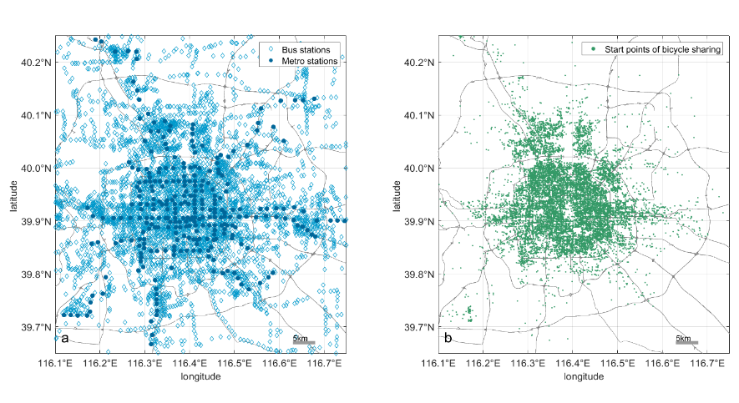
Soft transport modes: China country of Bikes
Spatial distribution: Public transportation vs. bike-sharing
Spatial patterns of metro and bus stations vs. origins of trips by ofo are highly correlated in Beijing.
Geographic distributions of access points for the public transit and shared bicycles
Travelling distance by the public transit and shared bicycles
CIVITAS FORUM 2018• 21-September 2018• Umea, Sweden

Slide 20
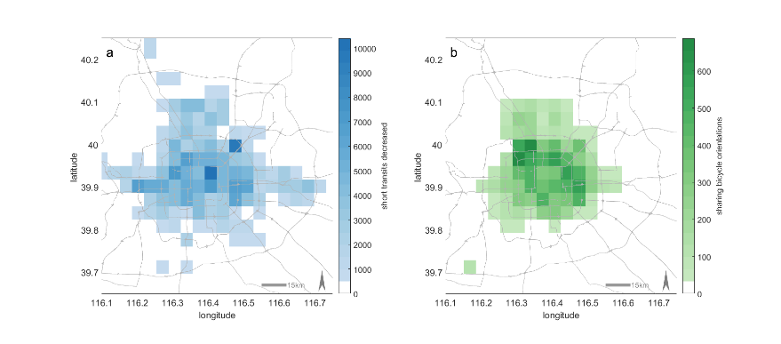
Soft transport modes: China country of Bikes
Impacts of bike-sharing system on public transportation
Spatial distribution of short transit reduction and shared bicycle usage
短途公交出行与共享单车使用的空间分布比较
Short transit decreased while overall daily transit traffic increased
总公交出行增加，但短途公交出行减少
CIVITAS FORUM 2018• 21-September 2018• Umea, Sweden

Slide 21
Soft transport modes: China country of Bikes
Rising issues in bike sharing in china
A review of the emergence, development, and consolidation of stationless e-bike-sharing systems in China.
A discussion of government-company interaction in dealing with stationless e-bike-sharing system issues.
Exploring the impacts of bike-sharing system on public transportation.
A hierarchical framework for governing stationless e-bike-sharing systems.
CIVITAS FORUM 2018• 21-September 2018• Umea, Sweden

Slide 22


深圳地铁智能化建设与运营
Shenzhen Metro Intelligent Construction & Operation
利用信息化技术优化与顾客沟通渠道
Optimize communication channels with clients with IT technology
微博 Microblog
数据量112万
Data: 1.12 million
（占日均客流量25%）
(25% of daily ridership)
APP
微信 Wechat
截至目前，自媒体终端用户数据总量373万，占日均客流量83%。
So far, i-Media data of 3.73 million, 83% of daily ridership
顾客沟通
Commu-nication
数据量149万
Data: 1.49 million
（占日均客流量33%）
(33% of daily ridership)
数据量112万
Data: 1.12 million
（占日均客流量25%）
(25% of daily ridership)
《地铁早班车Metro Morning》
每月播出不少于22期 Over 22 broadcasts per month
各类视讯产品每月播出不少于4部
Over 4 video works shown per month
CIVITAS FORUM 2018• 21-September 2018• Umea, Sweden

Slide 23
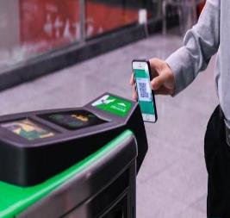

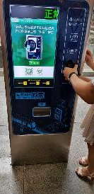
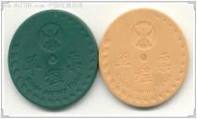
Shenzhen Metro Intelligent AFC and Mobile Payment
AFC信息化历程 IT Progress of AFC
2018.7
2018.5
NFC、金融IC卡乘车 Take train with NFC, Banking IC Card
2015.12
APP乘车码直接乘车
Take train with APP ticketing code
APP网上购票，现场取票
Buy tickets online via APP and take them on site
2004-2015
深圳地铁为国内首个全面使用接触IC卡
First company applying IC card
CIVITAS FORUM 2018• 21-September 2018• Umea, Sweden

Slide 24
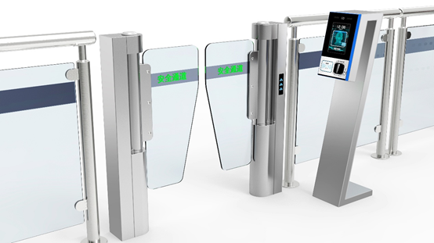
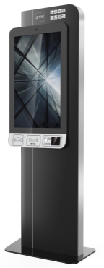
Shenzhen Metro Intelligent AFC and Mobile Payment
近期目标 Short-term Target
人脸识别智能边门
Intelligent Face-recognition Entrance
配置人脸识别、身份证读取模块，提供自助票务业务处理。Equipped with face recognition, ID card reading module, provide self-service ticket business.
智能票亭
Smart Ticketing Booth
From Metro Operator to Data Operator
CIVITAS FORUM 2018• 21-September 2018• Umea, Sweden

Slide 25
New market for smart mobility and smart cities
Huawei case study – Smart mobility in smart city
Continuous and huge R&D investments account for 10%–14% of the company‘s total revenue every year.
Intelligent Opearation center and Politic Dashboard
CIVITAS FORUM 2018• 21-September 2018• Umea, Sweden

Slide 26
New market for smart mobility and smart cities
DIDI and Technology driving evolution
CIVITAS FORUM 2018• 21-September 2018• Umea, Sweden

Slide 27
New market for smart mobility and smart cities
DIDI and smart mobility and Technology driving evolution
CIVITAS FORUM 2018• 21-September 2018• Umea, Sweden

Slide 28
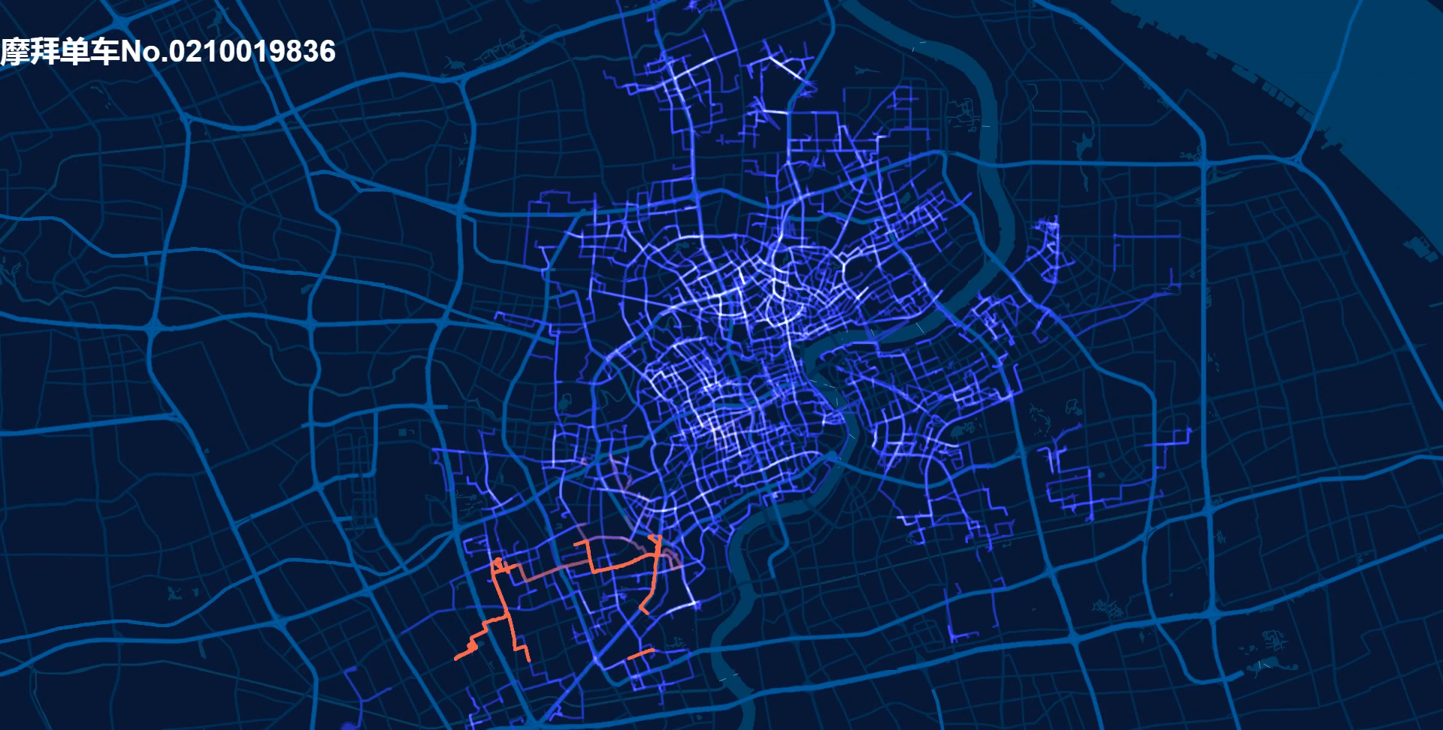
New market for smart mobility and smart cities
MAGIC CUBE and new fronteers of BIKE SHARING
The first 365 days of our first bike’s life
Unlocked by 1,975 different users
Ridden 2,021 times
Travelled over 4,850km
CIVITAS FORUM 2018• 21-September 2018• Umea, Sweden

Slide 29
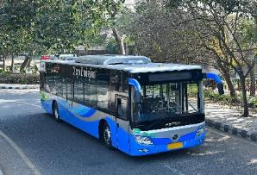











ELECTRIC MOBILITY - BYD and FOTON at a glance
The footprints of our pure electrics buses in EU :
61 cities in 21 EU countries
FOTON
2017
/ 07
BYD Electric Taxi Sales Volume up to end of 2017:
86,869 units (46,203 e6+40,666 e5)
86,869辆（其中e6占46,203辆，e5占40,666辆）
BYD has delivered over 35,000 electric buses worldwide
AUV electric buses have completed product certificate, implementing knock-down and production on the overseas market.
FMG
Passenger car
Taxi
City bus
Coach
+
Mining sites
Airports
Logistics
Sanitation
Construction
Harbors
Warehouses
7 Vehicles to be Electrified
4 Special Fields
CIVITAS FORUM 2018• 21-September 2018• Umea, Sweden

Slide 30
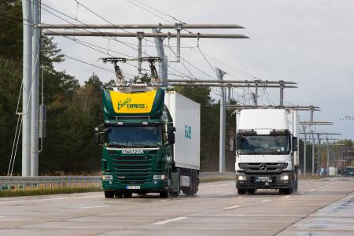
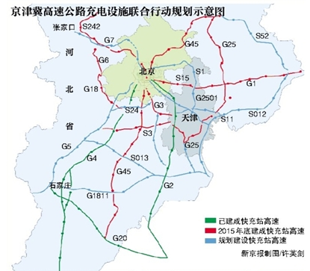
ELECTRIC MOBILITY – City logistic
Dual subsidies from central and local government
Policy to give better traffic rights for new energy cars needs to be developed in local areas.
Establish integrated charging service network in city clusters
Build road exclusive for electrical and gas vehicle
CIVITAS FORUM 2018• 21-September 2018• Umea, Sweden
Notes:
2015年7月，http://tech.ifeng.com/a/20150731/41407372_0.shtml
京津冀新能源小客车充电设施协同建设联合行动计划，2015-2020年规划
2015年12月，国家电网 http://news.mydrivers.com/1/461/461996.htm
七纵是指沈海、京沪、京台、大广、京港澳、二广、包茂高速；四横是指青银、连霍、沪蓉、沪昆高速；两网格是指京津冀鲁网格和长三角网格

Slide 31



ELECTRIC MOBILITY – Best practice of Shenzhen bus company
1. National and local subsidies
2. Leases to reduce upfront investments
3. Optimized charging and operation
4. Lifetime warranty of batteries
CIVITAS FORUM 2018• 21-September 2018• Umea, Sweden

Slide 32

Mobility and tourism means to boost local economies
Tourist traffic lines are important products
The sustainable mobility options can smartly and efficiently extend visitors' stay.
Systematical and smart design of the tourism traffic line will enable high quality touring experiences in sightseeing, accessibility, interactivity, entertainment and immersion into local culture and history.
CIVITAS FORUM 2018• 21-September 2018• Umea, Sweden

Slide 33

Mobility and tourism means to boost local economies
Local cultural resources are the most crucial elements for tourism destination. The geo-culture of the destination is based on the formation rules of “cultural zone”, “cultural circle” and “cultural cluster”.
Tourism traffic lines design based on "cultural belt", "Cultural circle" can be more complete to show the cultural characteristics of the destination.
CIVITAS FORUM 2018• 21-September 2018• Umea, Sweden

Slide 34



Mobility and tourism means to boost local economies
PAYMENT TECHNOLOGIES and tourism opportunities
Mobile payment + urban tourism travel business big data smart operation platform
The front end through the mobile payment entrance will make the transaction behavior of consumers and merchants data, making the traditional city travel business precipitation data, accumulating credit, and commercially high data.
          The back end analyzes and processes large data, and realizes "speaking with data, making decisions based on data, acting on data".
CIVITAS FORUM 2018• 21-September 2018• Umea, Sweden

Slide 35
SMART Urban Transportation Control and Management
Big data and inteligent traffic planning and control in Shenzhen
Complete data set
  Statistical data
  Operational data
    Transit inforamation and boarding passenger information
    Curb side real time parking monitoring
  Mobile data
    Activity data
  GPS data
    from táxi and comercial vehicles and BAIDU LOCATION
    MOBILITY DATA with TENCENT partnership
CIVITAS FORUM 2018• 21-September 2018• Umea, Sweden

Slide 36
SMART Urban Transportation Control and Management
Big data and inteligent traffic planning and control in Shenzhen
Zonal Real-Time Traffic Management Strategies Based on Traffic Flow Back-Tracing Model
CIVITAS FORUM 2018• 21-September 2018• Umea, Sweden

Slide 37
SMART Urban Transportation Control and Management
Big data and inteligent traffic planning and control in Shenzhen
Technical law-Enforcement for Illegal Parking
CIVITAS FORUM 2018• 21-September 2018• Umea, Sweden

Slide 38

Big data and inteligent traffic planning and control in Shenzhen
From 2015, car-hailing platforms were growing very fast, causing 30% drops of taxi passenger miles
Emission Trade. through calculating the vehicle energy consumption and emissions from freight companies and bus companies, it provides key element for engaging carbon emissions trade
CIVITAS FORUM 2018• 21-September 2018• Umea, Sweden

Slide 39
THE WAY AHEAD
2019 & 2020 ACTIVITIES
    2019 ACTIVITIES
      Booth at Intertraffic China in Beijing
      A Chinese delegation will visit Funchal, and Las Palmas
    2020 ACTIVITIES
      Will invite Chinese experts and professionals to join our European Final Conference
      Deliverable: “Best Practices in Urban Mobility Measures used for Tourism Mobility in Chinese Cities”
    FROM 2018 TO 2020
    for dissemination and cross-fertilization purposes
      Continue using our WeChat DESTINATIONS’ Dissemination Tool
      Follow-up of opportunities arising from our cross-fertilization with China
      Link with URBAN-EU-CHINA http://www.urban-eu-china.eu/en/ (DG RTD)
Notes:
How are all demo WP leaders approaching/ what progress made re x.1 cross site coordination and x.2 task measure design.

Slide 40
THE WAY AHEAD
CHALLENGES AND OPPORTUNITIES
    CHALLENGES / BARRIERS
    Language communication
    Chinese business culture
    Keep Chinese stakeholders interested in DESTINATIONS
    DESTINATIONS’ cross-fertilization scope = Timing & Budget limitations
    OPPORTUNITIES
    Some Chinese stakeholders already expressed an interest in joining the 2019 delegation to visit Funchal & Las Palmas
    Shenzhen Bus Group has also expressed an interest in visiting the other 4 DESTINATIONS sites
    BYD / Foton E-buses very interesting for DESTINATIONS cities
    Cooperation with DIDI / use of QR codes very useful to attract Chinese tourists
    Will bring Chinese experts and professionals to DESTINATIONS Final Conference in Europe
    Our deliverable “Best Practices in Urban Mobility Measures used for Tourism Mobility in Chinese Cities” will be useful for all European cities
Notes:
How are all demo WP leaders approaching/ what progress made re x.1 cross site coordination and x.2 task measure design.

Slide 41

THANK YOU
谢谢大家!

