Slide 1
VOLTIA
eFleet Advisory Deployment Plan
Switching Conventionally Fueled LCV Fleets to Electric - NOW
Notes:
Movie: https://www.youtube.com/watch?v=dWfsC-fmm-0
Audience questions RE: interest in going electric:
Your main obstacles?
How many vehicles?
Cost/timeline?

Slide 2
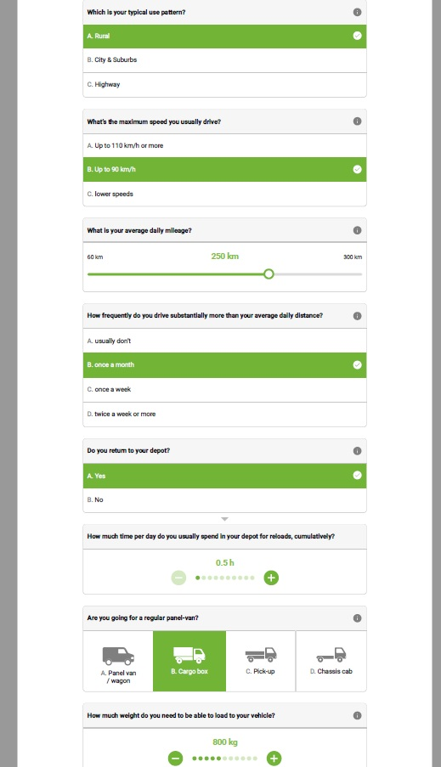
Online eFleet Suitability
Assessment
Easy to use
Do it yourself
Free
No Commitment
No Risk
First Step
Market Knowledge
Notes:
https://voltia.com/en/decisiontool#/

Slide 3
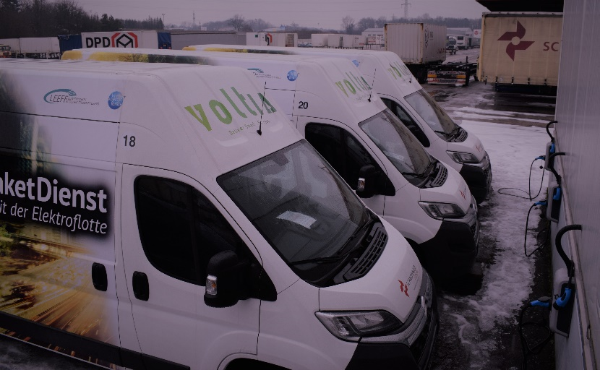
eFleet Advisory Deployment Plan - How?
Interviews with:
Fleet managers
Drivers
Operations
Finance
Leadership
Data on driving patterns & needs:
Operational objectives
Operational needs (size, range, payload)
Routes
Times
Patterns (i.e., stops, downtime)
Analysis of:
Depot/parking
Charging opportunities
Financial situation

Slide 4
Current situation
Analysis
Solution
Voltia Deployment Plan Sample Analysis- BATTERY RANGE
TF Logistics routes distribution per average daily mileage (a histogram):v
Full size 3.5t van 60 kWh
MAXI Voltia
VW e-load UP fit
EV models with best fit
km /day
OPPORTUNITY WINDOW
Little fuel savings & impact; TCO & economics not sound
Increasingly complex re-charging solutions;
too-frequent charging
Affordable EVs
Medium impact
& fuel savings
High-end EVs
optimized electric TCO
high impact & fuel savings

Slide 5
THANK YOU
Voltia.com
Aaron Fishbone
Aaron.fishbone@voltia.com
We want to help covert diesel fleets to electric, so please don’t hesitate to contact us

