Slide 1
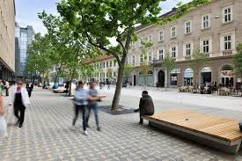

SHARED SPACE
&
VISUALLY IMPAIRED PERSONS
Fahad Anwar, PhD candidate , DICATAM,
UNIVERSITA DEGLI STUDI DI BRESCIA,
SESSION: URBAN ROAD SAFETY MANAGEMENT: A SHARED RESPONSIBILITY

Slide 2
Overview
INTRODUCTION
PREPARATION
VISUAL IMPAIRMENTS
SHARED SPACE
FIELD WORK
OBSERVATIONS
CONCLUSION

Slide 3
Introduction
Motivation and importance
-Ignored topic
-Controversial
Functioning of shared space

Slide 4
Preparation
Understanding the problem through the user/expert field visit.
The understanding of a design.
Visual impairments
The concept of the shared space.
Theory versus reality and implementation

Slide 5
Hans Monderman
“A wide road with a lot of signs is… saying, go ahead, don’t worry, go as fast as you want, there’s no need to pay attention to your surroundings. And that’s a very dangerous message.”(Hans Monderman. )

Slide 6
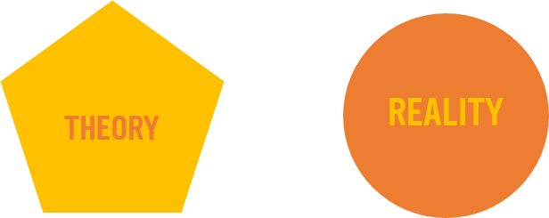
Theory versus reality
Shared space relies on people behaving considerately all the time, but this is not the reality. Even Monderman himself conceded that road design can only do so much; he said (in Lyall 2005) shared space does not change the behaviour of the 15% of drivers who will behave badly no matter what the rules are.

Slide 7

Visual impairments
An estimated 253 million people live with vision impairment: 36 million are blind and 217 million have moderate to severe vision impairment .
81% of people who are blind or have moderate or severe vision impairment are aged 50 years and above .
(WHO)
.

Slide 8

Research Questions
How does shared space works for visually impaired persons?

Slide 9

Shared space
Shared space is an urban design and traffic engineering concept that integrates Pedestrian, vehicles and other road users through the removal of traditional street.
Elements such as signs, traffic lights, pedestrian barriers, road markings and kerbs
(Shared Space 2005).

Slide 10
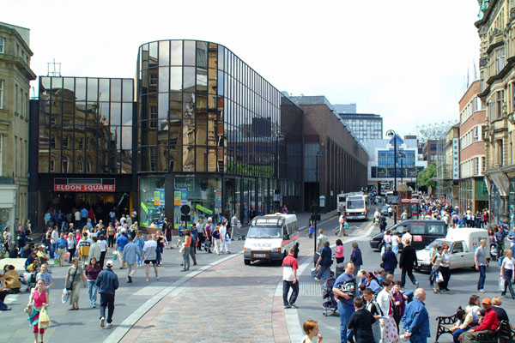
Brighton, United Kingdom
Blackett Street, Grainger Town,
Newcastle upon-Tyne

Slide 11
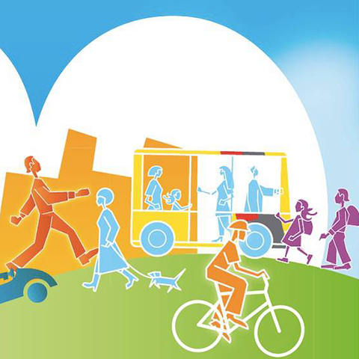
Advantages
Pedestrian movement
Social equality
Traffic calming
Economic advantages
Environmental advantages

Slide 12

Disadvantages
Safety concerns

Slide 13
Research Approach
Identification of users and space.
Individual visit.
user/expert analysis.

Slide 14
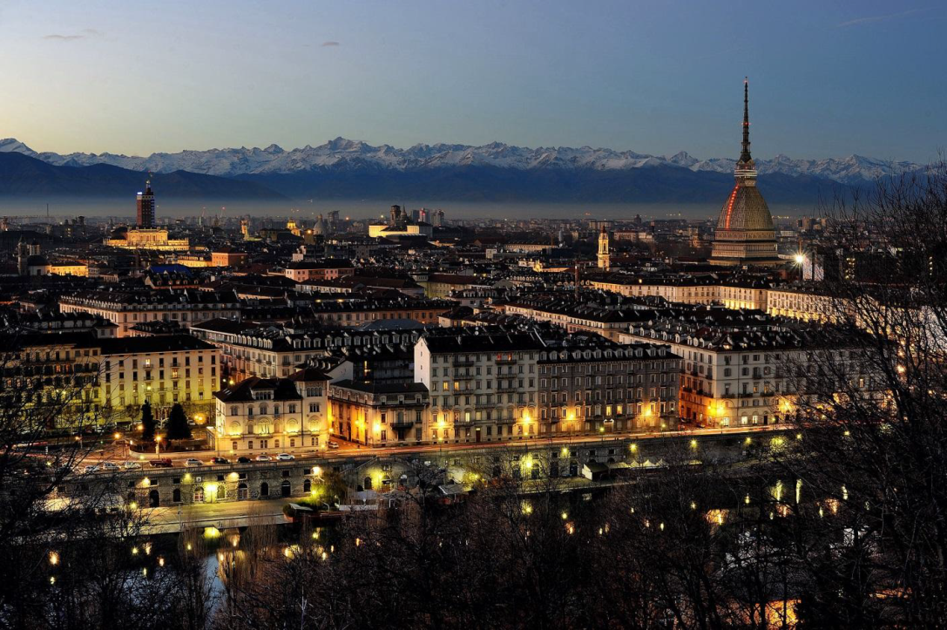
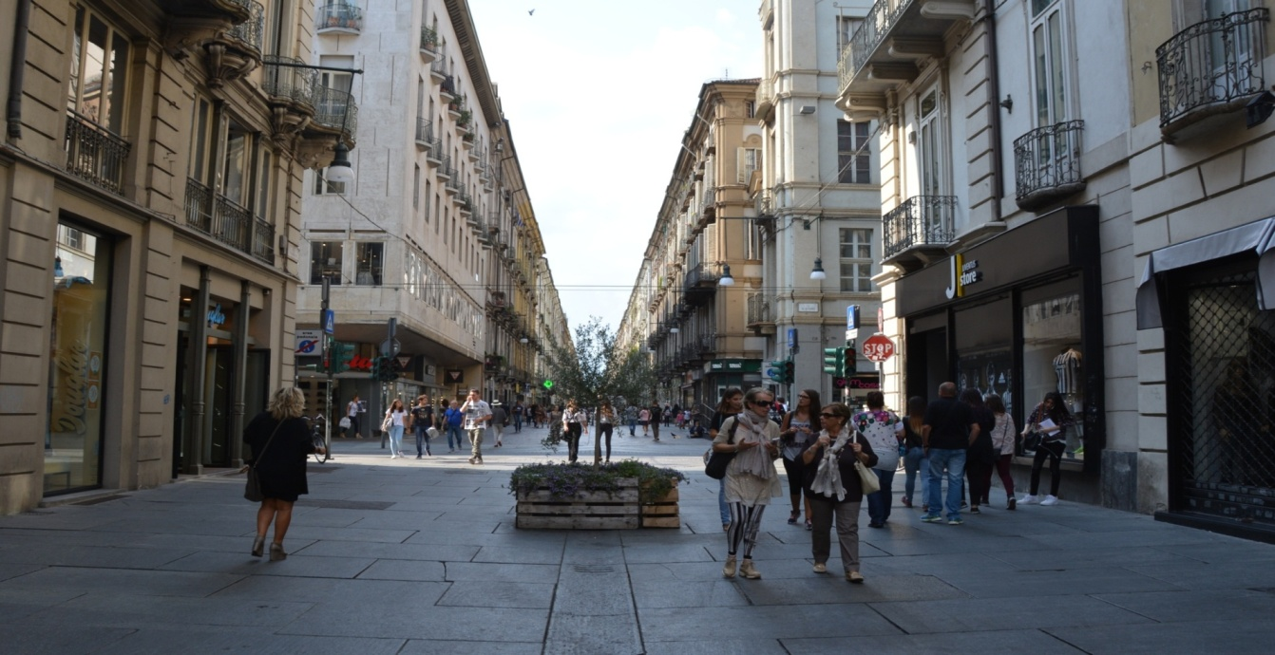
Via Garibaldi, TURIN

Slide 15
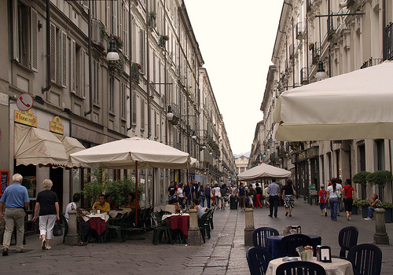
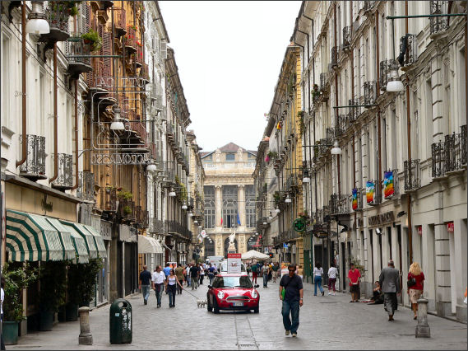
Via Garibaldi, TURIN
Via Garibaldi is an actual shared space in the heart of the city. Its very important touristic and commercial zone. Also huge number of official buildings and offices are near to it which makes it very important. It joins two of the most important piazzas of the city. It has different flow of traffic at different times of the day which makes it more interesting.

Slide 16
User/expert Analysis
In the user/expert analysis the expert users are involved who can give you the best feed back as they are the experts and can point out the things that other normal users can not.

Slide 17
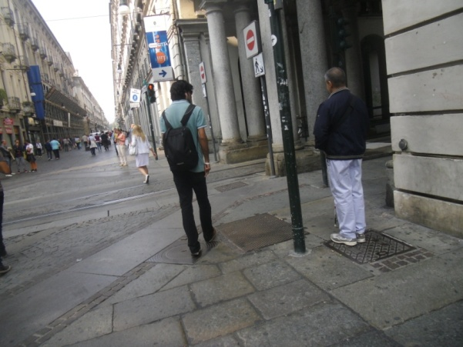
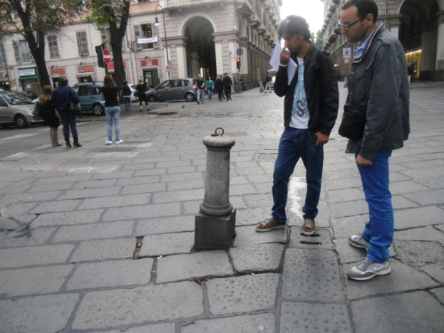
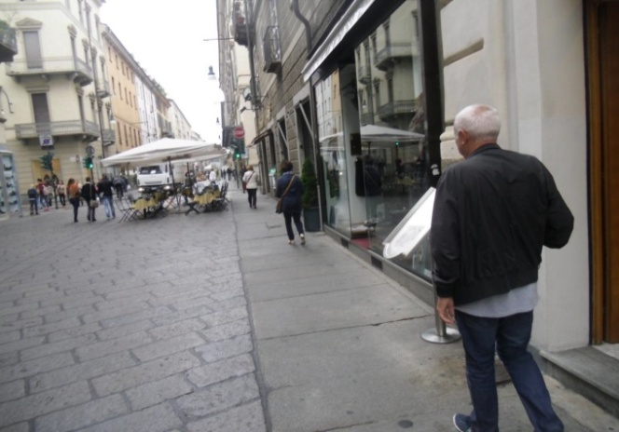
User/expert Analysis

Slide 18
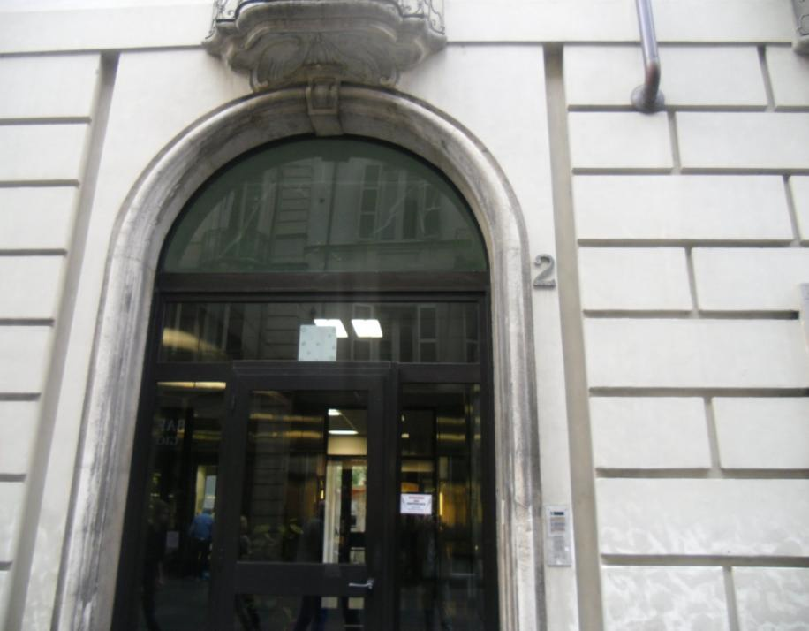
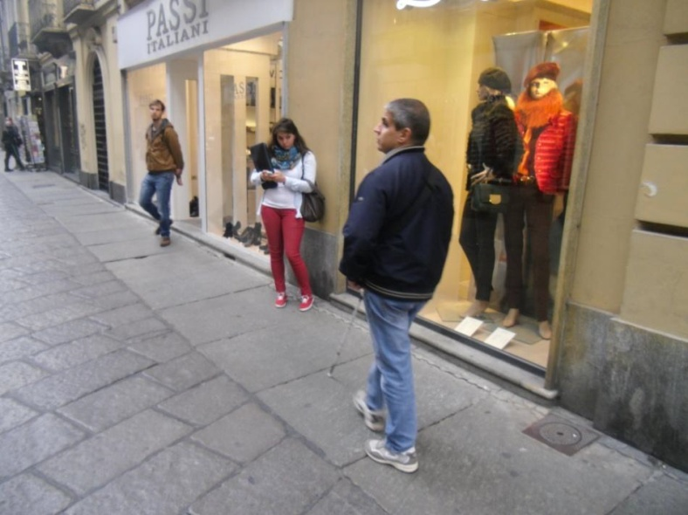
Methodology
Pictures
Interviews
Making notes
Videos

Slide 19
Observations
COMMONALITIES IN BOTH VISITS SIGN BOARDS OBSTACLES REFERENCE SOUND TRAFFIC SIGNALS WALKING STRATEGY | DIFFERENCES PEOPLE BICYCLES PEOPLE SELLING STUFF CARS | 1ST VISIT _At 2pm it was just after lunch time so the street was not so full people. _More bicycles just after lunch time . _Around lunch time less people selling stuff _Almost no cars at 2pm. | 2ND VISIT At 10am it was less crowded as people were busy in work. _Less bicycles during the morning. _More people on the street to sell things during morning. _ A lot of transport vehicles as It was morning time.

Slide 20
Suggestions
Warning strip
The visually impaired persons suggested that the street lacked tactile pavements which was very necessary. My idea is to use a small strip which would give the concept of safe space.
This strip will be very small just for the visually impaired persons as a warning sign .
Shared space and safe space
The Safe Space would be seen as the equivalent of the footway in a traditional street but it would not prevent motorists, cyclists and pedestrians from sharing the larger part of the street area - the shared space – where they are confident about doing so .

Slide 21
Suggestions
Parking for cars and bicycles
The best solution would be to make a bicycle path by different color in the middle of the street. There obviously would still be people walking on it but not so much . This psychological segregation will be helpful for both bikers and pedestrians
As there are no bike stands so I suggest the induction of stands next to the bikes lane along with the benches
Acoustic traffic signals
The Audio Tactile Pedestrian Detector has a vibrating button which emits both
audio and tactile signals indicating that the green man signal is lit and that it is
therefore safe to cross the road.

Slide 22
Suggestions
Non visual landmarks
The introduction of small water bodies and greenery can be used as non-visual landmarks by the visually impaired persons . The smell of water and plants can be used as an indication of a safety zone.
Color contrast
To illuminate the area under all circumstances and to avoid light pollution, the choice of the light source, the light color, the type of lighting columns and their positioning has to be consistent and conscious

Slide 23
Conclusion
By reintroducing this element of risk, existing shared spaces have exhibited many health and safety, environmental, economic and sociocultural benefits. Concerns have been raised
about its negative impacts on more vulnerable road users, but I believe these can be
overcome with planning and meaningful consultation and collaboration with those
groups (especially the blind and partially sighted) that could be negatively affected.
There are many more issues that need to be addressed - from modifying official
guidelines and legislation to educating people about the shared space concept. But
with creativity and determination, solutions to these problems can be found.

Slide 24
Thank you!
Fahad Anwar, PhD candidate , DICATAM,
UNIVERSITA DEGLI STUDI DI BRESCIA,
Ph# +39 0303711264
Mob# +39 3347856583
skype: fahad_leone
email: f.anwar@unibs.it
https://www.unibs.it/

