Slide 1
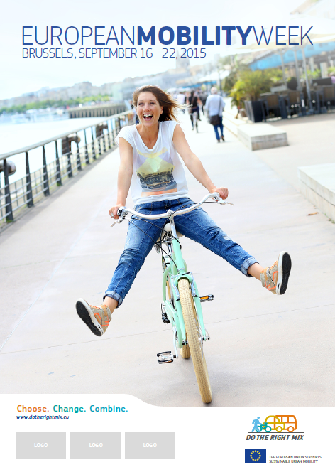





What is it about?
A week-long campaign in European towns and cities concluding with 'In Town without My Car' day on September 22
Encourages a modal shift from private car use to more sustainable/active modes of transport (i.e. cycling, walking or public transport).
An opportunity to experiment, e.g. with reduced speed or traffic zones
An occasion to launch permanent measures regarding safe routes to school

Slide 2
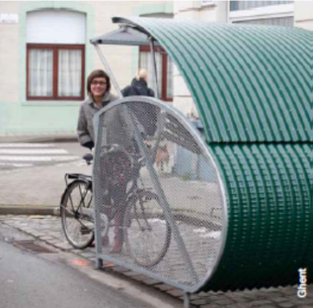
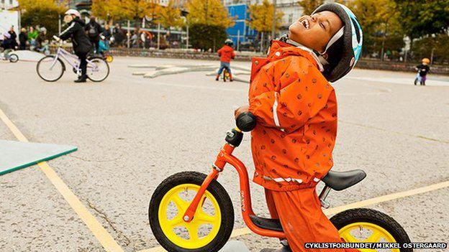
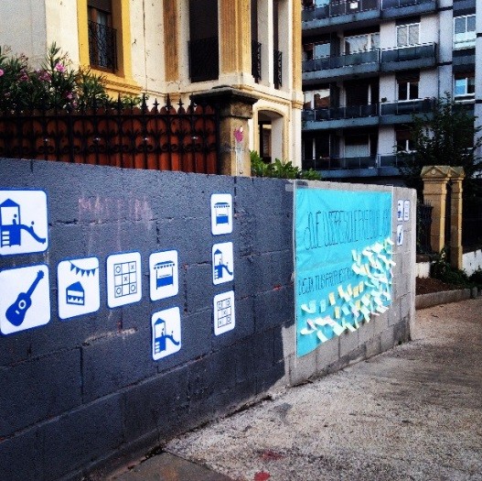
..and safe routes to school
For example, in 2015 there were:
  238 speed reduction programmes near schools;
  188 pavement enlargements;
  100 school travel plans;
  905 bike facilities; and
  321 awareness raising campaigns etc.
So! EMW is a great ‘label’ to give to such measures which only need be announced or linked to EMW (not necessarily opened or launched as such during that week).
Registration for 2016 to open in May here
The Secretariat can share details on active cities upon request
Photo credit: Josu Ateca Acebo

Slide 3
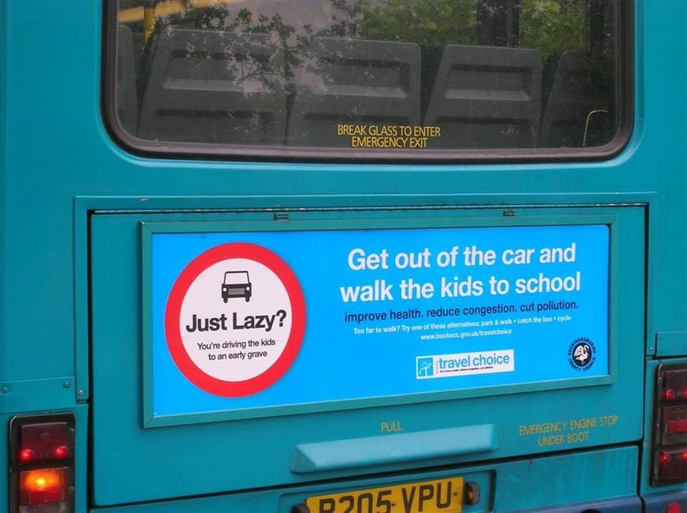
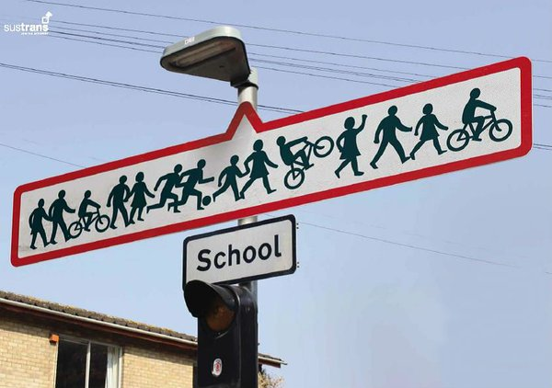

www.mobilityweek.eu
Jerome Simpson
European Secretariat
Jsimpson@rec.org

