Slide 1
FIWARE and Smart Mobility
Information for EUROCITIES

Slide 2
frontierCities:
Who We Are
Promoting the use of FIWARE technology in European Cities
Disbursing €3.9 million in grant funding
Focus on Smart Mobility Solutions
Develop and Deploy Applications for Cities
Connect Cities to Web-Developers, SMEs & Start-Ups

Slide 3
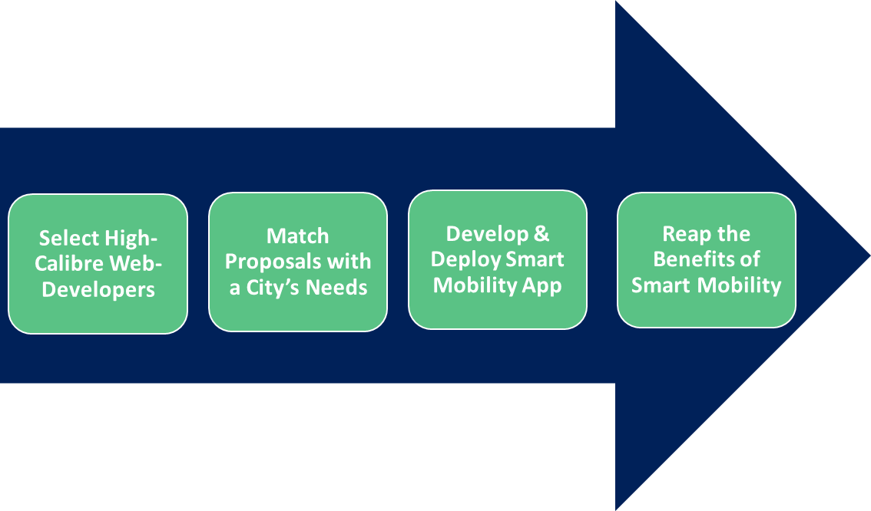
frontierCities:
How We Work
1st Step
2nd Step
3rd Step
4th Step

Slide 4
Smart Mobility Solutions in Action
Intelligent Traffic Systems – Dublin
Deploy sensors to monitor traffic movement
Data analysis then adjusts traffic lights systems
Reducing traffic congestion
Cutting commuting times
Lowering CO2 emission
Uber
Citizen selects their driver
GPS enabled technology allows you to watch the driver approach your location
GPS maps the route to your end destination
Pay via card linked to your online account
Rate your driver
Fraction of the cost of a regular taxi

Slide 5
Why frontierCities?
Needs Assessment: We assist cities identify their smart mobility needs
Partnerships: Match proposals which address a city’s specific needs
Support: We will offer business & technical support to the ensure high quality customised application development
Cost: Cities will not have to pay for the cost of the application’s development
Positive Impact: Once applications are deployed they will increase the quality of life of citizens and your city’s smart mobility performance
Profile: Showcase your city as a forward-looking actor embracing future internet technology applications.

Slide 6
Application Process
frontierCities will launch our call for proposals from applicants on November 20th with our final deadline for proposals closing on March 14th. During this period we will be seeking interested cities to participate in frontierCities. Once we have selected our grantees we will then match their proposals with interested cities.
Two-Step Application Process
Step 1
Submission Date
Jan 14th 2015
Step 2
Submission Date
March 14th 2015
Call Opens
Nov 20th 2014
Grantees to be Selected

Slide 7
Interested in Participating ?
Right now we’re preparing our launch on November 20th
In the meantime contact us and register your interest and we’ll be in touch with you!
We’ll keep you posted on upcoming events!
We will update you with the latest frontierCities developments
Contact us:
cities@fi-frontiercities.eu
Visit our website: www.fi-frontiercities.eu

Slide 8
Thank You
https://www.facebook.com/frontierCities
@frontiercities
Robbie Stakelum
projects3@frontierservices.eu
cities@fi-frontiercities.eu
+32 (0) 251 410 75

