Slide 1
Webinar
Mobility Management
Behaviour Change Theories for Cycling Promotion
13th of August 2015

Slide 2
Introduction

Slide 3
Introduction
Programme
timing | subject | speaker
15h00 | Welcome and introduction | Sarah Martens
15h10 | Behaviour Change Theories in Love To Ride | Thomas Stokell
15h40 | Q&A

Slide 4
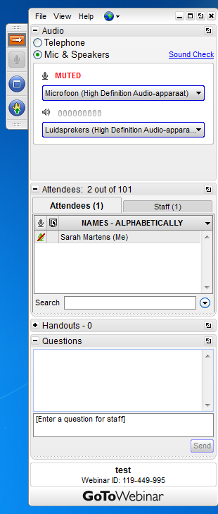
Introduction
How does GoToWebinar work?
Hide / Unhide the control panel
(Mute / Unmute yourself)
Full screen
Request to be unmuted to ask questions

Slide 5
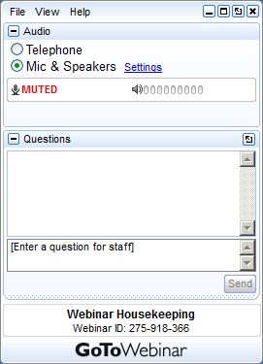
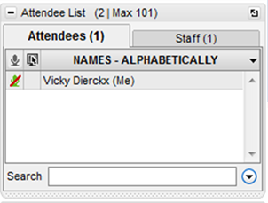
Introduction
How does GoToWebinar work?

Slide 6
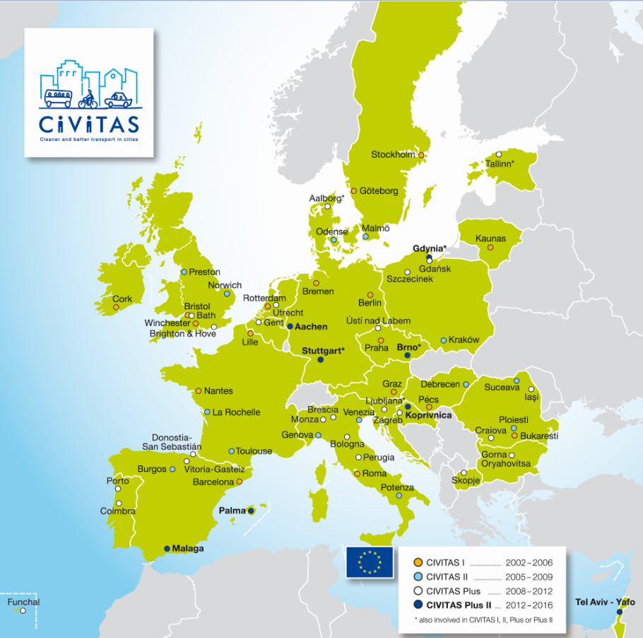
CIVITAS Demonstration cities
Notes:
The cities are spread around all the memberstates of the European Union, so cities can learn from each other

Slide 7
The CIVITAS Community
Projects:
Dyn@mo and 2Move2
WIKI and CAPITAL
CIVITAS Forum Network
CIVINET local-language networks
10 Thematic Groups

Slide 8
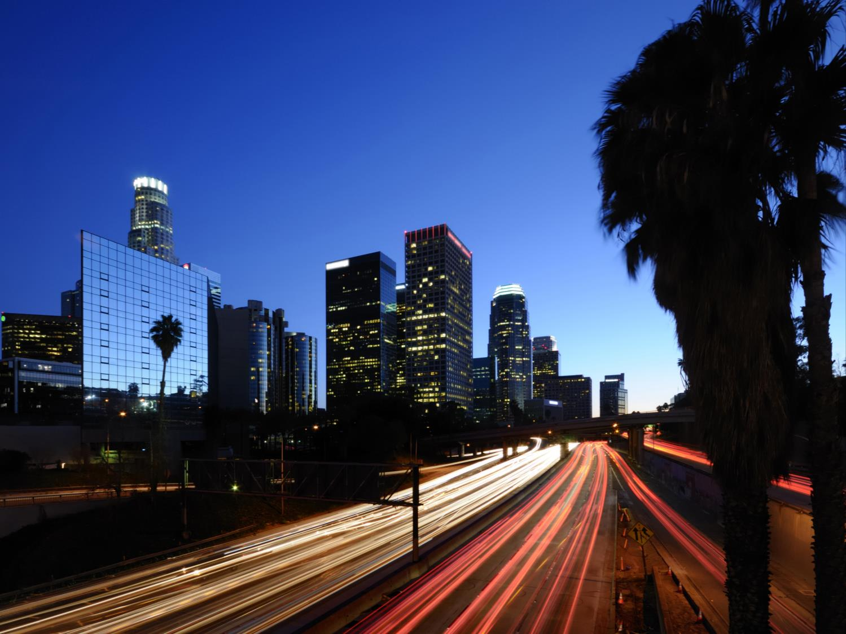
Thematic Groups
Car
Independent
Lifestyles
Safety and
Security
Integrated
Planning
Demand
Management
Strategies
Collective
Passenger
Transport
Mobility
Management
Transport
Telematics
Public
Involvement
Clean Fuels
and Vehicles
Urban Freight
Logistics
Notes:
Car independent lifestyles, Mobility Management, Demand management, Cleaner fuels and vehicles, Safety and Securite, Transport Telematics, Collective Passenger Transport, Urban Freight Logistics, Integrated Planning and Public Involvement
If interested in one of the domains you can thematic groups

Slide 9
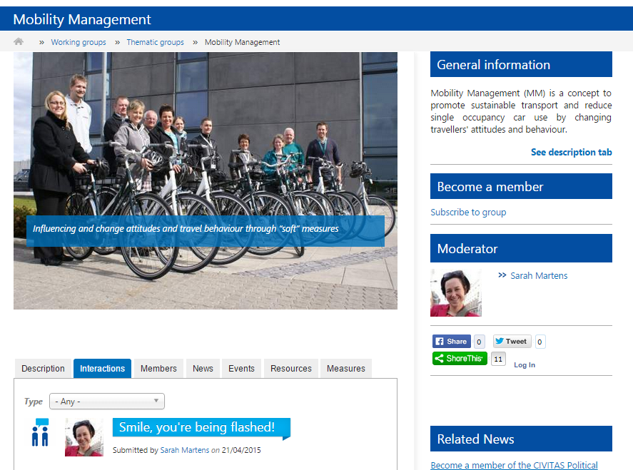
Introduction
This webinar is organised by the CIVITAS Thematic Group on Mobility Management

Slide 10
Information on TG Mobility Management
Join us!
www.civitas.eu/TG/mobility-management
Create profile and request membership
Start discussing
What theories are most effective?
What barriers do you encounter?
What kind of support do you need?
…
Send suggestions and questions to sarah.martens@mobiel21.be

Slide 11
The CIVITAS Thematic Group on Mobility Management
Questions ?
Ask questions by:
Raising your hand via the GoToWebinar Control Panel
Starting a chat in your control panel

Slide 12
How we can apply behaviour change theory to get more people riding bicycles?
Thomas Stokell -

Slide 13
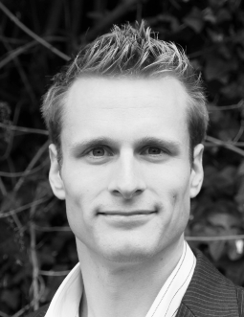
Thomas Stokell
social marketer
more than 12 years’ experience designing behaviour change programs
specifically to promote cycling.
National Bike Week in New Zealand
Love to Ride in the UK

