Slide 1
Keeping Utrecht Accessible
CIVITAS Forum
Vitoria-Gasteiz, Spain
Dominique Simhoffer, Communication Manager

Slide 2
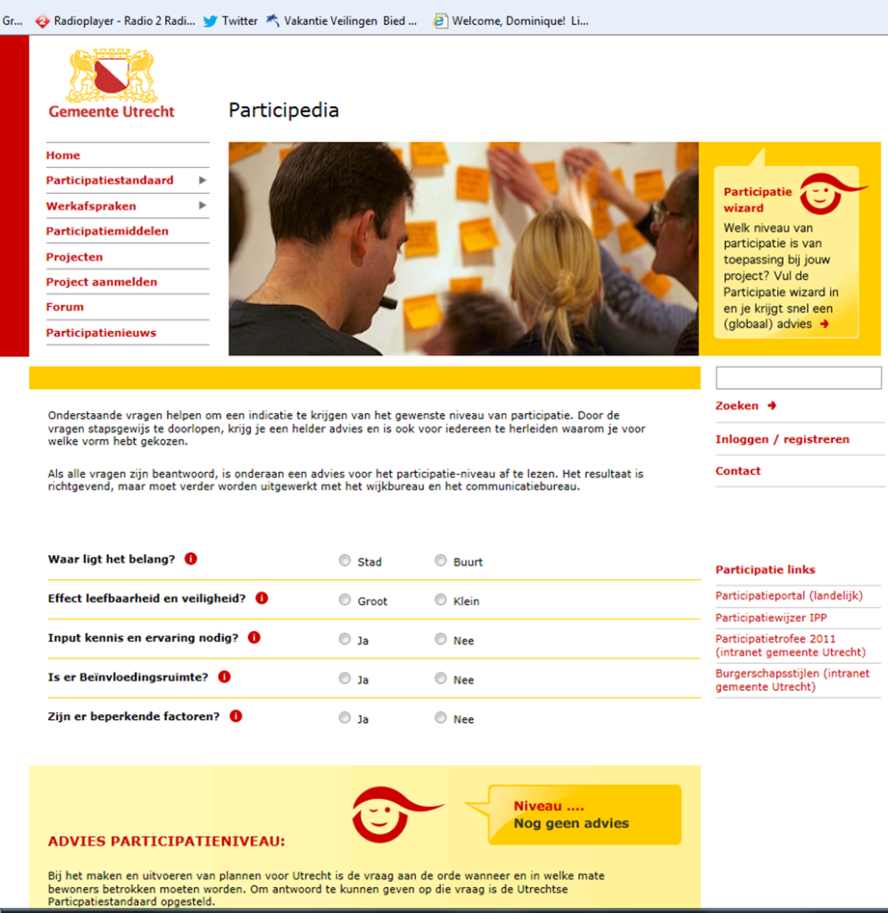
Integrated approaches to access management in Utrecht
Policy document Utrecht Attractive and Accessible 2030
Action plans for bicycles, public transport, bike and car parking, cleaner transport, cleaner freight transport, Air Quality improvement and
Mobility Management.
The Participation Standard, www.participedia.nl
Participation wizard (levels: informing, consulting, advising, co-production)
Examples; car sharing, utrecht electric, sustainable freight traffic, bicycle facilities, park and ride, environment zone, monitoring air quality, traffic management, tram, spatial planning to stimulate the desired behavior.
And Mobility Management

Slide 3
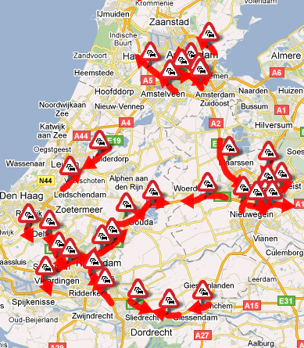
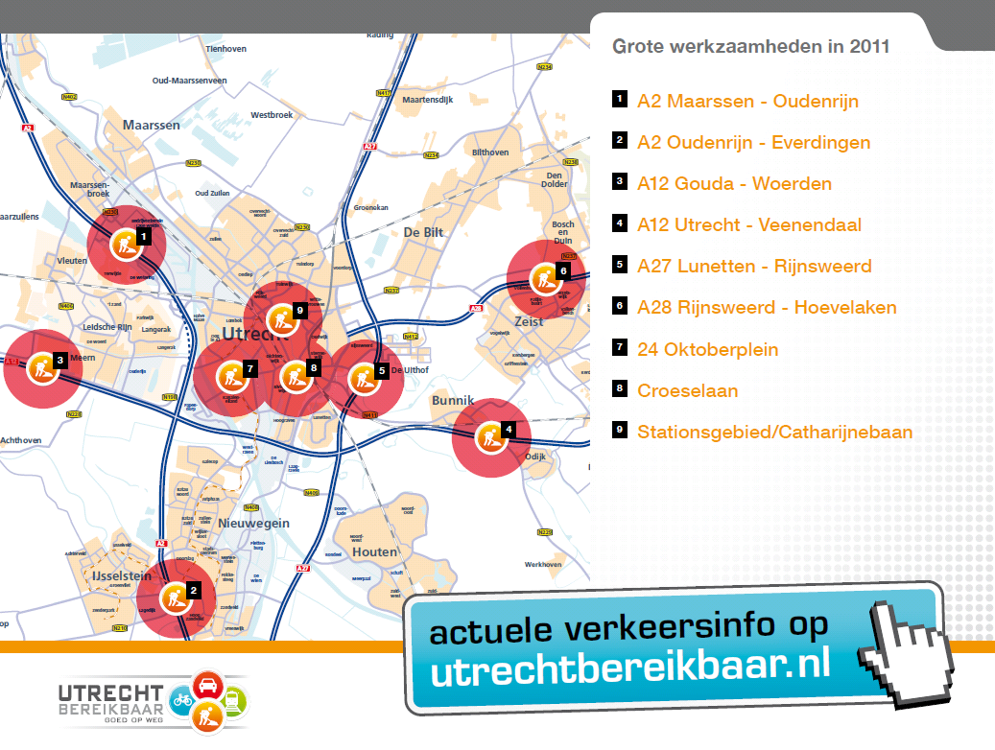
The Dutch context
16,6 million residents, 8 million cars
‘Randstad’: densely populated economic centre, with 7 million residents
4 main cities (Utrecht 315.000 citizens)
200-500 km of traffic jams each working day
Rotterdam harbor generates heavy road-borne freight.
Huge road constructions works
Utrecht counts:
316.277 citizens
168 nationalities
228.359 jobs
135.617 homes
149.410 trees
321 restaurants

Slide 4
Utrecht Accessible
Quick Facts
PT pass for all public transport & public
rental bikes . Area, city of Utrecht, 400 companies
Commuters use the PT pass.
Companies buy the PT pass
Two years of planning, operational in 2008
PT pass sells itself
Commitment of all parties involved with
one budget and one central office
Total Costs €15 M (including infrastructure)
Investment: 60% government: 40% companies

Slide 5
Utrecht Accessible
Public-private co-operation
Infrastructure authorities
Public Transport authorities
Trade & Industry
Mission
To prevent severe congestion
Modal shift from car to Public Transport
Avoiding rush hour
Measures
Coordination of road construction planning
Regional traffic management
Giving priority to public transport
Taking mobility management measures
Joint communications

Slide 6
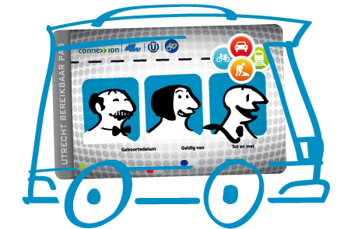
Lessons learned Coordination of road construction planning, Regional traffic management
To coordinate and manage an integrated planning, you need a central database and you need regional cooperation!
It takes a lot of time to organize and implement public and public/private co-operation, so start early!
Invest in relations between people, they make it work!

Slide 7
Public Transport Pass
Reduction of 2,000 – 4,000 cars during peak hours
Sold to all major employers in Utrecht
Subsidized (60%) low price, but a high minimal purchase quantity
Income tax facility during 24 months
Utrecht Accessible Pass
Free access to all Public Transport
Free access to public bicycles (business and private use)
Dedicated commuter bus services
Train for some corridors
Access to special built Park & Ride’s

Slide 8
Results
Effect PT Pass -> Good product
• Over 20,000 passes sold
• 400 employers in Utrecht area are involved
• 40% former car users use the PT Pass
• 3,200 cars less during rush hours Strong Brand
75% brand recognition
Partnerships
Businesses, Mobility Managers, Human Resource managers, Chamber of Commerce, Infrastructure authorities, PT authorities.
‘Close to 40% of surveyed pass-holders would travel by car again when the Utrecht Accessibility Pass offer ends’.

Slide 9
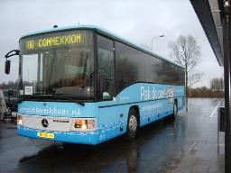
Lessons Learned
Use existing public transport,
new lines need a long acceptation period
Park & Ride only successful if frequently visited by public transport, with direct connections to business areas
“Champions” can help the launch, but the individual company decides to participate
After 10.000 cards sold, the service starts selling itself

Slide 10
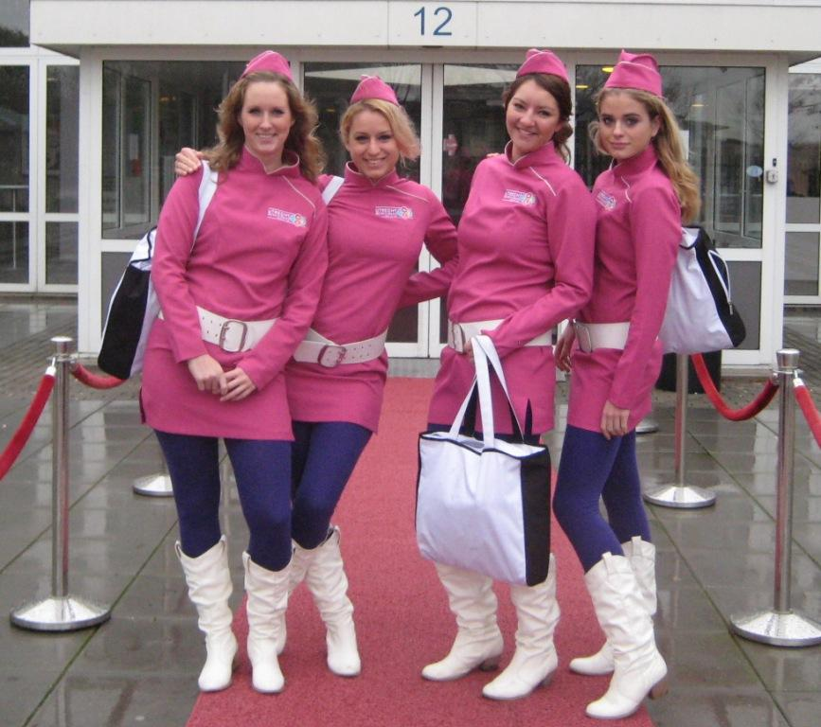
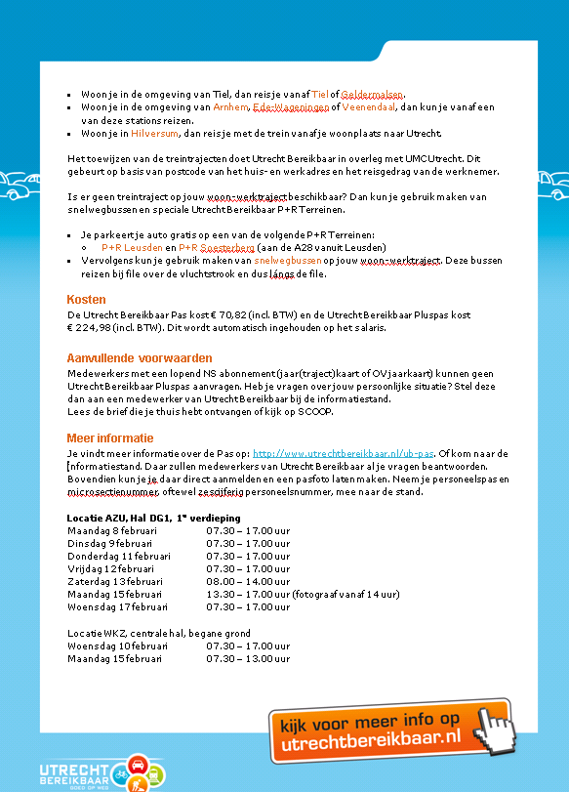
Marketing and Sales
Common brand and logo
Promotion teams and AM
In-company communication
Digital contracting and ordering
Webshop for small/medium sized companies

Slide 11
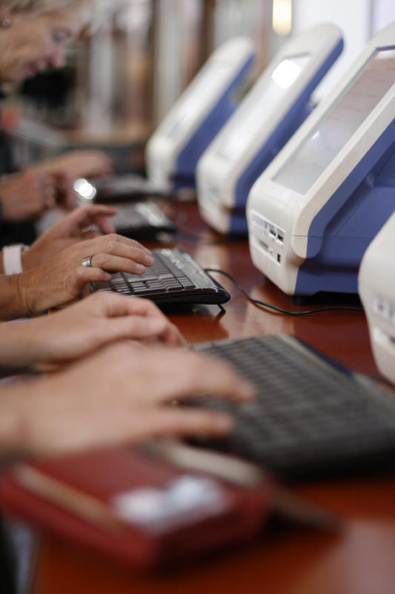
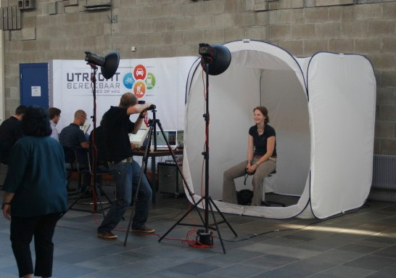
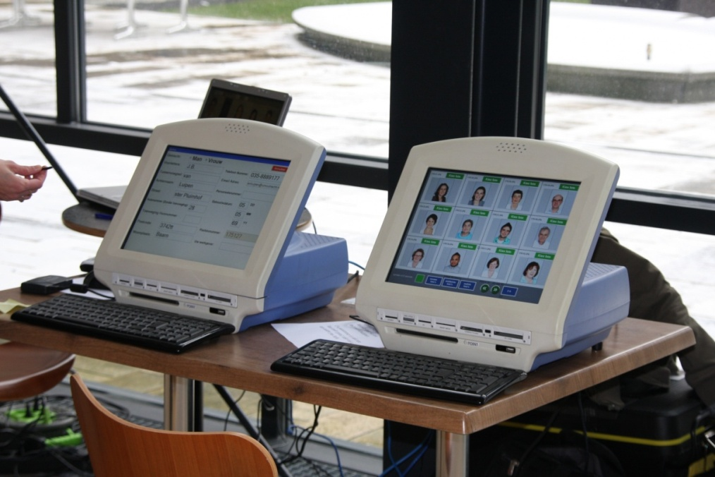
Marketing and Sales
Registration Process
CIVITAS Forum 2012 l City of Utrecht, Utrecht Accessible

Slide 12
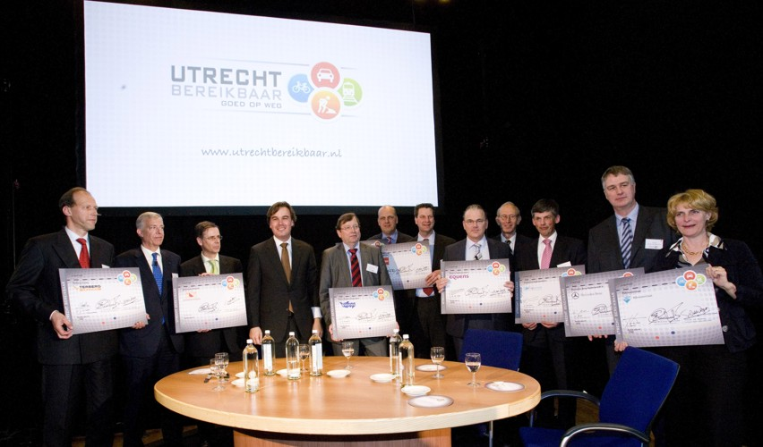
Lessons Learned
Introduction is costly and takes time, but customers are loyal, even if price increases
Supporting internal communications and taking over employee registration, speeds up the employers’ decision-making process
Only feasible for long-term projects
Rich database of commuter information
CIVITAS Forum 2012 l City of Utrecht, Utrecht Accessible

Slide 13
Communication Program
One brand, one sender, joint press contacts
Project communication by individual authorities
Utrecht Accessible creates extra channels:
(Mobile) websites: 200.000 visitors a year
Weekly news alerts: 14.000 subscribers
Twitter - #verkeer030
Advertisements
Billboards
Radio spot with music logo warnings for congestion and alternatives for traveling
CIVITAS Forum 2012 l City of Utrecht, Utrecht Accessible

Slide 14
Website: Road under construction
CIVITAS Forum 2012 l City of Utrecht, Utrecht Accessible

Slide 15
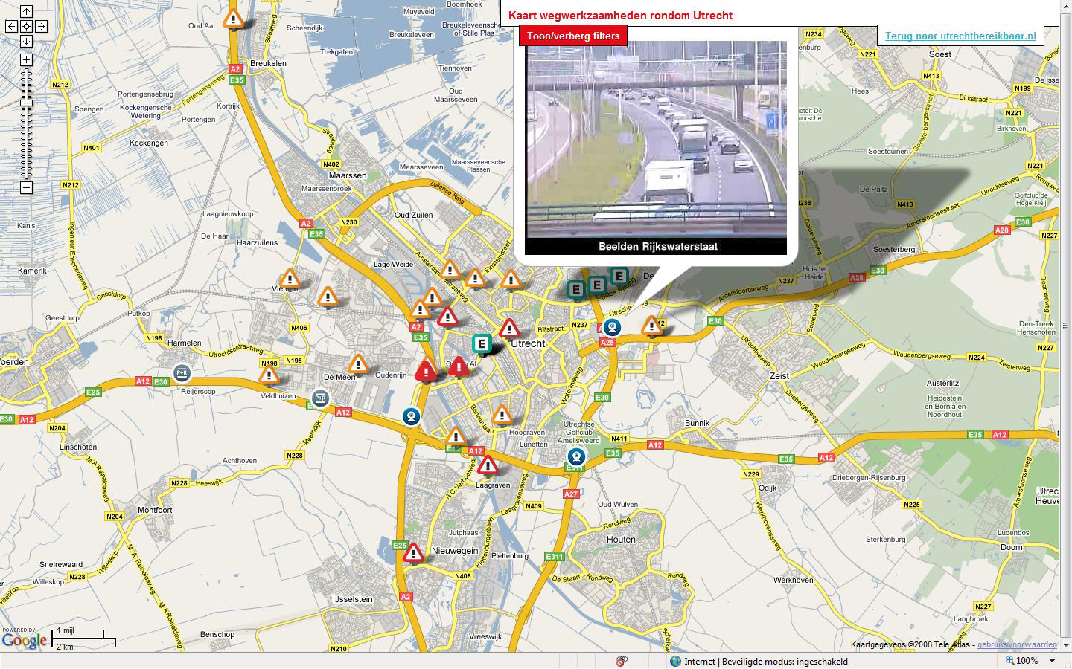
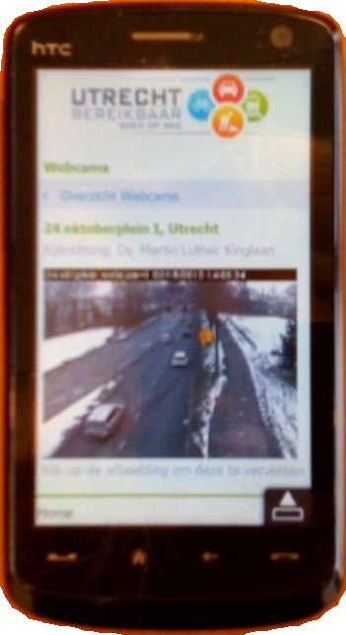
Website: Travel information
CIVITAS Forum 2012 l City of Utrecht, Utrecht Accessible

Slide 16
Website: Travel information
CIVITAS Forum 2012 l City of Utrecht, Utrecht Accessible

Slide 17
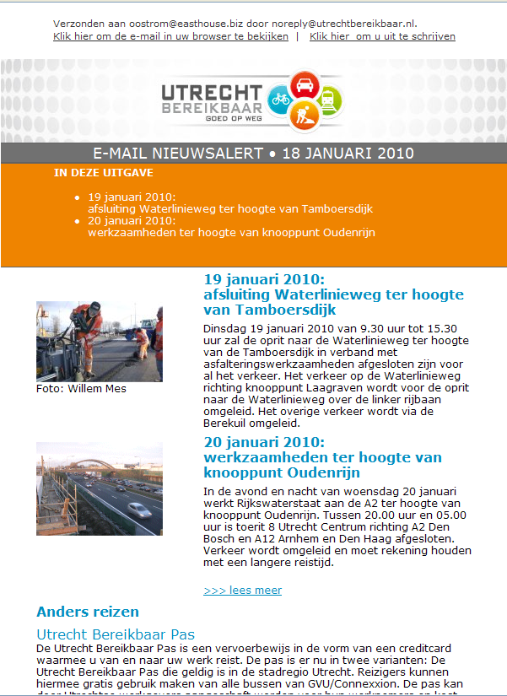
E-mail News Alerts
8 Times a month
Only in case of severe congestion
Planning tool for logistics
Highly appreciated!
CIVITAS Forum 2012 l City of Utrecht, Utrecht Accessible

Slide 18
Lessons Learned
Common budget creates common commitment
Close cooperation between involved communications departments
Think from the viewpoint of the recipient
Infrastructure authorities keep control of their own communications
CIVITAS Forum 2012 l City of Utrecht, Utrecht Accessible

Slide 19
Lessons Learned
You need time
For decision-making process
To negotiate contracts
To brand the service
To sell the products
Keep good record of decisions and history, to face changes in politics and stakeholder staff
Surveys provide valuable information and are necessary for monitoring use and effects

Slide 20
Near future
Subsidies have finished, UB organization becomes self supporting, on a non-profit basis
Government steps back
Companies want Utrecht Accessible to stay
New services added: shuttles, electric cars, temporary working spaces, discounts at events
CIVITAS Forum 2012 l City of Utrecht, Utrecht Accessible

Slide 21
Thank you!
For further information, please contact:
d.simhoffer@utrecht.nl
+31 612851978
www.utrechtbereikbaar.nl

