Slide 1
Electric mobility Electric car trials in Aalborg and Denmark
CIVITAS Forum
Jens Mogensen, ARCHIMEDES Project, Aalborg
24-26 September 2012
Vitoria-Gasteiz, Spain

Slide 2
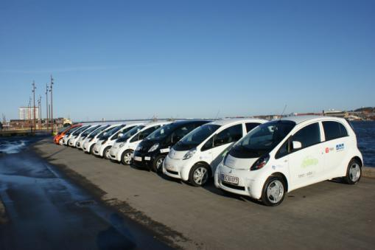
Agenda
Objectives
The trial - set up
Some key evaluation results
Energy consumption
Range
CO₂ emissions
Economy
Reliability
User attitude / acceptance
Conclusion – remarks to sessions key questions

Slide 3
Objectives
to gather experiences from ordinary users of EV
to identify under which conditions the EV in its present technical version (OEM EVs), is an attractive alternative to ordinary cars.
to evaluate CO2 savings totally for the project and to indicate differences between CO2 savings depending on the drivers’ behavior.
to gather experiences with intelligent charging.

Slide 4
The trial - setup
ARCHIMEDES trial in Aalborg :
10 Evs in two years. 80 test families, three months each. ~200,000 km, 42,600 kWh and 5,600 charging
National project:
170 EVs in two years. 1,360 test families, three months each. 4,400,000 km. 938,000 kWh and 125,000 charging.
Financed by national funds, sponsors and company owned by power plants
Data trackers in cars and charging points.
Web log and surveys

Slide 5
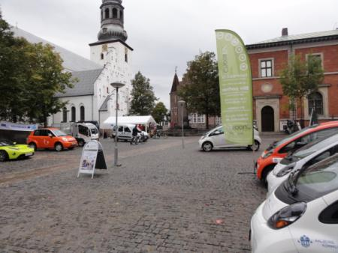
Key evaluation results: Energy consumption
New European Driving Cycles:
Vehicle | Peugeot Ion etc. | Peugeot 207 1.4 | Peugeot 207 1.4 HDi
Fuel type | Electricity | Petrol | Diesel
Energy-consumption NEDC | 0.135 kWh/km | 17.2 km/l | 23.8 km/l
Energy-equivalent |  | 9.17 kWh/l | 9.98 kWh/l
Energy-efficiency (kWh/km) | 0.135 kWh/km | 0.533 kWh/km | 0.419 kWh/km
Consumption compared to Petrol car | 25,3% | 100% | 78,6%
Real figures, 700,000 km, 19.000 charging
Vehicle | Peugeot Ion etc. | Peugeot 207 1.4 | Peugeot 207 1.4
Fuel type | Electricity | Petrol | Diesel
Energy-consumption, real figures | 0.213 kWh/km | 13.7 km/l | 19.2 km/l
Energy-equivalent |  | 9.17 kWh/l | 9.98kWh/l
Energy-efficiency (kWh/km) | 0.213 kWh/km | 0.669 kWh/km | 0.52 kWh/km
Consumption compared to Petrol car | 31,8% | 100% | 77.7%
EV uses 68.2% less energy than a comparable petrol car and 59.1% less than the diesel version.

Slide 6
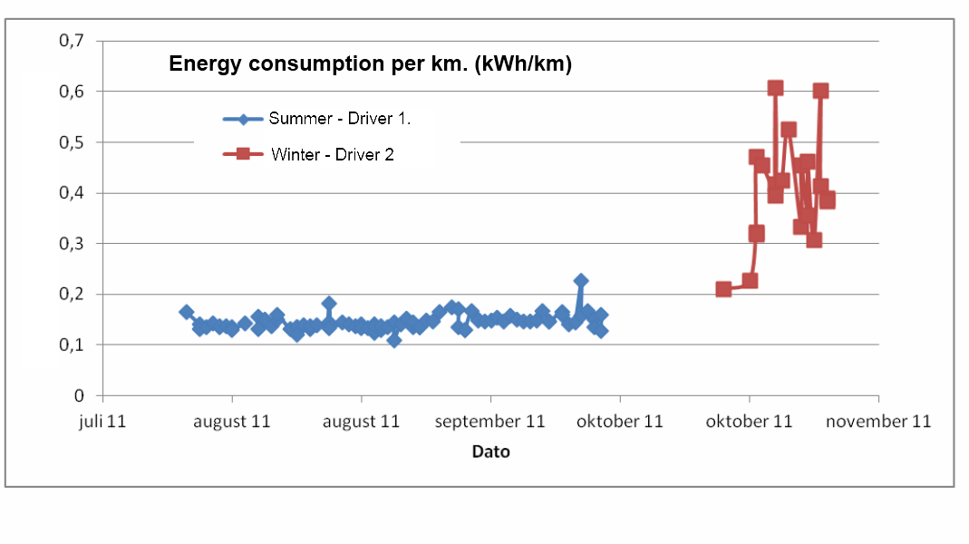
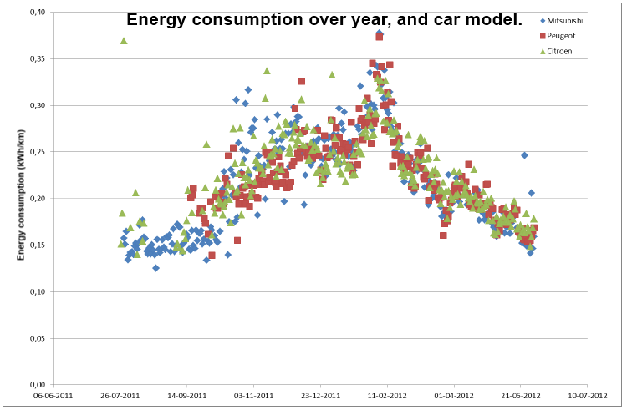
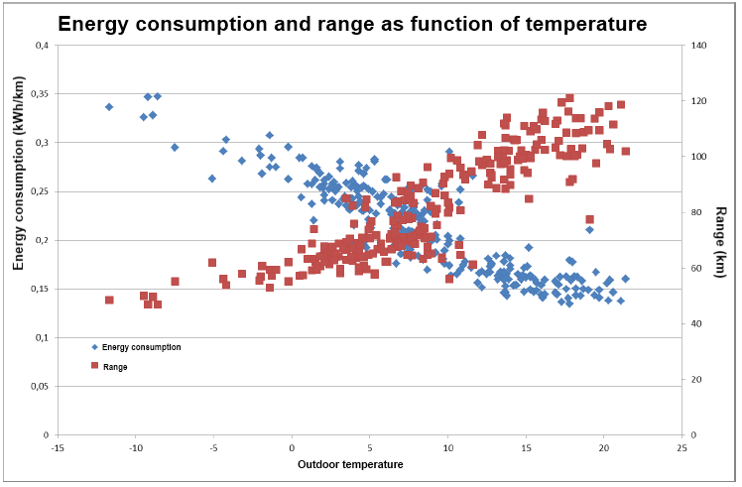
Factors that influence energy consumption

Slide 7
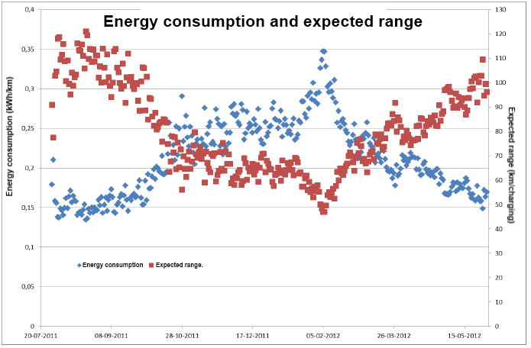
Key evaluation results: Range
Expected range in the winter is only half of that in the summer NEDC range is 150 km but half the year you will have a range below 70 km

Slide 8
Key evaluation results: CO₂ emissions
Vehicle | Peugeot Ion | Peugeot 207 1.4 HDi
Fuel type | Electricity | Diesel
Energy-consumption NEDC | 0.135 kWh/km | 0.419 kWh/km
Energy-consumption, real data | 0.213kWh/km | 0.52 kWh/km
Well to Tank | 359 grams CO₂ / kWh | 45 grams CO₂ / kWh
Tank to Wheel | 0 grams CO₂ / kWh | 267 grams CO₂ / kWh
Well to Wheel | 359 grams CO₂ / kWh | 312 grams CO₂ / kWh
Well to Wheel per km, NEDC | 48 grams CO₂ / km | 130 grams CO₂ / km
Well to Wheel per km, Real data. | 76 grams CO₂ / km | 162 grams CO₂ / km
CO₂ emission compared to diesel car, NEDC | 36.9% | 100%
CO₂ emission compared to diesel car, real data | 46.9% | 100%
Based on NECD figures and on Real consumption data, the EV emits 63.1% and 53.1% less CO₂ per km. CO₂ emission Well to Tank is based on the averages Danish electricity production

Slide 9
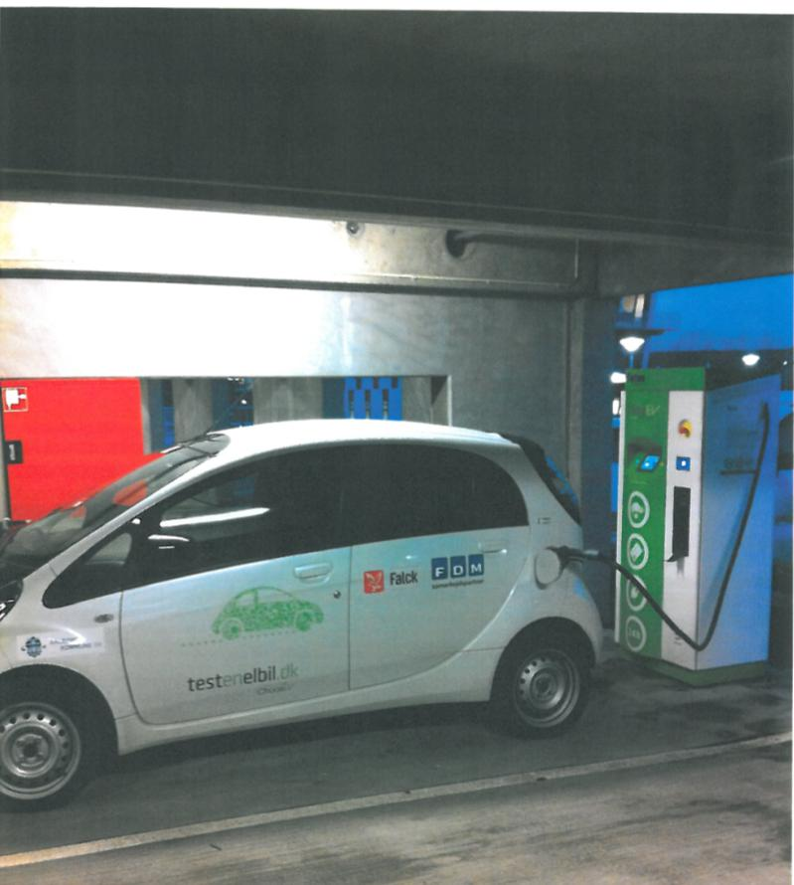
Key evaluation results: Energy operating costs
Vehicle | Peugeot Ion | Peugeot 207 1.4 | Peugeot 207 1.4 HDi
Fuel type | Electricity | Petrol | Diesel
Energy-consumption NEDC | 0.135 kWh/km | 17.2 km/l | 23.8 km/l
Energy-equivalent |  | 9.17 kWh/l | 9.98 kWh/l
Energy-efficiency (kWh/km) | 0.135 kWh/km | 0.533 kWh/km | 0.419 kWh/km
Cost per kWH | 0.2740 €/kWh | 0.1812€/kWh | 0.1544 €/kWh
Cost per km | 0.03758€/km | 0.09664€/km | 0,06443€/km
Cost compared to Petrol car | 38,9% | 100% | 66,7%
Based on NEDC the EV is 61.1% cheaper in energy operation cost than a comparable petrol car and 42% cheaper than the diesel version.
Vehicle | Peugeot Ion | Peugeot 207 1.4 | Peugeot 207 1.4
Fuel type | Electricity | Petrol | Diesel
Energy-consumption, real figures | 0.213 kWh/km | 13.7 km/l | 19.2 km/l
Energy-equivalent |  | 9.17 kWh/l | 9.98kWh/l
Energy-efficiency (kWh/km) | 0.213 kWh/km | 0.669 kWh/km | 0.52 kWh/km
Cost per kWH | 0.2740 €/kWh | 0.1812€/kWh | 0.1544€/kWh
Cost per km | 0.06040€/km | 0.12081€/km | 0.08053€/km
Cost compared to Petrol car | 50% | 100% | 66.7%
Realistic figures for consumption: 50% cheaper in energy operation cost than a comparable petrol car and 25% cheaper than the diesel version. The economical advantages of using an EV is less than the energy savings due to the higher €/kWh price for electricity than for petrol or diesel

Slide 10
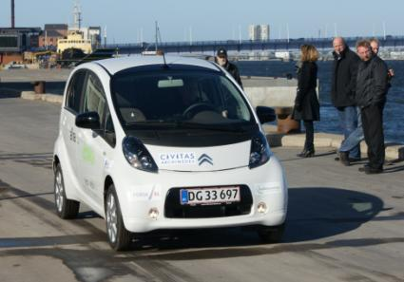
Key evaluation results: Reliability
Non EOM Cars: Hand-build or re-build petrol cars.
1 in 2 does work.
170 OEM cars in this trial, One year and more than 2,000,000 km:
Empty 12 Volts battery 57 Technical failure 3 Traffic accidents 4 Flat tyre 3

Slide 11
Key evaluation results: Acceptance
+ | -
Reliability Fast acceleration Low noise level Low fuel costs. | Range Price
Long time cost ?
Before- and after survey as a Stated Preference Surveys:
In how many situations does the user prefer EV over the conventional car?
 | Before | After.
Male | 45 % | 38 %
Female | 51 % | 44%
Averages | 48 % | 41%
Main reason: RANGE and price

Slide 12
What are the biggest challenges and potential solutions in the introduction of electric vehicles?;
Reliability og non-OEM cars.
RANGE.
What are the key factors of success in adding electric vehicles to a municipal fleet?;
Finding the niches where the cars can be used in spite of limited range.
Organisational changes – create acceptance and motivation without creating problems by overselling.
What are the challenges and solutions in terms of implementing recharging infrastructure?
Hen and egg problem.
Infrastructure in public area as psychological driver.
CIVITAS Forum l 24-26 September 2012 l Vitoria-Gasteiz, Spain

Slide 13
Thank you!
For further information, please contact:
Jens Mogensen
jms-teknik@aalborg.dk
CIVITAS Forum l 24-26 September 2012 l Vitoria-Gasteiz, Spain

