Slide 1
The effectiveness of public transportation control center in Kocaeli
CIVITAS Forum,
Kocaeli, Turkey (Forum Member)
Abdulmutalip Demirel, Head of Transportation Department
24-26 September 2012
Vitoria-Gasteiz, Spain

Slide 2
OUTLINE
GENERAL INFORMATION ABOUT KOCAELI
PUBLIC TRANSPORT CONTROL CENTER
PASSENGER INFORMATION SYSTEMS
CONCLUSION
CIVITAS Forum l 24-26 September 2012 l Vitoria-Gasteiz, Spain

Slide 3
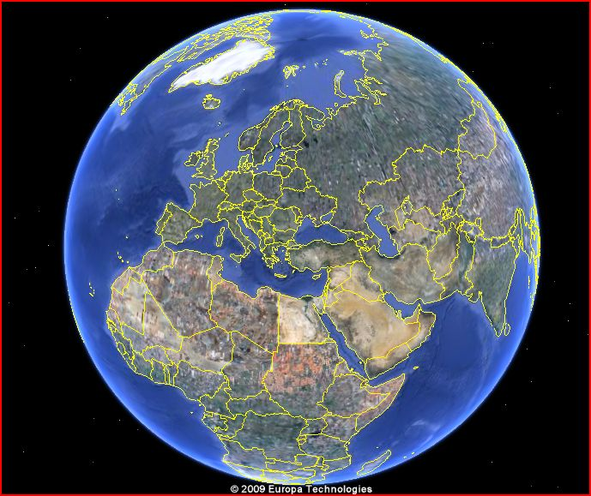
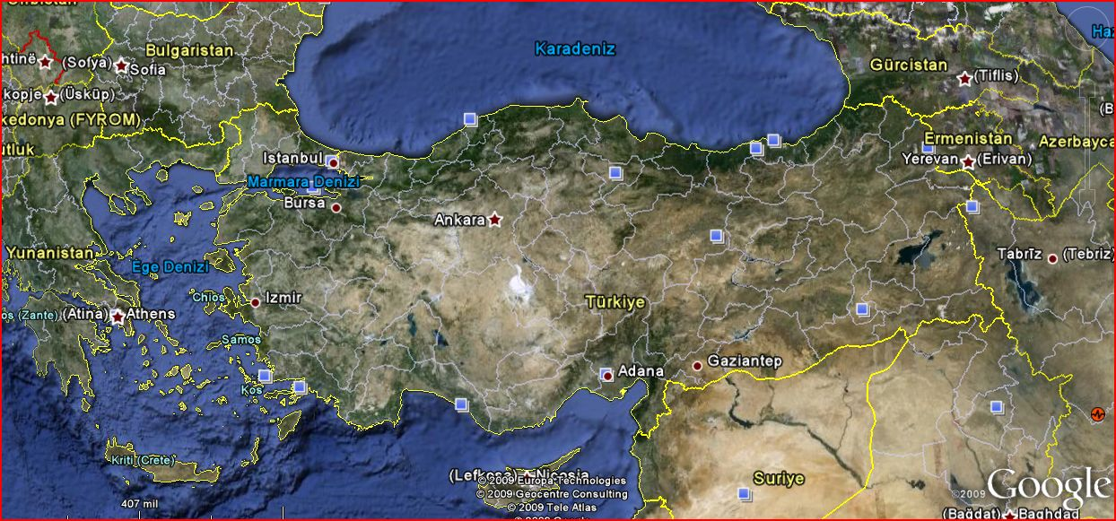
LOCATION OF KOCAELI
Area 3.418 km²
Population 1.601.000 – 468 kişi / km2
Annual population growth rate ‰21,28
CIVITAS Forum l 24-26 September 2012 l Vitoria-Gasteiz, Spain

Slide 4
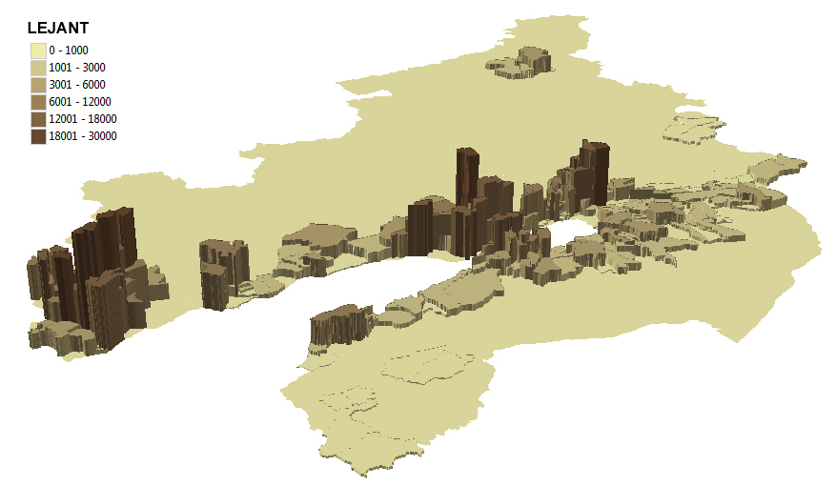
POPULATION DISTRIBUTION
İZMİT
GEBZE
CIVITAS Forum l 24-26 September 2012 l Vitoria-Gasteiz, Spain

Slide 5
DAILY TOTAL TRIP
Daily Total Trip
2.605.758
Average trip rate
1,55
CIVITAS Forum l 24-26 September 2012 l Vitoria-Gasteiz, Spain

Slide 6
TRIP DISTRIBUTION
PRIVATE CAR % 18,9
PUBLIC TRANSPORTATION
% 21,5
OTHERS %2,1
SERVICE % 14,8
TRAIN %0,7
SEAWAYS %0,1
CIVITAS Forum l 24-26 September 2012 l Vitoria-Gasteiz, Spain

Slide 7
PRIVATE BUSES
2071 PRIVATE BUSES
127 MUNICIPAL BUSES
352 TOTAL LINE
11901 DAILY TOTAL TRIP
560.000 TOTAL DAILY PASSENGER
CIVITAS Forum l 24-26 September 2012 l Vitoria-Gasteiz, Spain

Slide 8
WHY WE NEED PUBLIC TRANSPORATION CONTROL CENTER
Passenger demands
Public information systems
Onboard passenger information systems
Timetable planning systems
Optimizing planning
Data analysis and reporting
Public Transportation Prioritization

Slide 9
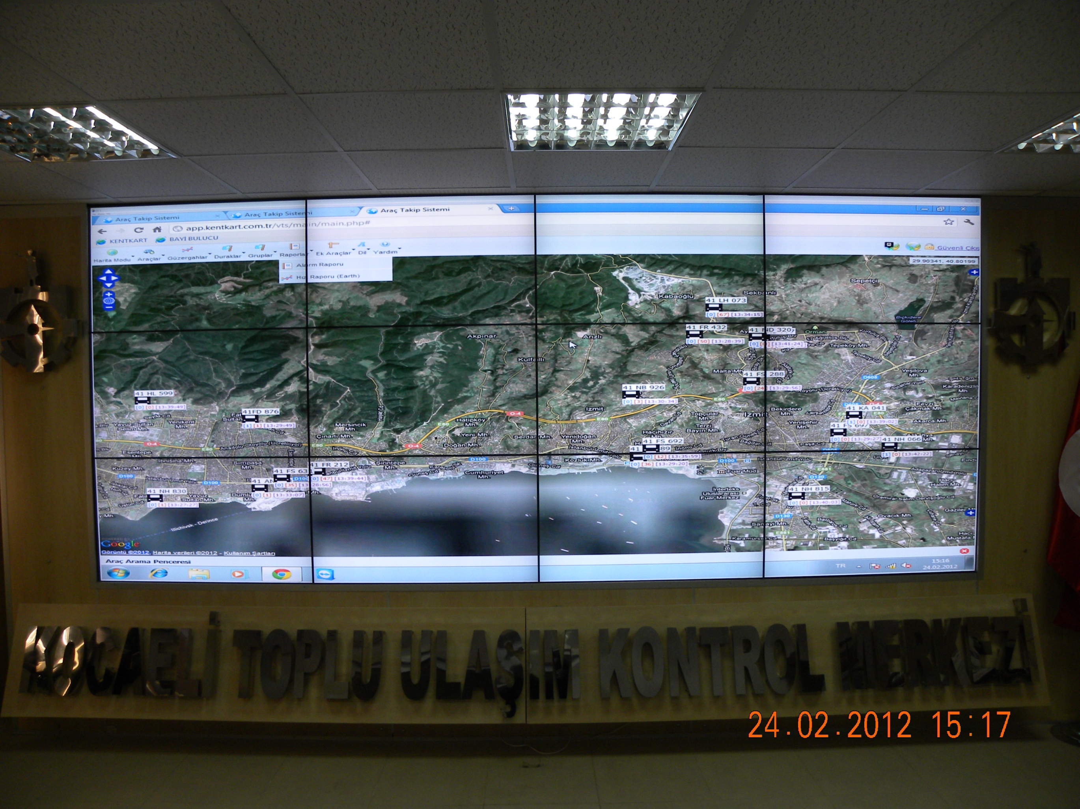
PUBLIC TRANSPORT CONTROL CENTER
CIVITAS Forum l 24-26 September 2012 l Vitoria-Gasteiz, Spain

Slide 10
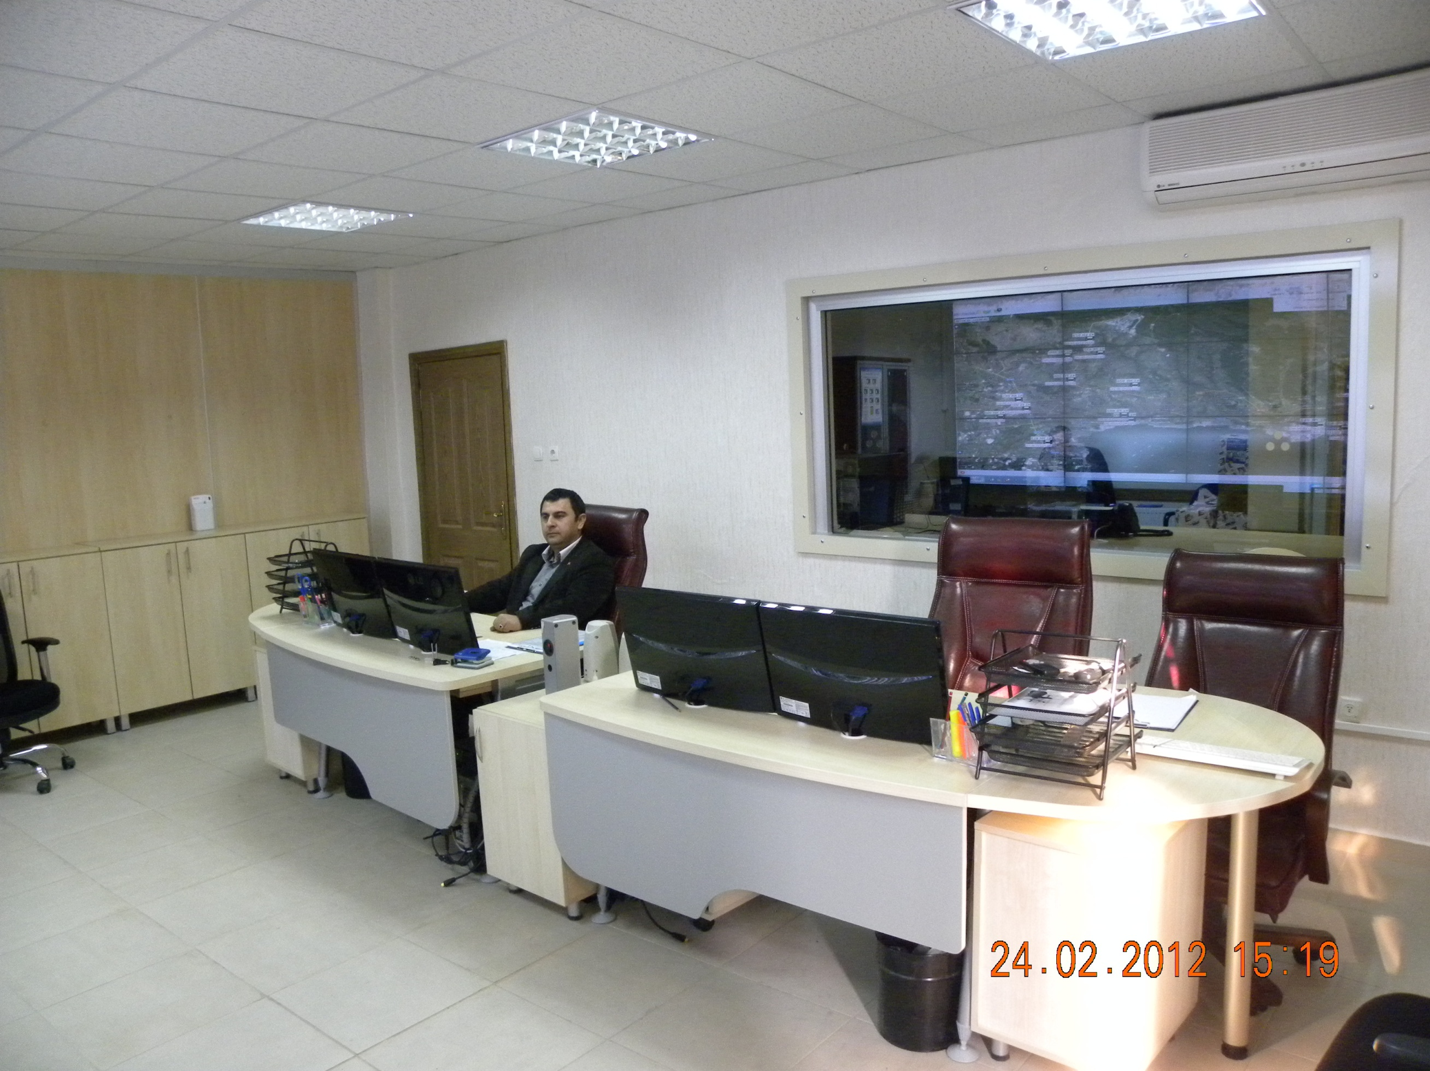
PUBLIC TRANSPORT CONTROL CENTER
2 CHIEF
4 CONTROL CENTER STAFF
6 CALL CENTER STAFF
CIVITAS Forum l 24-26 September 2012 l Vitoria-Gasteiz, Spain

Slide 11
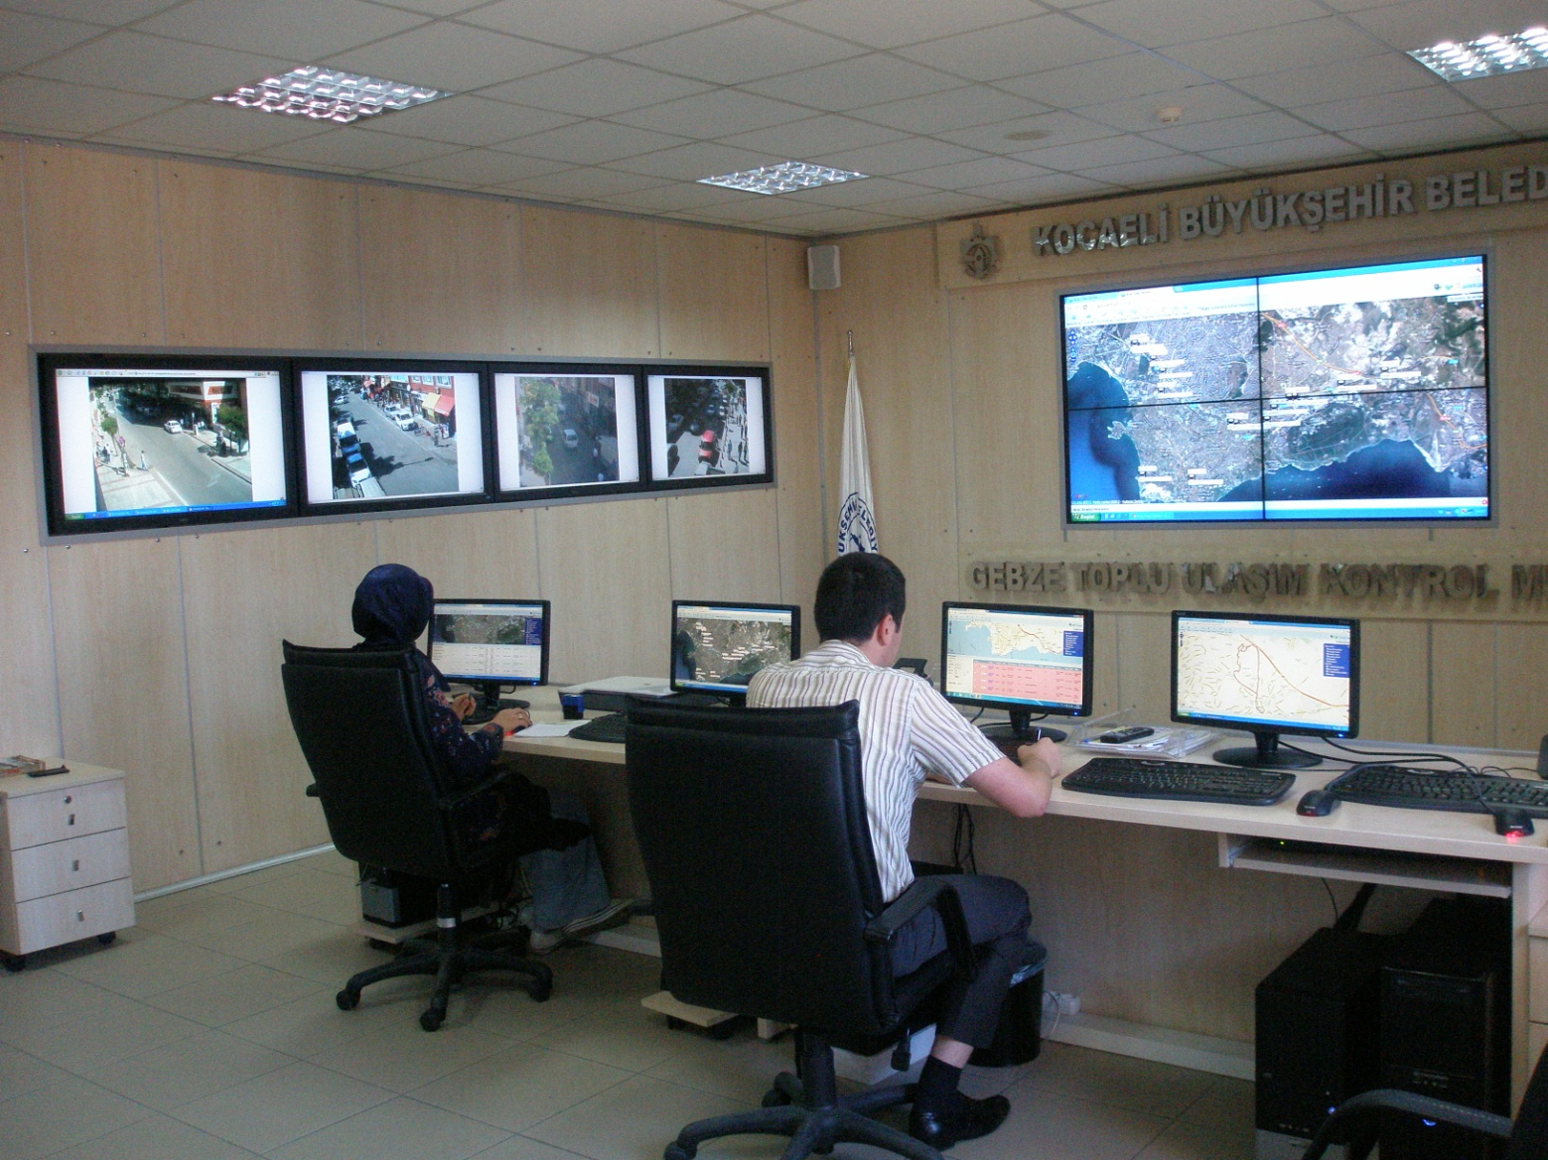
PUBLIC TRANSPORT CONTROL CENTER (GEBZE DISTRICT)
1 CHIEF
2 CONTROL CENTER STAFF
CIVITAS Forum l 24-26 September 2012 l Vitoria-Gasteiz, Spain

Slide 12
WHAT ARE THE FUNCTIONS OF PUBLIC TRANSPORATION CONTROL CENTRE?

Slide 13
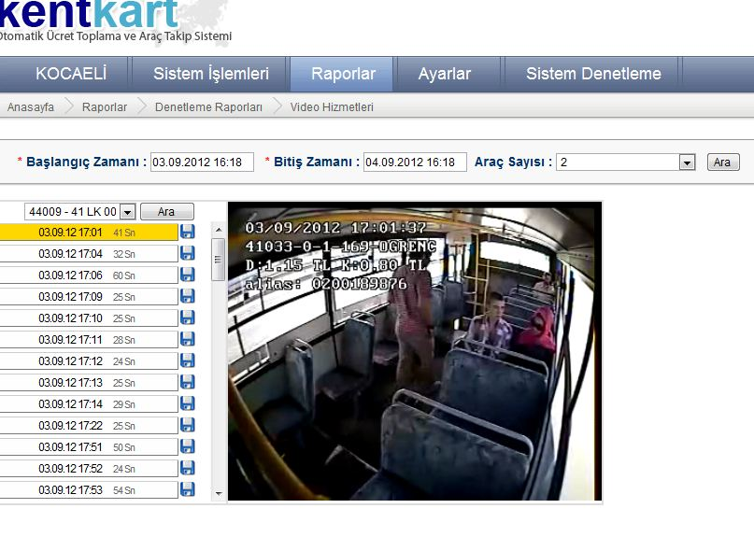
INSTANT CCTV
CIVITAS Forum l 24-26 September 2012 l Vitoria-Gasteiz, Spain

Slide 14
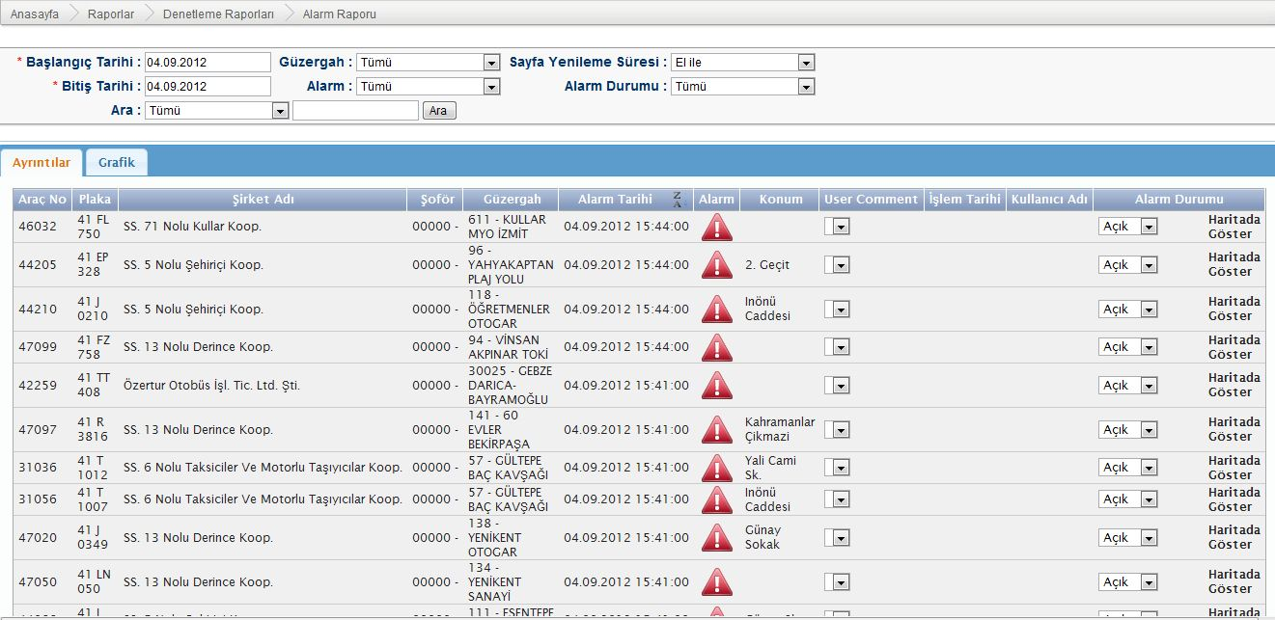
SPEED CONTROL (Alarms)
CIVITAS Forum l 24-26 September 2012 l Vitoria-Gasteiz, Spain

Slide 15
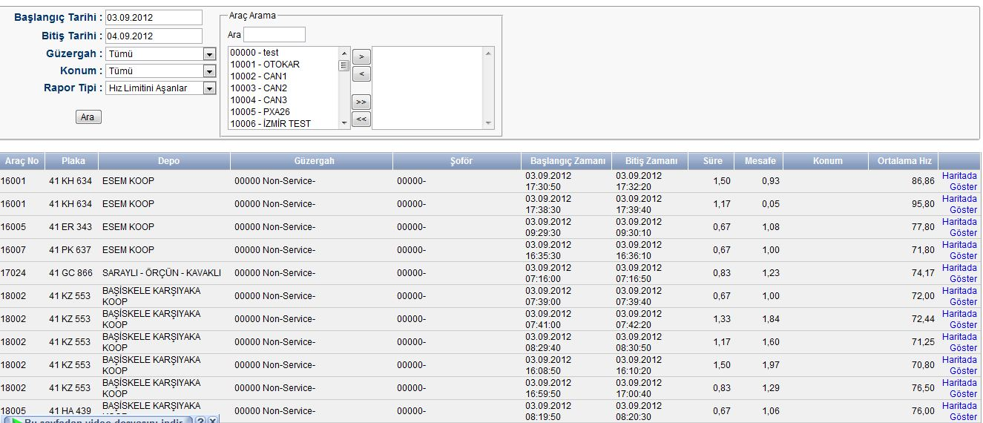
AVERAGE SPEED
CIVITAS Forum l 24-26 September 2012 l Vitoria-Gasteiz, Spain

Slide 16
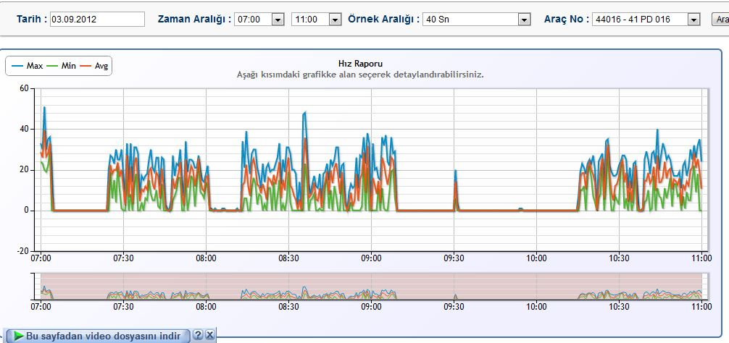
DETAILED SPEED REPORT
CIVITAS Forum l 24-26 September 2012 l Vitoria-Gasteiz, Spain

Slide 17
BUS STOPS PASSING TIME
CIVITAS Forum l 24-26 September 2012 l Vitoria-Gasteiz, Spain

Slide 18
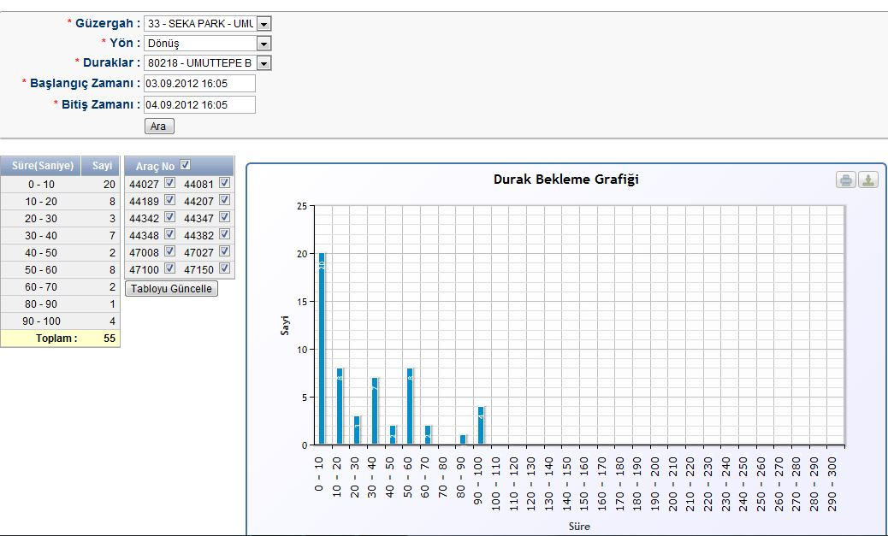
BUS STOPS WAITING TIME
CIVITAS Forum l 24-26 September 2012 l Vitoria-Gasteiz, Spain

Slide 19
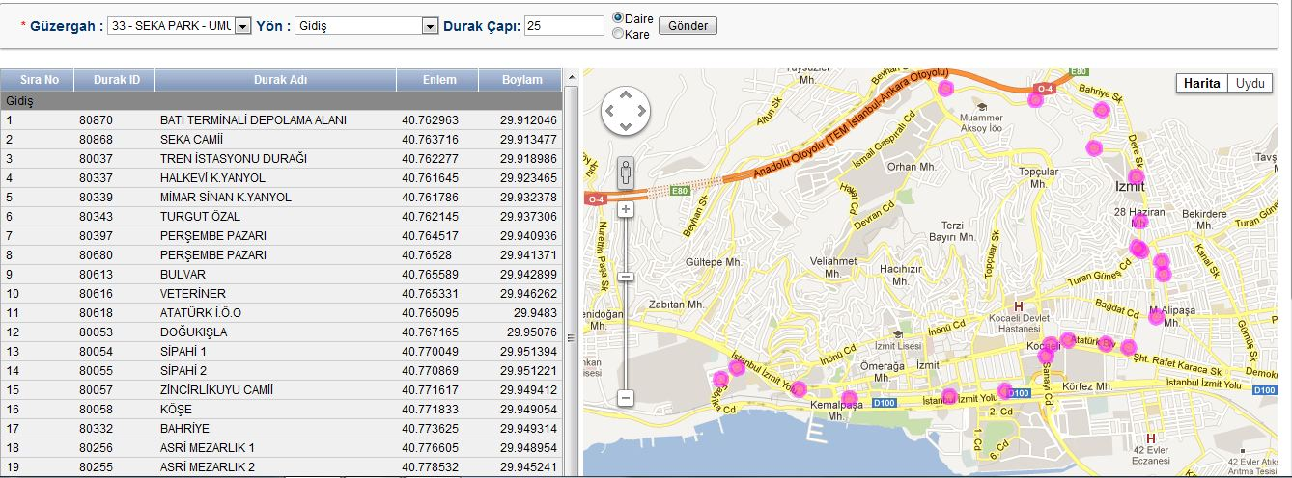
BUS STOPS ON MAP
CIVITAS Forum l 24-26 September 2012 l Vitoria-Gasteiz, Spain

Slide 20
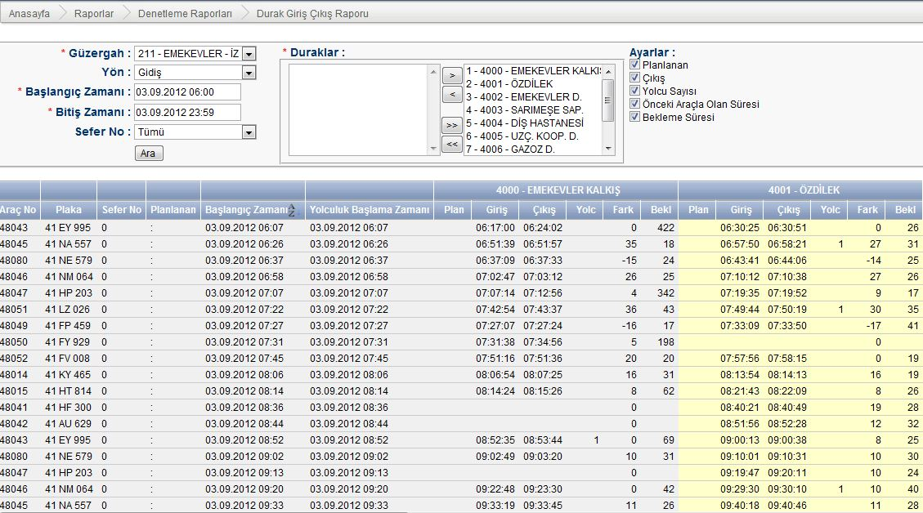
TIMETABLE Control of planned and real time travel
CIVITAS Forum l 24-26 September 2012 l Vitoria-Gasteiz, Spain

Slide 21
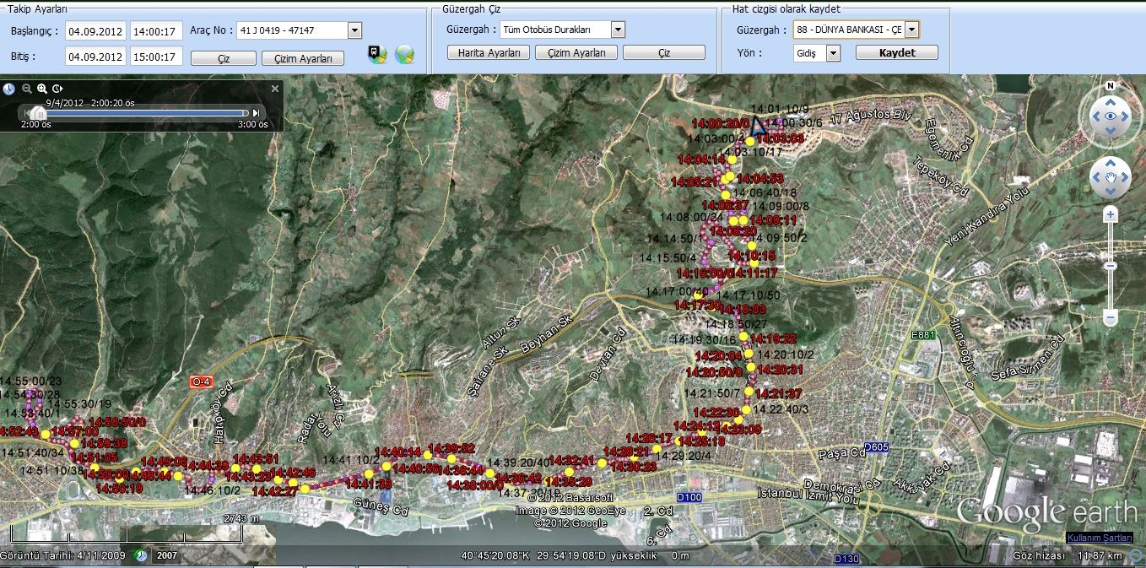
BUSLINE ON MAP
CIVITAS Forum l 24-26 September 2012 l Vitoria-Gasteiz, Spain

Slide 22
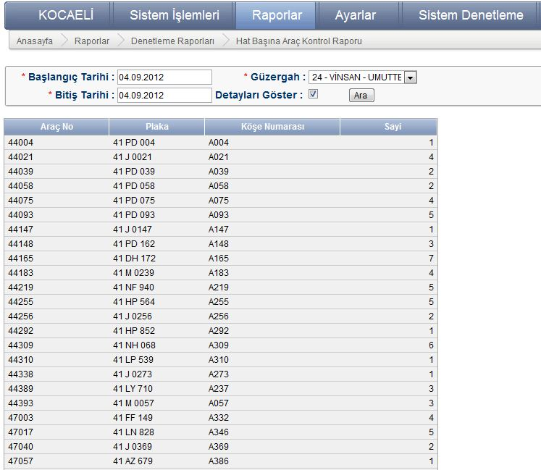
VEHICLES LAPS
CIVITAS Forum l 24-26 September 2012 l Vitoria-Gasteiz, Spain

Slide 23
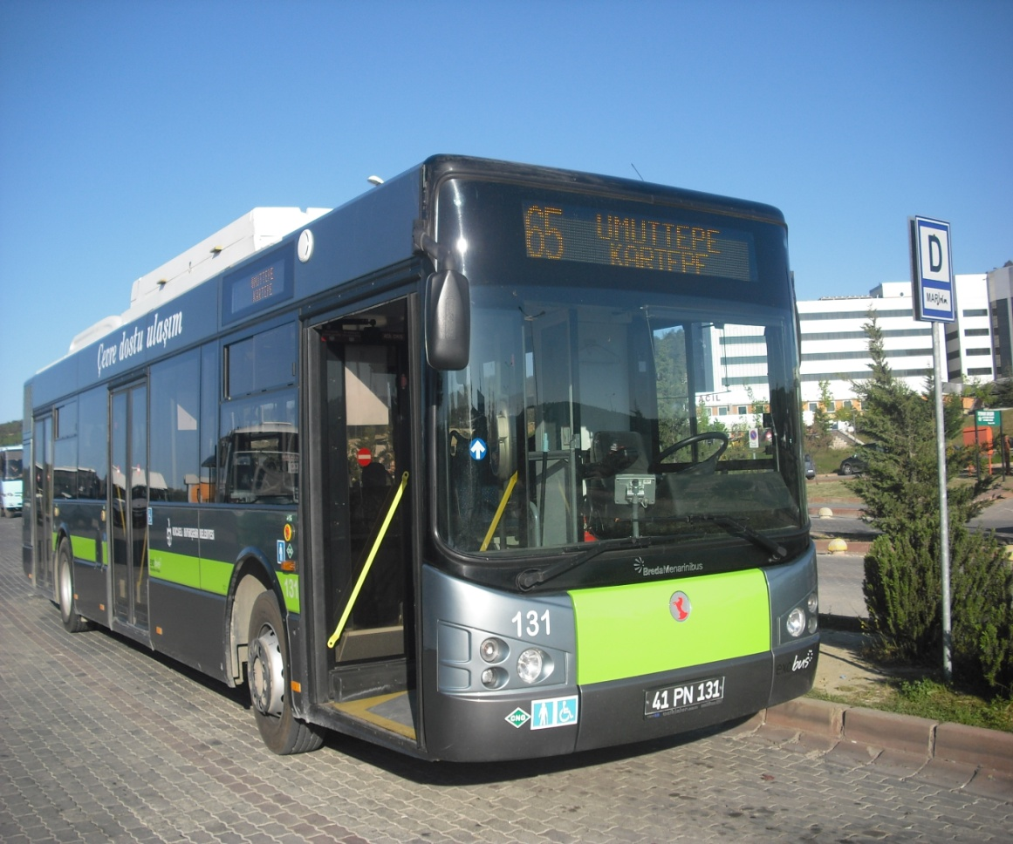
IN VEHICLE PASSENGER INFORMATION SYSTEMS
CIVITAS Forum l 24-26 September 2012 l Vitoria-Gasteiz, Spain

Slide 24
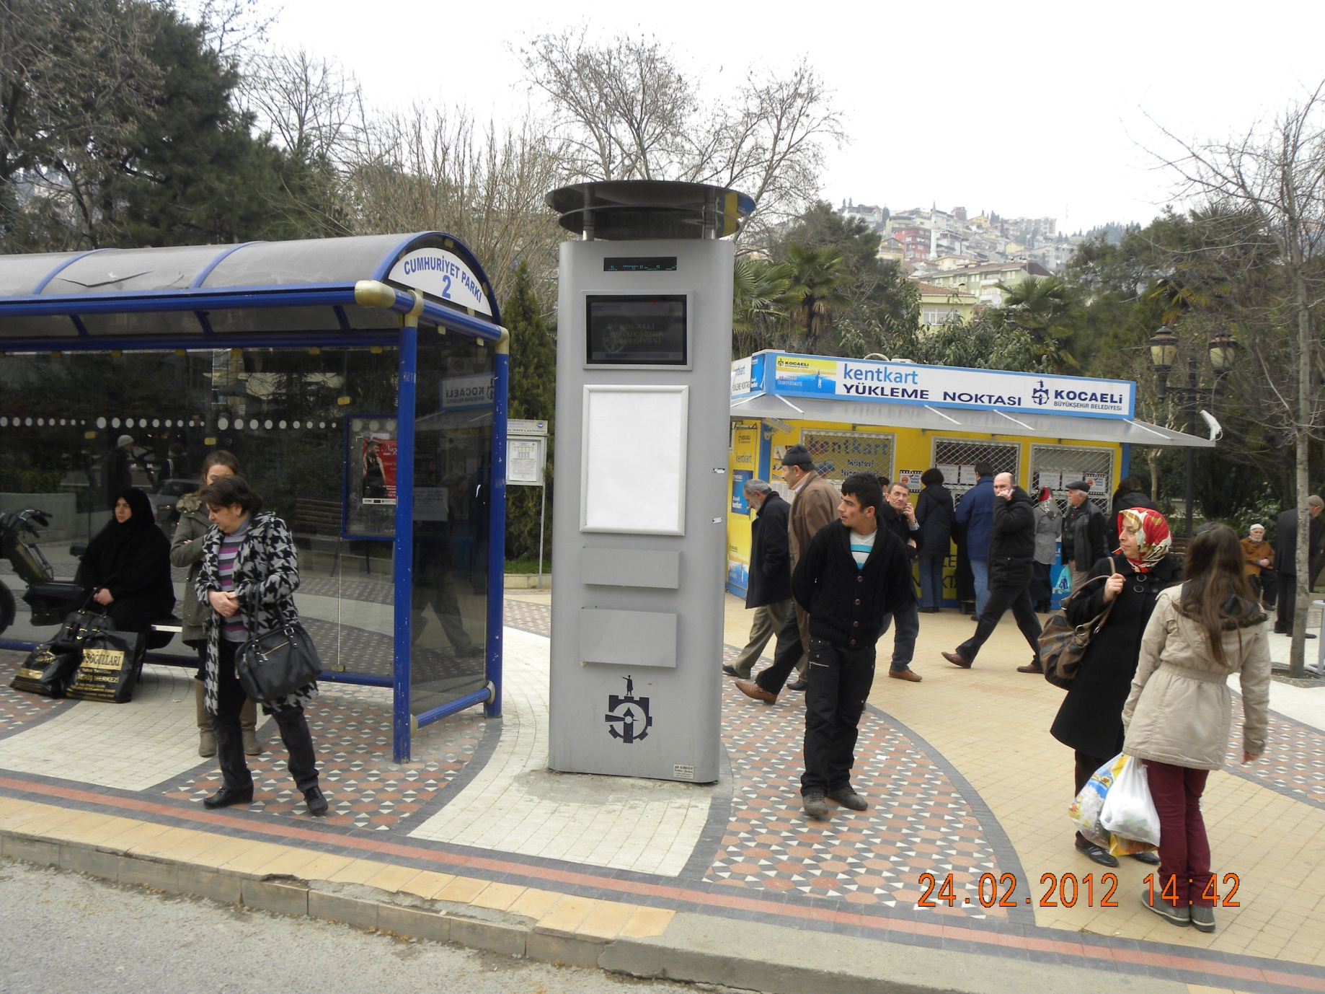
OUTDOOR PASSENGER INFORMATION SYSTEMS
CIVITAS Forum l 24-26 September 2012 l Vitoria-Gasteiz, Spain

Slide 25
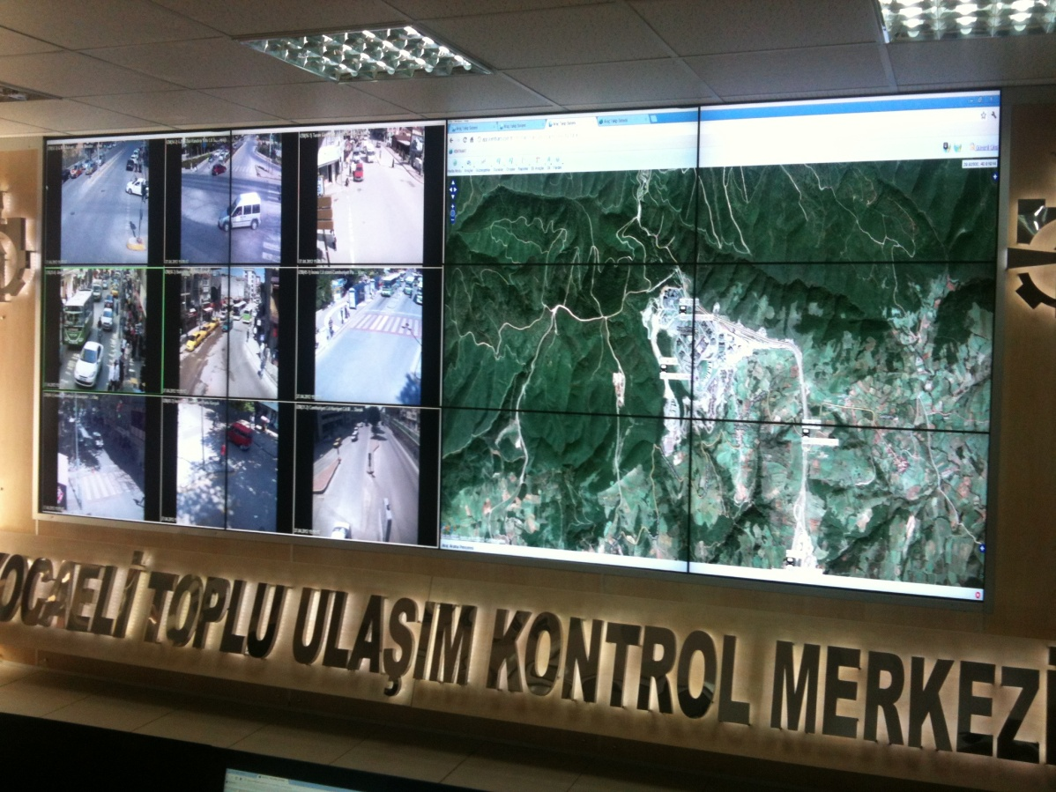
CALL CENTER
7 DAYS
24 HOURS
CIVITAS Forum l 24-26 September 2012 l Vitoria-Gasteiz, Spain

Slide 26
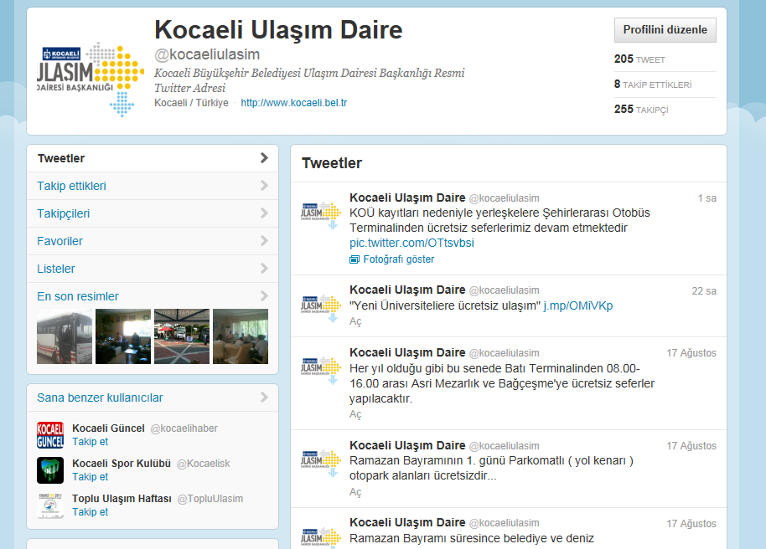
EMAIL – TWITTER - FACEBOOK
www.twitter.com/kocaeliulasim
ulasim@kocaeli.bel.tr
CIVITAS Forum l 24-26 September 2012 l Vitoria-Gasteiz, Spain

Slide 27
RESULTS
Passenger satisfaction
Speed in operations
Real time tracking the buses.
Drivers working time data gathered
Obeying the rules as speed limits, lay time at stops, etc. can be checked.
• Driver can notify center for help

Slide 28
RESULTS
Automated control on drivers and passengers
More effective use of fleet
Effective control of bus lines and planning
Savings on cost of fuel and personnel
Instant knowledge of any vehicle failures or road problems
Route control and checking the bus line in past
For future, this system will be integrated with the Traffic Signalling System to allow PT priority.

Slide 29
Thank you!
For further information, please contact:
ulasim@kocaeli.bel.tr
www.twitter.com/kocaeliulasim
CIVITAS Forum l 24-26 September 2012 l Vitoria-Gasteiz, Spain

