Slide 1

Advantages and Disadvantages of Using Hybrid Cars in a Car Sharing Club in Bath
CIVITAS Forum
Prof. Graham Parkhurst, University of the West of England, Bristol
24-26 September 2012
Vitoria-Gasteiz, Spain

Slide 2
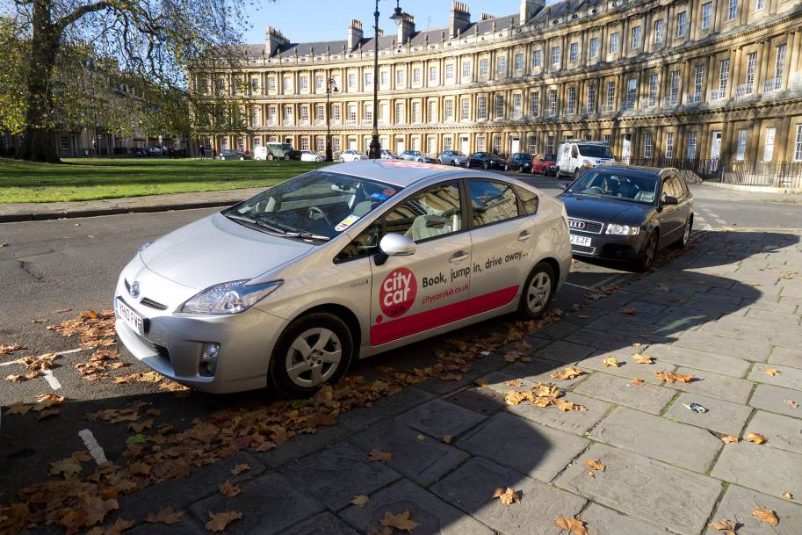
Overview
UK and Bath context
Evaluation overview
Cost-Benefit Analysis
Quantitative Survey
Qualitative Study
Conclusions
CIVITAS Forum l 24-26 September 2012 l Vitoria-Gasteiz, Spain

Slide 3
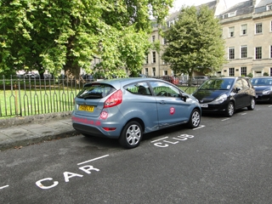
Carsharing in UK
  Known as “car clubs” in UK
  Commercial and Social Enterprise Providers
  162,000 car club members in UK in 2011 (Harmer and Cairns, 2011)
  Policy Objectives
  Reduced parking demand
  More sustainable lifestyles
CIVITAS Forum l 24-26 September 2012 l Vitoria-Gasteiz, Spain

Slide 4
Carplus Annual Survey 2010/11
(Harmer and Cairns, 2011) (N=8450)
  32% of UK members reduced car ownership after joining
  54% of members did not own car before joining
  30% said they would have bought a car if they had not joined
  Over 85% of members use car club cars less than once a month
  Car club members produce 75% fewer CO₂ emissions than average British driving licence holder
CIVITAS Forum l 24-26 September 2012 l Vitoria-Gasteiz, Spain

Slide 5
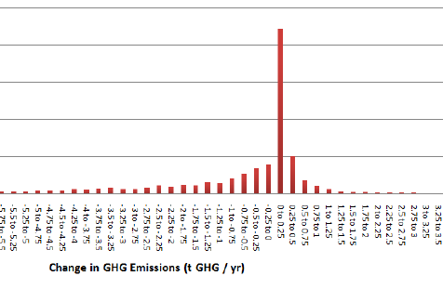
Changes in Emissions
(Martin and Shaheen, 2010) (N=9600)
CIVITAS Forum l 24-26 September 2012 l Vitoria-Gasteiz, Spain

Slide 6


Bath City Car Club Measure
Historic city of 85,000 residents
  limited parking in centre
City Car Club = largest UK operator
Expansion of fleet from 8 to 14 vehicles in April 2010
  6 Toyota Prius hybrid vehicles
CIVITAS Forum l 24-26 September 2012 l Vitoria-Gasteiz, Spain

Slide 7
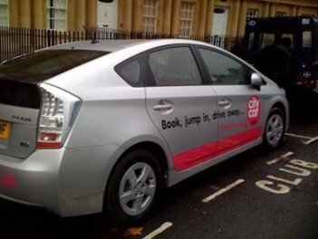
Each associated with a new parking bay* in a residential area
*Designated, reserved space on the public highway
CIVITAS Forum l 24-26 September 2012 l Vitoria-Gasteiz, Spain

Slide 8
Membership and Services
Membership increased by three times to 418 in the study period
  In part due to increase in spatial coverage of scheme
  £60 membership fee per year
Cars offered changed from Astra + Fiesta to Prius + Fiesta
  Small car rate £4.95/hour + £0.23/mile
  Large car rate £5.95/hour + £0.23/mile

Slide 9
2. Evaluation Overview
  Process
    Delivery of bays
    Choice of vehicles
  (Non-user awareness
    City centre survey)
  Social benefits -CBA
    Operator data (limited)
  User acceptance and behaviour
    Quantitative web survey
    Qualitative phone interviews
CIVITAS Forum l 24-26 September 2012 l Vitoria-Gasteiz, Spain

Slide 10
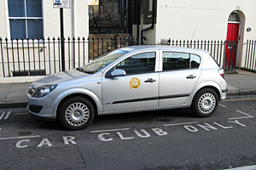
3. CBA Approach
  Comparison of hybrid with BAU vehicle (GM Astra)
  Over 5 years
  For fixed distance
  Discount rate 3.5%
    sensitivity 2% / 5.5%
CIVITAS Forum l 24-26 September 2012 l Vitoria-Gasteiz, Spain

Slide 11
Cost Benefit Analysis NPV Inputs
  Lease costs
  Fuel costs
    Derived from distance travelled
  Emissions social costs
    CO₂, NOx, PM
    official test data
    UK Government external cost factors
    sensitivity analysis: -20% +20%
CIVITAS Forum l 24-26 September 2012 l Vitoria-Gasteiz, Spain

Slide 12
CBA Findings
  NPV per vehicle = £179.41
    £1076.46 for six car fleet
    Sensitivity range £949.56-£1157.52
  Operating costs 75% of difference
    Higher hybrid lease costs more than offset by fuel savings
CIVITAS Forum l 24-26 September 2012 l Vitoria-Gasteiz, Spain

Slide 13
4 Web Survey of All Members
108 respondents (approx. 25%)
Assessment of Indicators:
  12 Noise perception
  13 Awareness
  14 Acceptance
  15 Spatial accessibility
  16 Economic accessibility
  17 Perception of security
  18 Accuracy of time keeping
  19 Quality of service
Comparison of hybrid with Ford Fiesta - only other CCC car offered
CIVITAS Forum l 24-26 September 2012 l Vitoria-Gasteiz, Spain

Slide 14
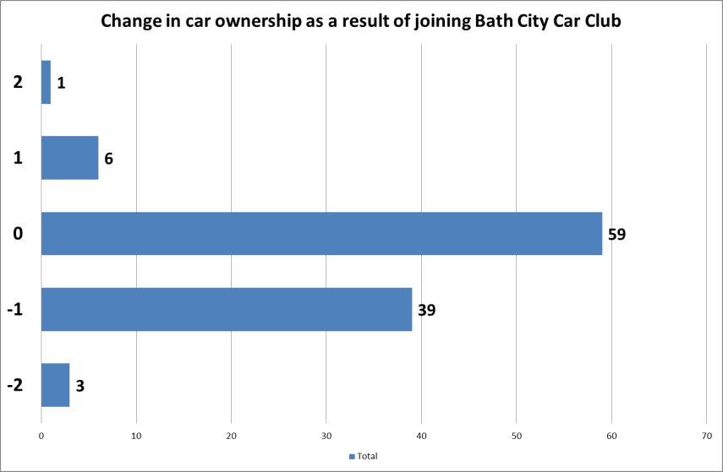
Car Ownership Changes
4. Findings
CIVITAS Forum l 24-26 September 2012 l Vitoria-Gasteiz, Spain

Slide 15
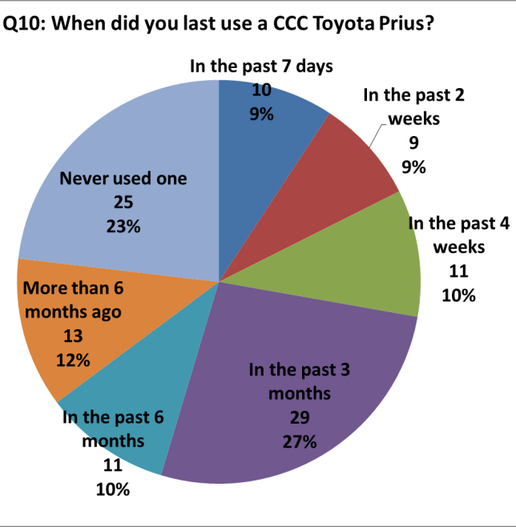
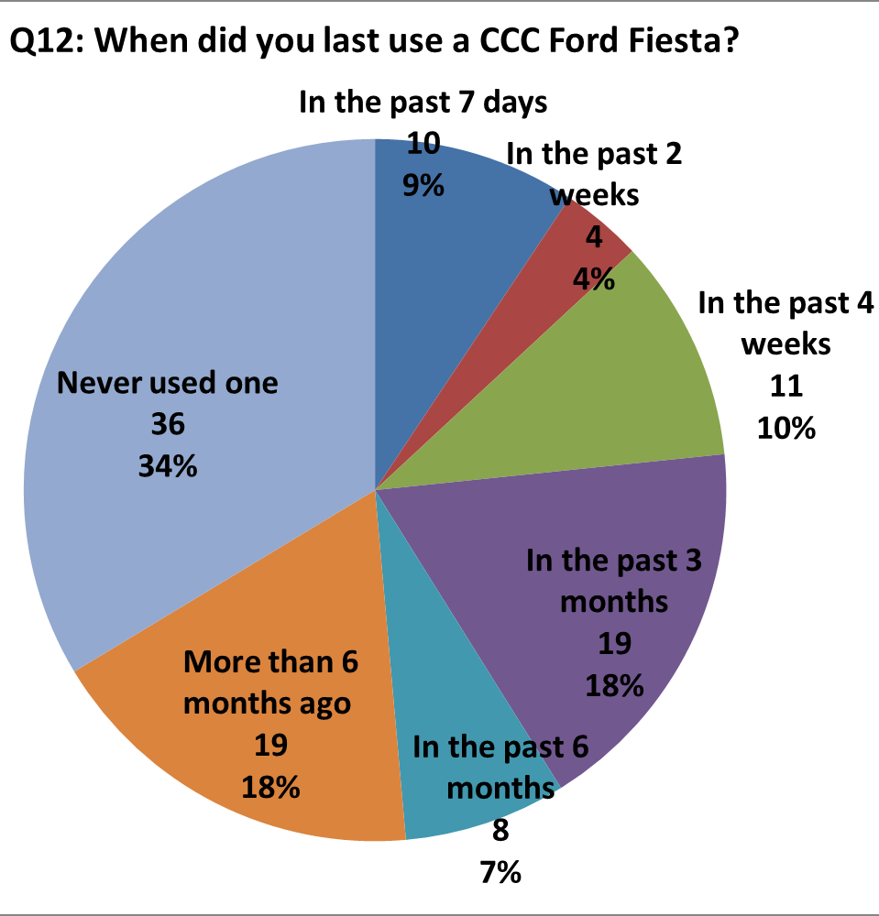
User Experience with Car Types
Toyota Prius
Ford Fiesta
CIVITAS Forum l 24-26 September 2012 l Vitoria-Gasteiz, Spain

Slide 16
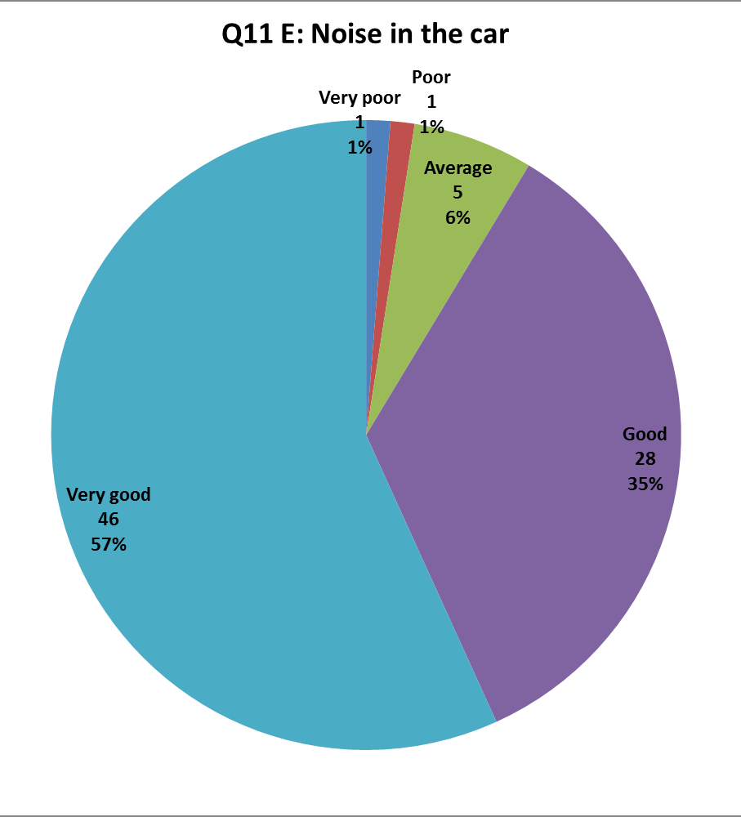
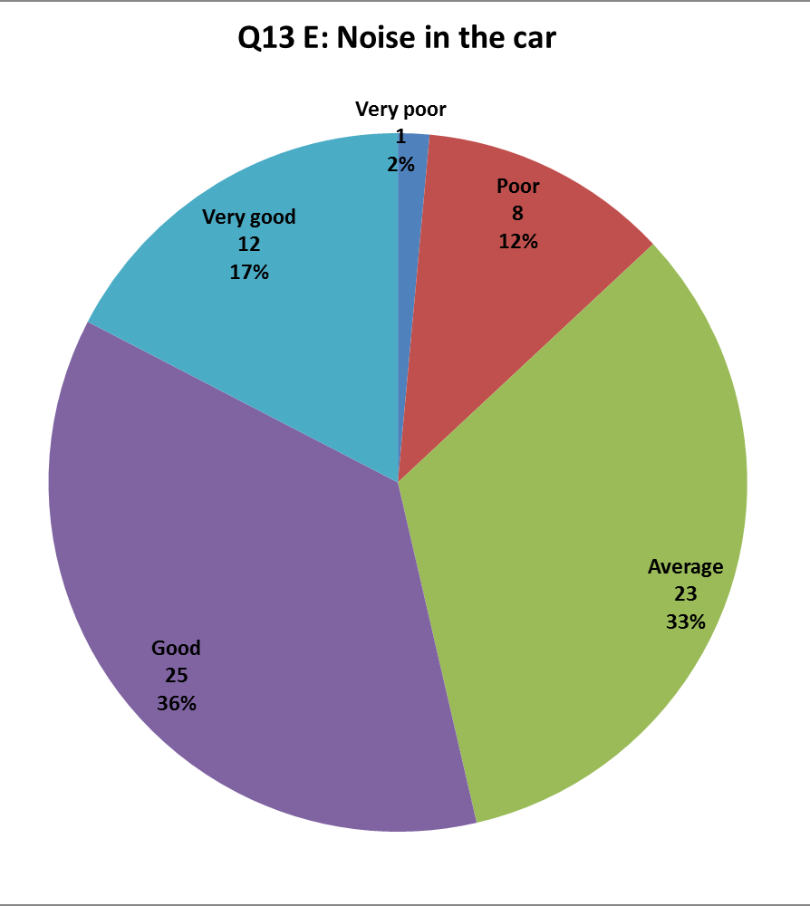
Perception of Relative Noise
Toyota Prius
Ford Fiesta
CIVITAS Forum l 24-26 September 2012 l Vitoria-Gasteiz, Spain

Slide 17
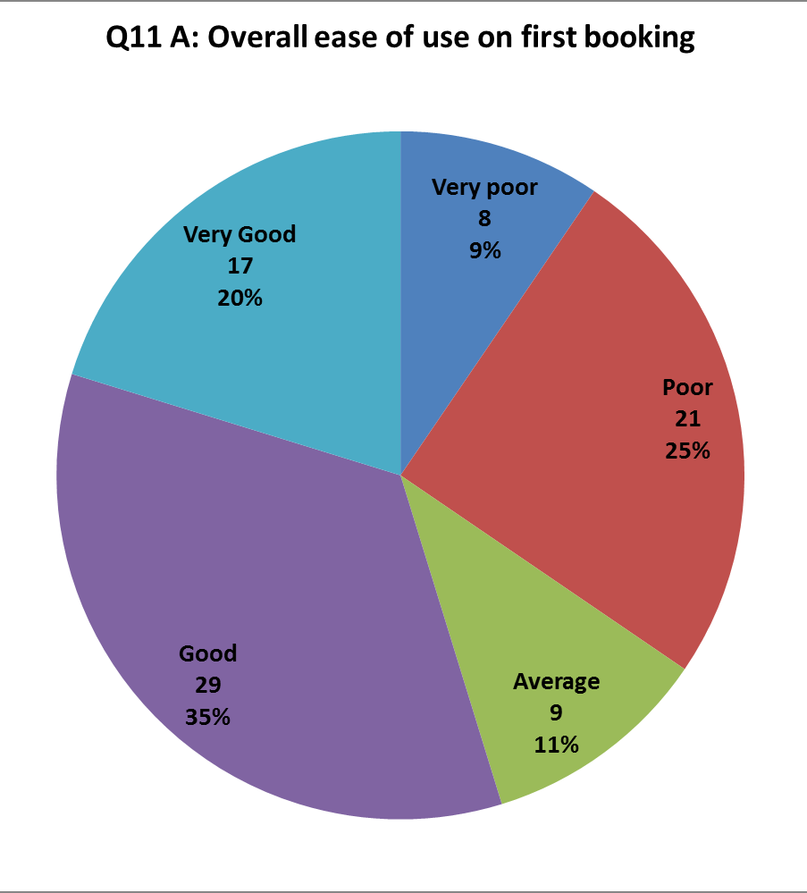
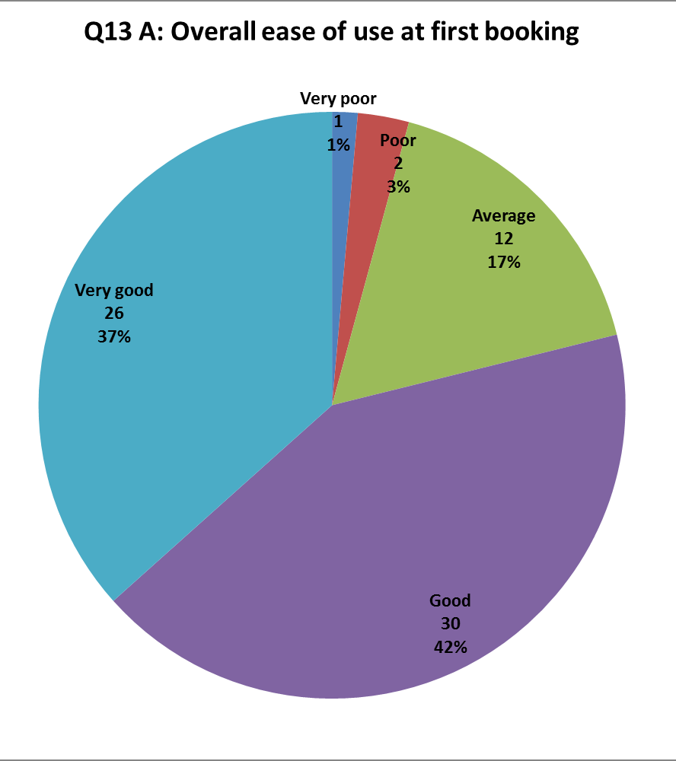
Quality of service
Ease fo use on first booking
Toyota Prius
Ford Fiesta
CIVITAS Forum l 24-26 September 2012 l Vitoria-Gasteiz, Spain

Slide 18
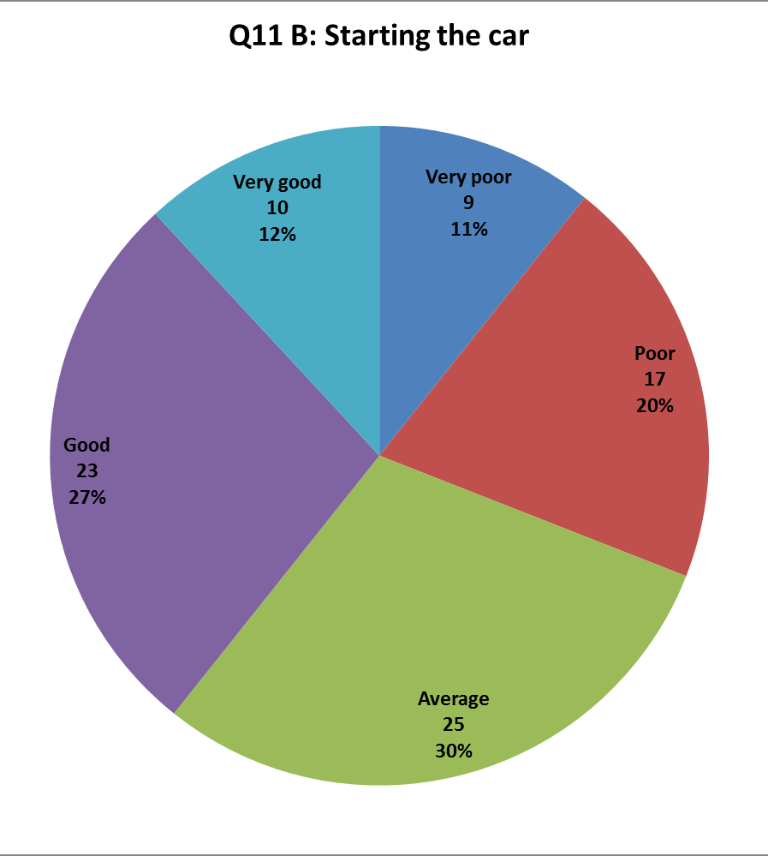
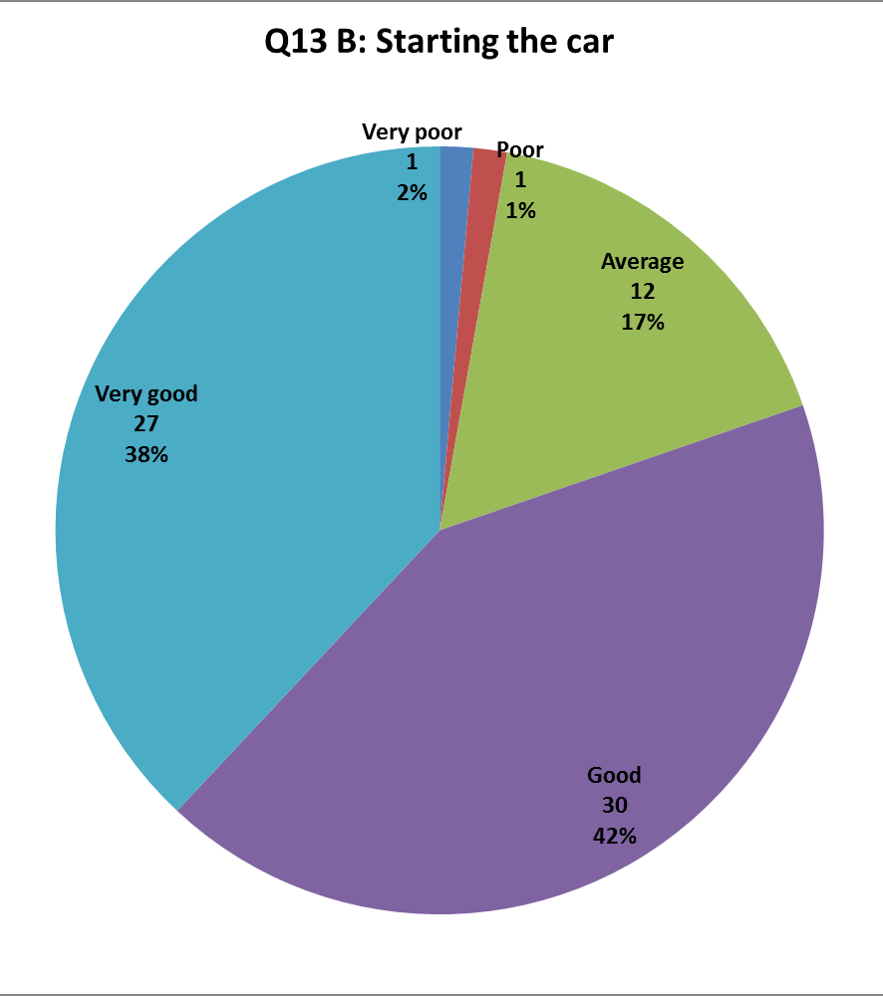
Quality of service:
Starting the car
Toyota Prius
Ford Fiesta
CIVITAS Forum l 24-26 September 2012 l Vitoria-Gasteiz, Spain

Slide 19
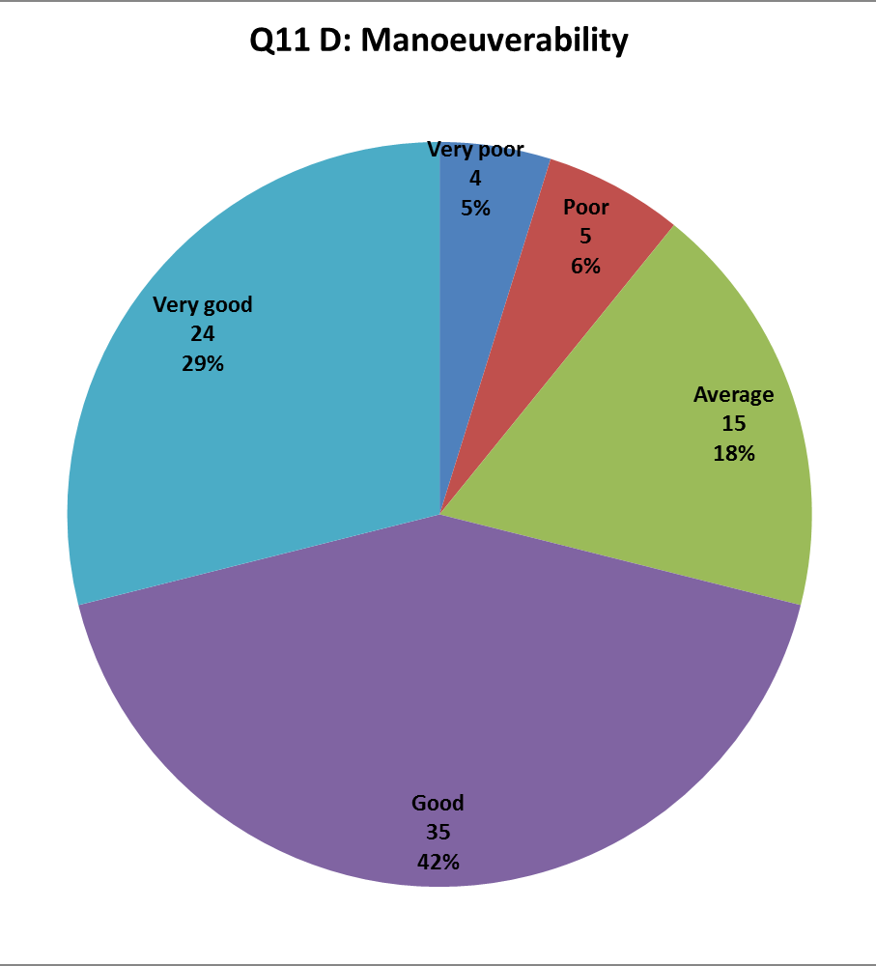
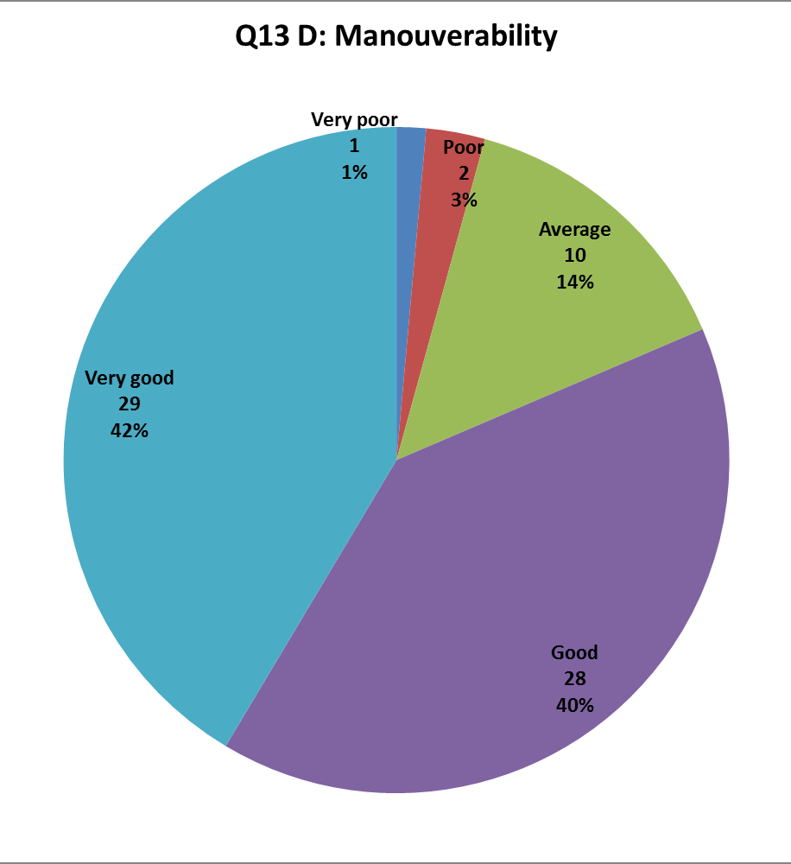
Quality of service:
Manoeuverability
Toyota Prius
Ford Fiesta
CIVITAS Forum l 24-26 September 2012 l Vitoria-Gasteiz, Spain

Slide 20
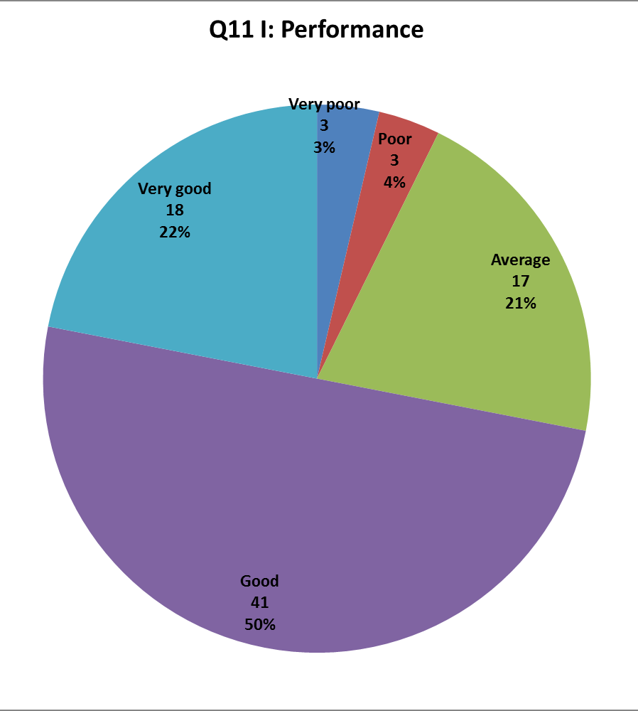
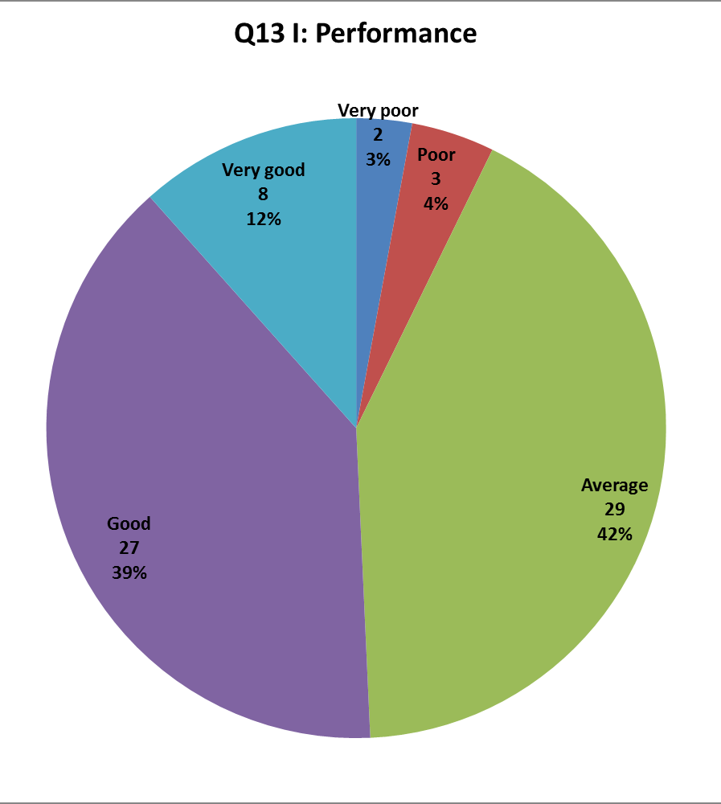
Quality of service:
Performance
Toyota Prius
Ford Fiesta
CIVITAS Forum l 24-26 September 2012 l Vitoria-Gasteiz, Spain

Slide 21
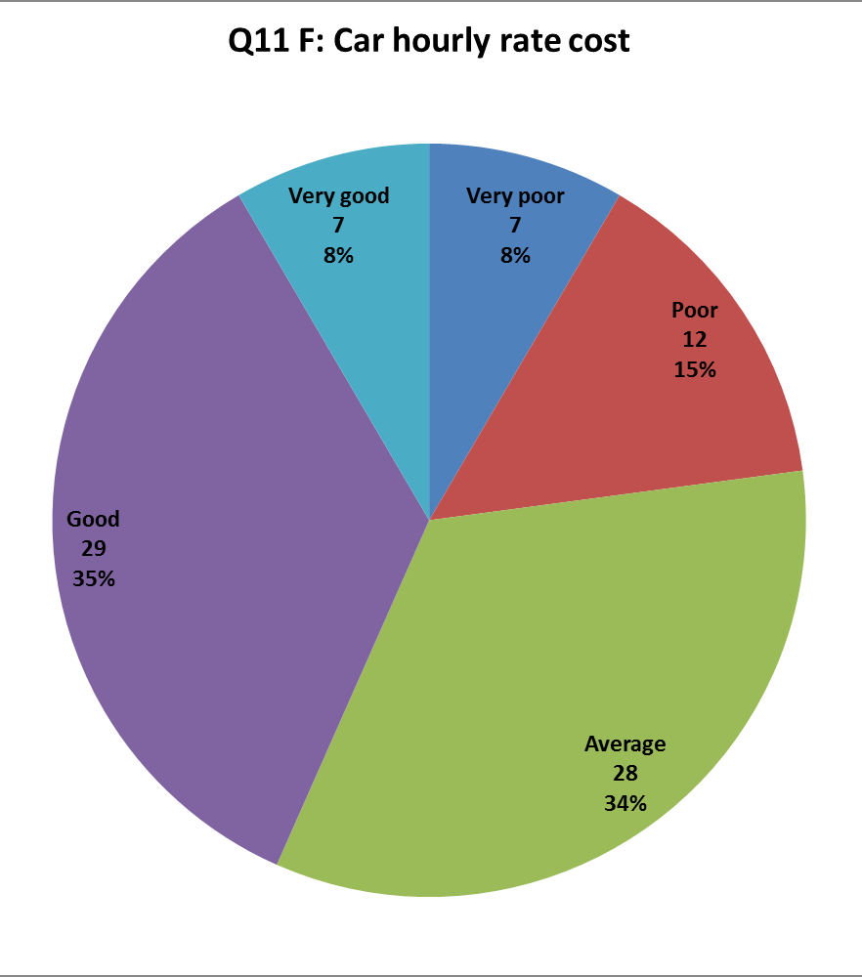
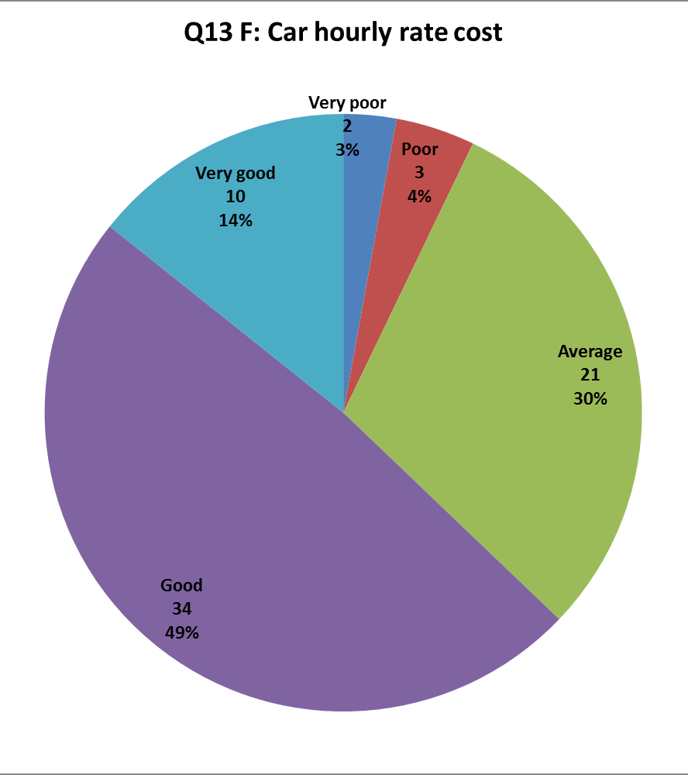
Economic accessibility
Car hourly rate cost
Toyota Prius
Ford Fiesta
CIVITAS Forum l 24-26 September 2012 l Vitoria-Gasteiz, Spain

Slide 22
5 Telephone Interviews with City Car Club members
16 participants selected according to:
  Date of joining
  Change in car ownership on joining
To seek in-depth understanding of:
  trip purposes
  travel behaviour change
  car ownership change
  analysis of ‘what if’ scenarios (e.g. absence of CCC)
CIVITAS Forum l 24-26 September 2012 l Vitoria-Gasteiz, Spain

Slide 23
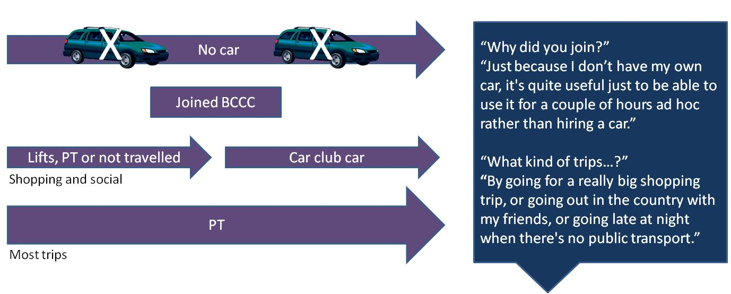
Example of an ‘accessor’
Participant 5 – male, 26-30, student, sharing residence with other adults
CIVITAS Forum l 24-26 September 2012 l Vitoria-Gasteiz, Spain

Slide 24
Motivations to Join
  No car
  Car but used by partner
  To save money and have greater convenience than using PT/taxi/hire car for occasional journeys
  To use for work-related travel instead of own car
  To maintain driving skills
CIVITAS Forum l 24-26 September 2012 l Vitoria-Gasteiz, Spain

Slide 25
Car Ownership After Joining
  Some with no intention to acquire car
  Others acquired car and no longer use car club often
    Opportunity to borrow car from family/friends
    Regular school escort journeys necessitated car
CIVITAS Forum l 24-26 September 2012 l Vitoria-Gasteiz, Spain

Slide 26
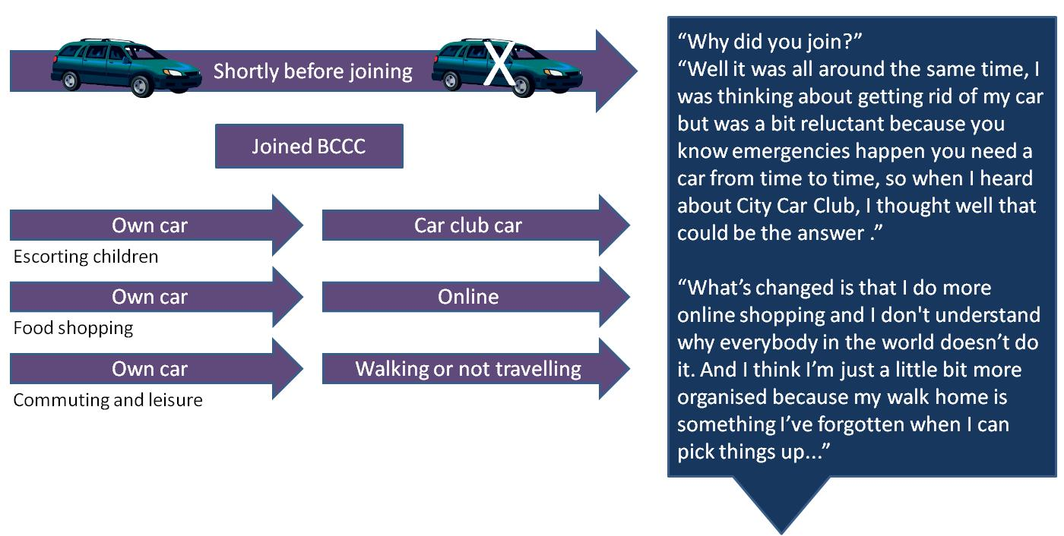
Example of a ‘shedder’
Participant 12 – female, 46-50, employed, living with partner and children
CIVITAS Forum l 24-26 September 2012 l Vitoria-Gasteiz, Spain

Slide 27
Motivations to Join
  Low and declining car usage but wished to have access to car and car club facilitated shedding
  Relinquished car (e.g. through redundancy) but shortly afterwards found occasional need for car and joined
  To save money and hassle of owning car
  To live more environmentally friendly lifestyle
  To use for work-related travel without having to own car
  Trigger of car insurance renewal
CIVITAS Forum l 24-26 September 2012 l Vitoria-Gasteiz, Spain

Slide 28
Car Ownership After Joining
  Adaptation over time to not owning car
    online shopping, consolidated journeys, change in destinations
    decreasing car club use over time
  No ‘shedder’ had intention to re-acquire own car
CIVITAS Forum l 24-26 September 2012 l Vitoria-Gasteiz, Spain

Slide 29
Conclusions
Demonstrated that large hybrid car is a viable option for a
  commercial car sharing scheme
  in a constrained historic city
CBA suggests small social cost advantage
  Most benefit to operator
User acceptance high
  Some indicators influenced by vehicle type
  Technology created acceptance barrier for some
Evidence that membership is dynamic
  And provides for multiple behavioural niches
CIVITAS Forum l 24-26 September 2012 l Vitoria-Gasteiz, Spain

Slide 30
Acknowledgements...
City Car Club
Bath and North-East Somerset Council
UWE Colleagues
  Dr Kiron Chatterjee
  Dr Miriam Ricci
  Dr Geoff Andrews
  Dr Eran Ben-Elia

Slide 31


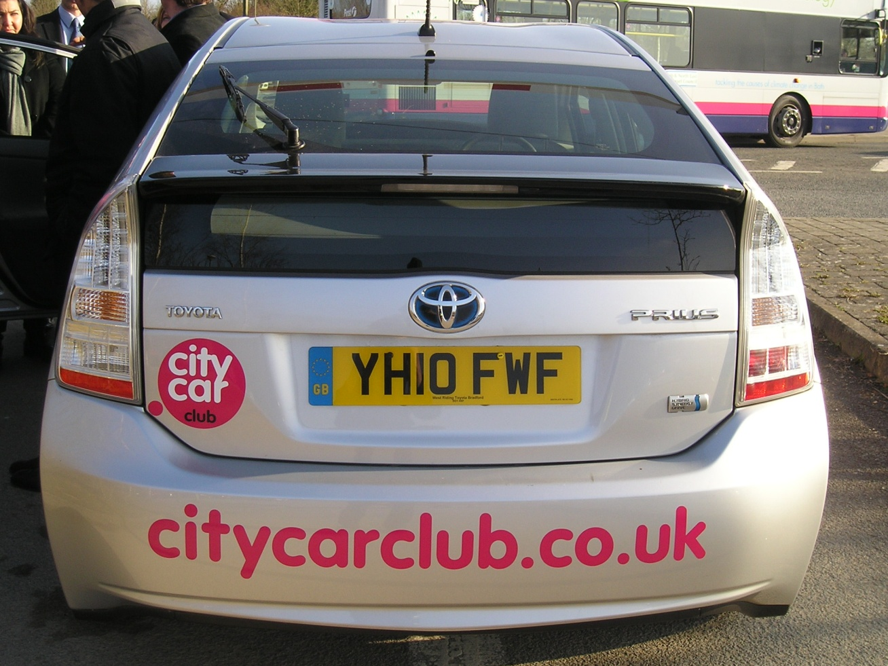

Thank you!
For further information, please contact:
graham.parkhurst@uwe.ac.uk
CIVITAS Forum l 24-26 September 2012 l Vitoria-Gasteiz, Spain

