Slide 1
CIVITAS SATELLITE
Financial Analysis - Cost Benefit Analysis
ECG meeting
Dirk Engels
19 September 2018

Slide 2
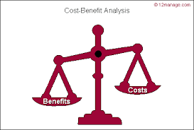
1. The context: the CIVITAS evaluation framework
  Need/requirement for in-depth analysis of crucial measures to understand better the impact/effort to implement balance as support for decision making on continuation, on extension to other areas of the city or region and take-up of the measures to other cities
  Definitions:
    Financial Analysis (FA): shows the cash flows (costs and revenues) to determine if a project is financially viable
    Social Cost Benefit Analysis (CBA): puts all impacts to the same nominator (money) making it easier to see the trade-offs between different effects.
    Cost Effectiveness Analysis (CEA): the viewpoint of one main impact: what is the cost to achieve a change of one unit of the impact
Notes:
A cost effectiveness analysis (CEA) takes the viewpoint of one main impact. For example, for different measures the cost of reducing one tonne CO2 can be compared. Or the cost of reducing one accident.
The financial analysis also provides information on whether a project is financially viable with and without funding.

Slide 3
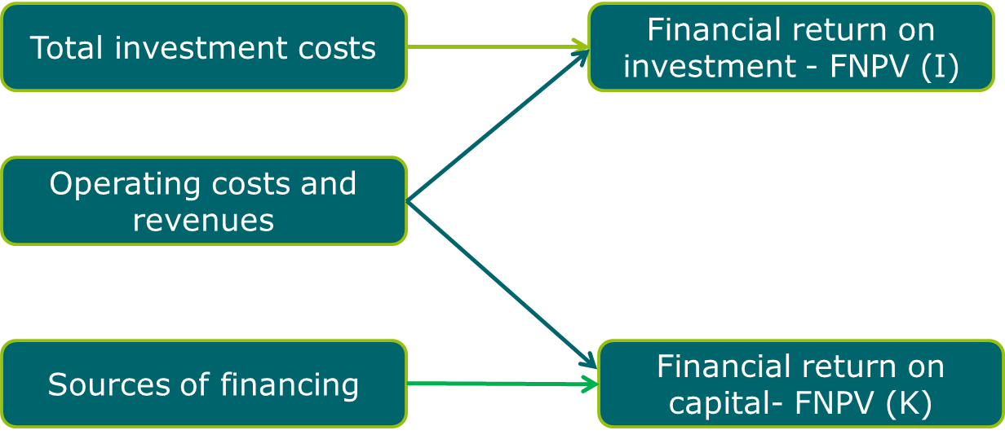
3. Road map Financial Analysis
  Financial indicators
    Financial return on investment (FNPV(I) and FRR(I)): extent to which the project net revenues are able to repay the investment, regardless of the sources or methods of financing.
    Financial return on capital (FNPV(K) and FRR(K))
Notes:
Financial return on investment (FNPV(I) and FRR(I))
The financial return on investment takes into account
- Total investment costs (hence the cost of the land, the buildings, the equipment, etc.).
- Total operating costs and revenues.
Hence the financial net present value of investment (FNPV(I)) and the financial rate of return of the investment (FRR(I)) compare investment costs to net revenues. This is a measurement of the extent to which the project net revenues are able to repay the investment, regardless of the sources or methods of financing. A project with a positive financial net present value has enough revenue to cover the investment and the operating costs.
Financial return on capital (FNPV(K) and FRR(K))
The financial return on capital takes into account
- Cost of financing (hence the loan repayments, the interest, the private equity and public contribution).
- Total operating costs and revenues.
The objective of the return on national capital calculation is to examine the project performance from the perspective of the operator (‘after the grant’).
CAPITAL: we take into account also the GRANT (although not included in the (sources of financing))

Slide 4
3. Road map Financial Analysis
  5 steps to calculate
    Development of a reference scenario
    Determination of the total investment costs
    Calculation of operating costs and revenues
    Determining the sources of finances.
    Calculation of the indicators.
- a cost (negative)
+ an income (positive)
n.i. not to be included
Notes:
Financial return on investment (FNPV(I) and FRR(I))
The financial return on investment takes into account
- Total investment costs (hence the cost of the land, the buildings, the equipment, etc.).
- Total operating costs and revenues.
Hence the financial net present value of investment (FNPV(I)) and the financial rate of return of the investment (FRR(I)) compare investment costs to net revenues. This is a measurement of the extent to which the project net revenues are able to repay the investment, regardless of the sources or methods of financing. A project with a positive financial net present value has enough revenue to cover the investment and the operating costs.
Financial return on capital (FNPV(K) and FRR(K))
The financial return on capital takes into account
- Cost of financing (hence the loan repayments, the interest, the private equity and public contribution).
- Total operating costs and revenues.
The objective of the return on national capital calculation is to examine the project performance from the perspective of the operator (‘after the grant’).

Slide 5
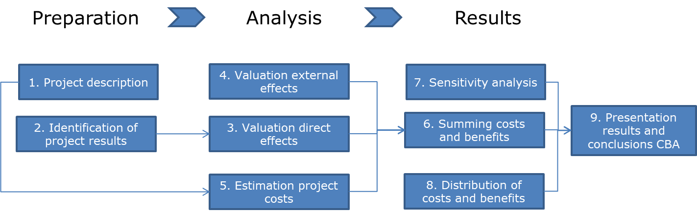
4. Road map Social Cost Benefit Analysis

Slide 6
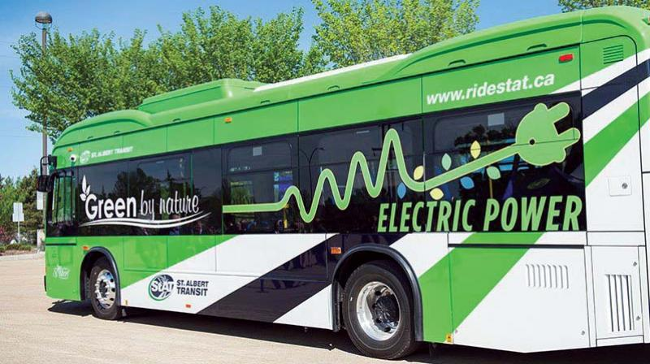


4. Road map Social Cost Benefit Analysis
  Step 1: Project description
    Project scenario
    Reference scenario: a business-as-usual scenario or a do-minimum
  Step 2: Identification project effects
    Direct effects
      Changes in monetary transport costs
      Changes in travel time
      Changes in travel time reliability
    External effects
      Change in emissions: air pollutants and greenhouse gasses (CO2, NOx, SOx, PM)
      Change in noise
      Change in accidents
    Project costs
      investment costs
      difference in operating costs
      residual value
      Investment <> maintenance
      fuel cost
Notes:
direct effects on the transport system: the differences in flows and costs
indirect effects are the effects of the reactivation on the wider economy - include shifts in economic activity between regions/cities > the danger of double counting, we propose not to include
external effects describe the impact of the project on the human environment and nature
• The external effects of the infrastructure itself (use of space, visual intrusion, etc.)
• The external effects linked to the use of the infrastructure and the changes in transport flows (air pollution, noise, traffic safety, etc.)
• The impact on the environment caused by possible changes in location of economic activity

Slide 7
4. Road map Social Cost Benefit Analysis
  Step 3: Valuation direct effects
    consumer surplus, defined as the excess of users’ willingness to pay
    producer surplus, the revenues by the producer minus the costs borne
  Step 4: Valuation external effects
    Emissions
    Noise
    Accidents
  Step 5: calculation project costs
  Step 6: summing all costs and benefits
    >> economic net present value (ENPV) indicating the social benefit of the project
  Step 7: Sensitivity analysis
    Capital costs +25% - Operating costs +25%
  Step 8: Distribution of costs and benefits over partners
Generalised price
Demand
P₀
A
P₁
B
C
Q₀
Q₁
Volume
Mode (euro/vehicle km*) | Euro/ vkm – EU25 | Euro/pkm or euro/tonkm
Passenger cars | 0.51 | 0.33
Buses | 2.15 | 0.24
Coaches | 1.47 | 0.08
HDV | 1.03 | 0.17
LDV | 1.25 | 6.10
Rail (passenger and freight) | 30.21 | 0.21(passenger)
IWW |  | 0.13 (freight)

Slide 8

5. Examples
  Introduction of articulated hybrid busses
  Ecodriving
NPV | Government | Society
Project investment cost | -16,681
Operational savings | 4,073
GHG emission savings |  | 684
Total | -12,608 | 684

Slide 9

5. Examples
  Energy savings for heating in trams
  Promoting Cycling (under preparation)
And, just to motivate you:
A cost-benefit analysis is used to evaluate the risks and rewards of projects under consideration. It can be used to project the potential benefits of investing in marketing ideas, product development, infrastructure enhancements and operational changes.

Slide 10

Further info and support
Eef Delhaye
Dirk Engels
Contact Details
Transport & Mobility Leuven
Diestsesteenweg 57, 3010 Leuven
eef.delhaye@tmleuven.be
dirk.engels@tmleuven.be
http://www.civitas.eu

