Slide 1
Marko Matulin University of Zagreb Faculty of Transport and Traffic Sciences Zagreb, 21 October 2013
CIVITAS-ELAN
Measure 4.4: Mobility management for large institutions

Slide 2
Presentation overview
Measure objectives
Implementation process
Measure outcomes
Impact evaluation
Process evaluation
Lessions learned from the process

Slide 3
Measure objectives
Focus on 8 institutions in the corridor
Develop travel plans for them
Increase the number of employees and students commuting by alternative modes by 10%
Increase the average number of passengers in cars by 20%
Increase the average use of carpooling in institutions in the corridor by 15%

Slide 4
Implementation process
23 institutions were approached; 8 were willing to participate
6 private companies and 2 student dormitories
Individual modal split survey was conducted in each institution
Several workshops organized for employees:
Purpose of the project and the measure
What are travel plans
What are the alternatives (biking, carpooling) and how to use them

Slide 5
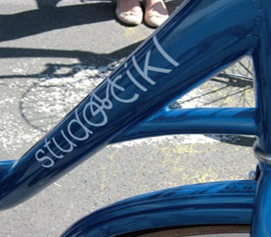
Implementation process
Promotional movie filmed: link
Ride-matching web site developed:
http://www.fpz.unizg.hr/autozasve/
Free bikes for students: STUDOCIKL (together with the measure 4.11)
Measure leader participated on numerous TV and radio shows promoting the measure

Slide 6
Measure outcomes
Number of carpools arrangements increased:
within the target group “employees”– from 8 in 2009 to 36 in 2012
among student population – from 26 in 2009 to 74 in 2012
8% more employees stated that they are willing to use carpooling as one of the transport alternatives when travelling to work (from 46% in 2009 to 54% in 2012)
On the city level no impact – measure was “too small” to leave a mark on the overall figures

Slide 7
Lessons learned
Communication can be difficult especially in the early stages:
Invest extra effort in communication
→ Key is to motivate people to make a change
Use cheap but “smart” tools such as multimedia
Try to include media (TV, radio, newspapers)
Combine the impact of different measures
Create synergies

Slide 8
Thank you for your attention!
University of Zagreb
Faculty of Transport and Traffic Sciences
http://www.fpz.unizg.hr
Marko Matulin
Department of Intelligent transport systems
mmatulin@fpz.hr

